Slide 1
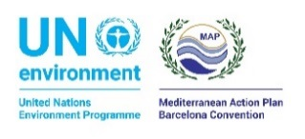
H2020 Review and Monitoring (RM) workshop on Assessment
10th meeting of the Horizon 2020 Review and Monitoring (RM) Group
23-24 September 2019 in Athens, Greece
What do we observe/what can we say already
Italy
Giordano Giorgi, Italian Institute for Environmental Protection and Research
giordano.giorgi@isprambiente.it
This project is funded by the European Union

Slide 2
Country contribution: Italy
1- Overall national Key Messages
Waste collection and composition: separate waste collection process is almost completed in some regions but, at national level, is still far from main objective also due to big cities. Main dumping sites have now been closed also as a consequence of EU infringements procedure
Waste water treatment: compliance to EU UWWTD is not yet reached in particular regarding secondary and more advanced treatment and also nitrogen and phosphorus abatement are not 75% in Po River Basin.
Industrial emissions: authorization process is fully implemented for every hazardous substance included in IED (former IPPC) EU Directive. Still, specific contaminated sites due to legacy industrial facilities have not been recovered and requires more efforts

Slide 3
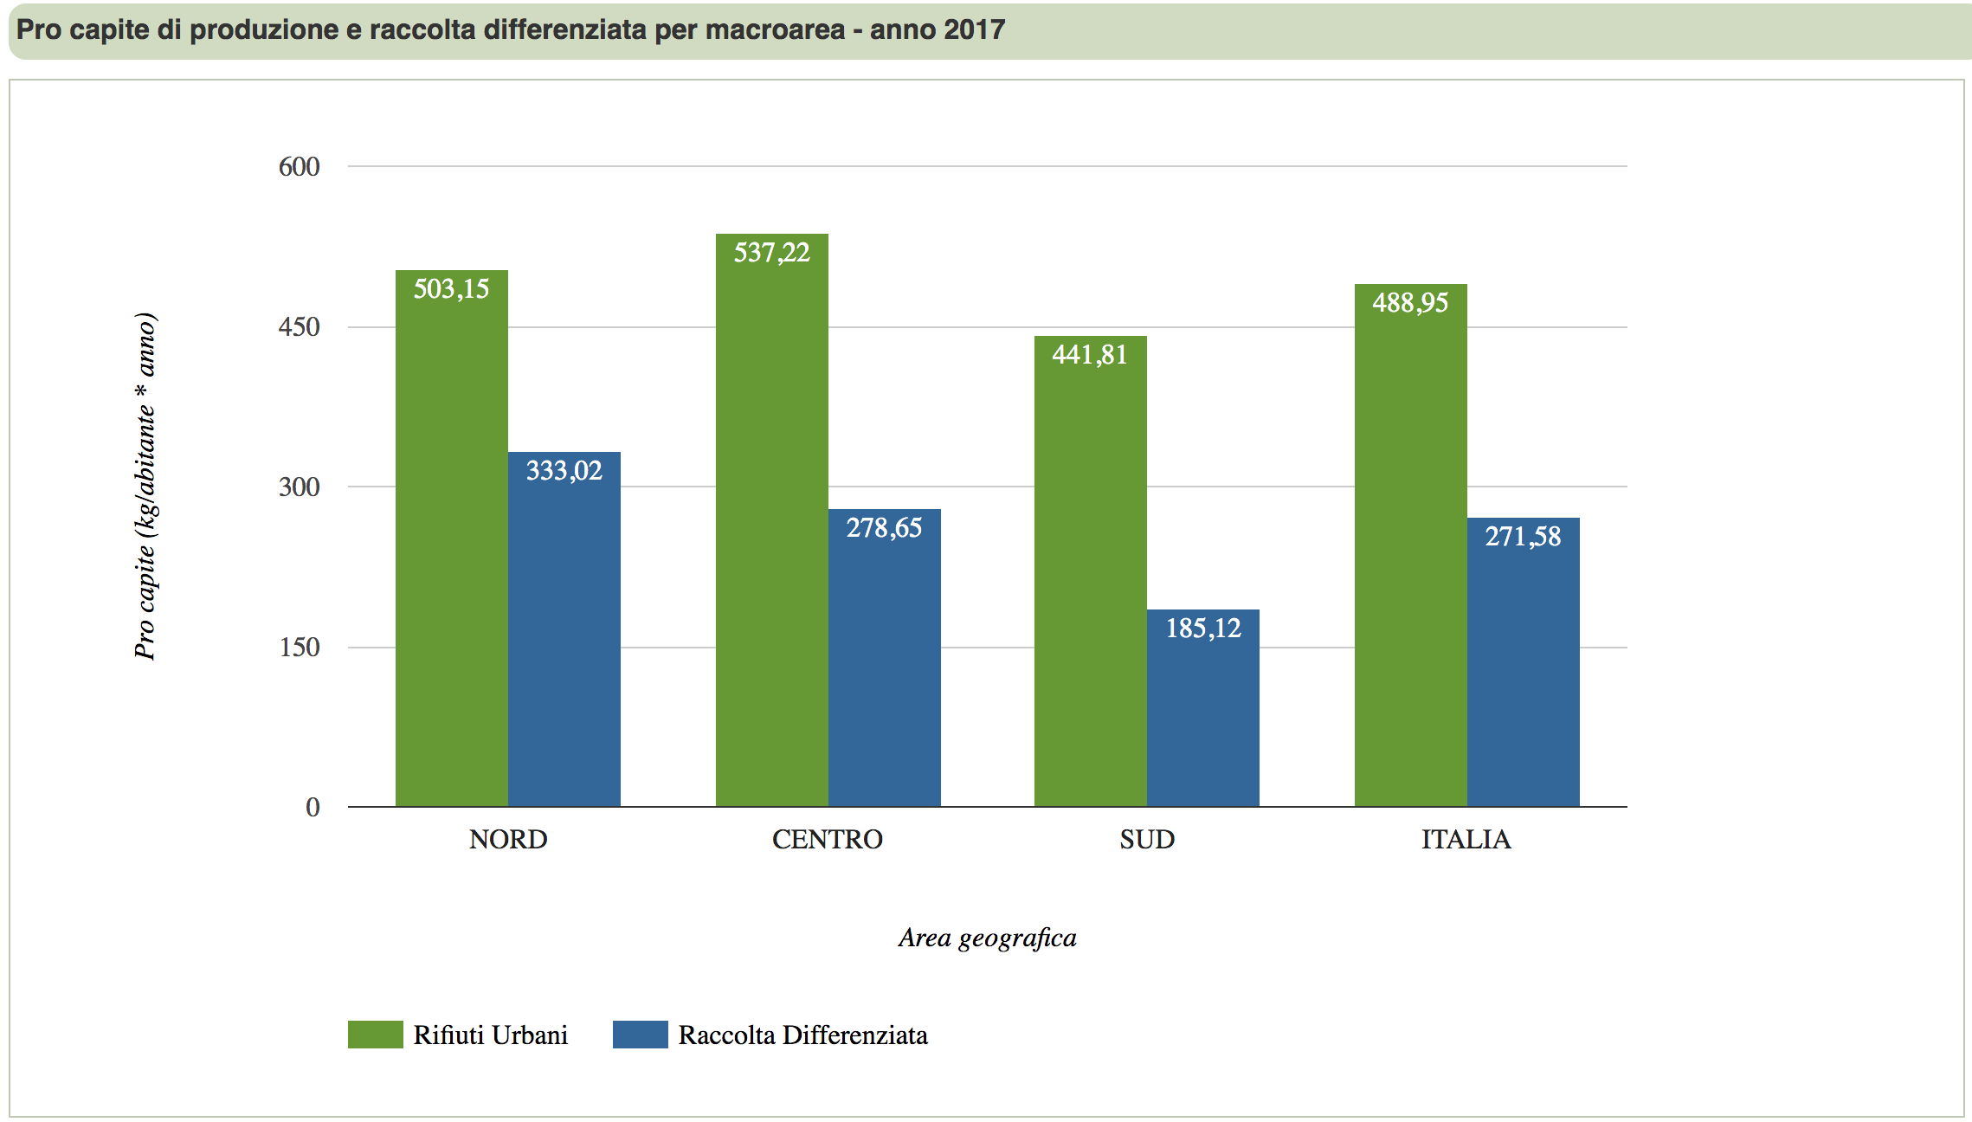
Country contribution: Italy
2- Thematic Analysis
Waste: separate waste collection process is high on the political agenda and some big cities (Rome, Naples,…) are suffering waste collection issues due to difficulties in the implementation of recycling plants or identification of new dumping sites. In some critical cases waste has to be exported in order to be properly treated or disposed
Total (green) vs recycled (blue) waste annual per capita production in kg – year 2017
Source: https://www.catasto-rifiuti.isprambiente.it

Slide 4
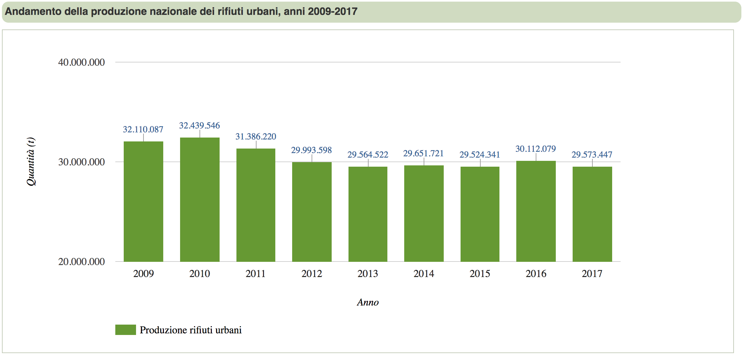
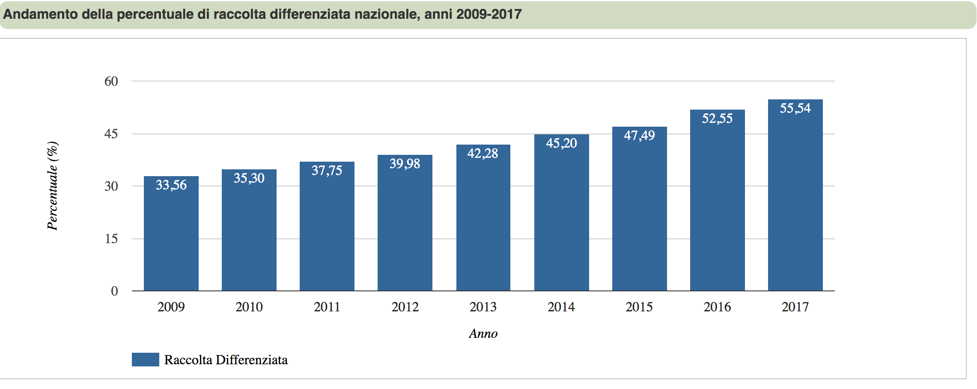
Country contribution: Italy
2- Thematic Analysis
Waste collection: trend of total vs recycled waste from 2009 to 2017
Total waste production in tonnes – year 2009-2017
Source: https://www.catasto-rifiuti.isprambiente.it
Recycled waste percentage – year 2009-2017
Source: https://www.catasto-rifiuti.isprambiente.it

Slide 5
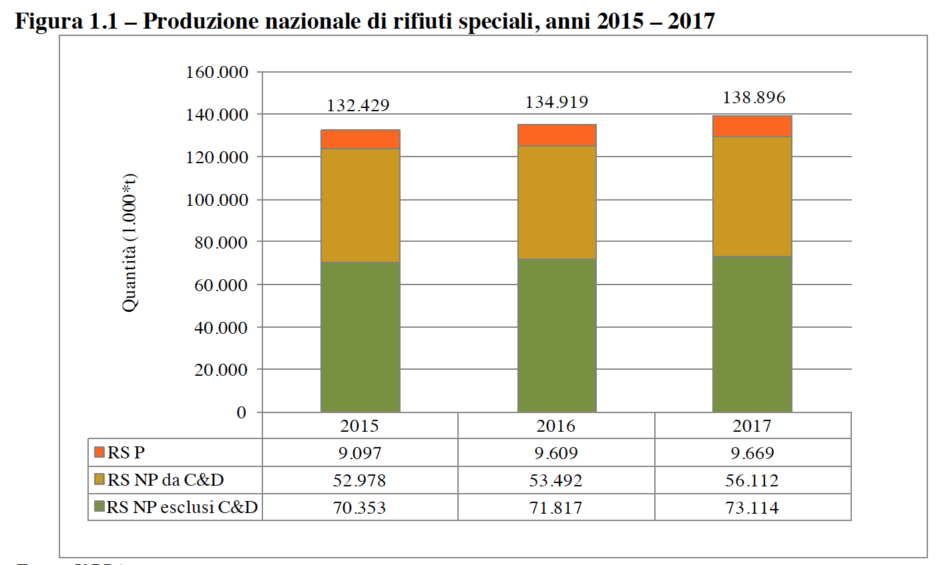
Country contribution: Italy
2- Thematic Analysis
Waste collection: special including hazardous waste from 2015 to 2017
Total hazardous (red), non hazardous from building (orange), non hazardous excluding building annual waste production in tonnes – year 2009-2017
Source: Rapporto Rifiuti Speciali – 2019, ISPRA

Slide 6
Country contribution: Italy
2- Thematic Analysis
Waste water treatment compliance check to EU UWWTD updated to 31/12/2014 {COM(2017)749 final}:
% of agglomerations with collected waste water or individual treatment collection system | % of agglomerations with secondary treatment | % of agglomerations with more advanced treatment in case discharge points is in sensitive area or in river basin catchment in sensitive area
93,8 | 71,9 | 65,1
Sensitive area or river basin catchment in sensitive area | % Nitrogen reduction | % Phosphorous reduction
Arno | 83,35% | 79,51%
Adriatico Nord-Occidentale | 75,12% | 87,50%
Bacino drenante dell’Arno | 74,46% | 75,82%
Catchment Distretto Padano | 67,16% | 73,10%
Area costiera dell’Adriatico Settentrionale | 75,29% | 76,07%

Slide 7
Country contribution: Italy
2- Thematic Analysis
Industrial emissions
E-PRTR has been greatly improved also in terms of ICT infrastructure to provide data providers with web tools to collect and transfer information
Remediation measures for contaminated sites are really challenging both from a technical and economic point of view.
To boost such measures, a new network EpiAmbNet has been established to promote epidemiological studies on contaminated sites with Italian Ministry of Health and the newly established National System for Environmental Protection – SNPA coordinated by ISPRA, and which convenes all Regional Environmental Agencies (ARPA)

Slide 8
Country contribution: Italy
2- Thematic Analysis
Industrial emissions
EpiAmbNet aims to make a strong link between bodies responsible for Health and Environmental protection and collects information from many on going projects like Sentieri on incidence of pathologies due to contamination
N. 45 Contaminated sites
In 8 years, 3.375 males deaths due to tumors in excess and 1.910 in females.

Slide 9
Country contribution: Italy
3-Process and progress
Main data gaps regards estimate of contaminant loading for NBB, in particular from diffuse sources and emerging contaminants
On-going update of estimate from riverine input required by EU EQS Directive and MSFD that should be completed by end of 2019
New monitoring programme to estimate loading of contaminants and nutrients from wet and dry atmospheric deposition:
N. 3 monitoring stations (Tremiti Isles in Adriatic Sea, Pianosa Isle in Thyrrhenian Sea and Lampedusa Isle in Sicily channel)
Starts in 2020

Slide 10
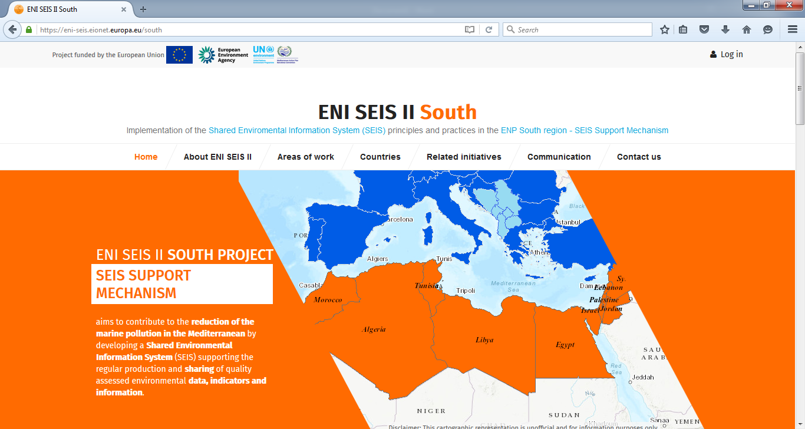
Thank you for your attention!
United Nations Environment Programme
Coordinating Unit for the Mediterranean Action Plan
Vassileos Konstantinou 48
Athens 11635, Greece
www.unepmap.org
European Environment Agency (EEA)
Kongens Nytorv 6
1050 Copenhagen K, Denmark
E-mail: ENI-SEIS2@eea.europa.eu http://www.eea.europa.eu/
http://eni-seis.eionet.europa.eu/south
This project is funded by the European Union

