Slide 1
6 September 2019
Work Package 4: Data management and infrastructure
First webinar on Infrastructure and data mangement
Michael Assouline, PhD
NCE2: Water and Marine
ICT and Data Management (ENI) Officer

Slide 2
Agenda of the webinar
10:00 | Welcome and opening of the meeting Tour de table (5’) Objective of the meeting and state of the art concerning the reporting process at country level (15’) Demo of INFO/RAC Data Centre (IDC) to access the envelopes for data submission (15’) Presentation of the latest data factsheets/dictionaries/spreadsheets version (20’) H2020 Data model design (10’) Summary and questions (15’) Technical missions in the countries and next steps (10’)
11:30 | End of the meeting

Slide 3
Objective of the webinar
  Data collection for the 2nd assessment report Horizon 2020 Mediterranean report Toward shared environmental information systems EEA-UNEP/MAP joint report EEA Technical report
  Following your feedbacks with regard to the H2020 reporting exercise and use of the spreadsheets, we updated the spreadsheets package and data dictionaries to support the production of H2020/NAP indicators
  Capacity building activities
  More webinars are planned to cover the thematic and reporting issues such as how to update spatial layers with the InfoRAC GeoNodeSDI, how to deal with missing data for the indicators, etc.
  This is what you will learn in this first webinar:
    Review of the spreadsheets;
    What’s new in the updated version of the spreadsheets?
    How to access to the platform?
    How to use the guidelines manual?
    How to deal with missing attributes?
    How to get technical or language support?
    What are the status in the countries?

Slide 4
Data flow Horizon 2020
  Close collaboration with INFO/RAC in charge of the development of the INFO MAP system for the Barcelona Convention
  Data reporter nomination: Creation of a users list (credentials) and rights for the use of the reporting tools at national level and distribution of a guide to define roles and responsibilities
  Development of a regional infrastructure for the H2020 indicator reporting regarding 3 thematic: waste, waste water and industrial emissions, including extension (marine litter, bathing water quality)
  Reporting of standardised quantitative data INFO/RAC Data Centre IDC
  Update of spatial datasets (GeoNodeSDI) and metada catalogue Adoption des standards européens (INSPIRE) and iso compliant (19115)
  Preparation of indicator factsheets for the methodological description by the thematic experts
  Preparation of the data dictionaries with all the standards (formats, fields, etc.) for each indicator and sub indicator
  Design of Excel tables « spreadsheets » for the H2020 indicators

Slide 5
Reporting on the INFO/RAC Data Centre (IDC)
As part of the INFO MAP system the IDC represents the technological framework within which the Mediterranean countries can organise their reporting and fulfil their obligation toward the Barcelona Convention
Demonstration of the tools during the workshop in Rome on data management and infrastructure October 2018
Creation of envelopes for each countries and each data flow
Implementation of quality controls (QC) based on the data dictionaries definitions to ensure storage in a consolidated database
Future use of web forms on line with prefilling capability linked with reporting obligations of the Barcelona Convention (IMAP, BCRS, BBN, MEDPOL)
XML data transfer protocol
Step by step manual for H2020 reporting (in English) “Procedure for Reporter to produce H2020 indicators data flow and spatial data collection under ENI SEIS South II project Guidance document - 12.12.2018”
Creation of guidelines with advanced functionalities (in English) “ Spatial Data Infrastructure and Reporting system User guideline”

Slide 6
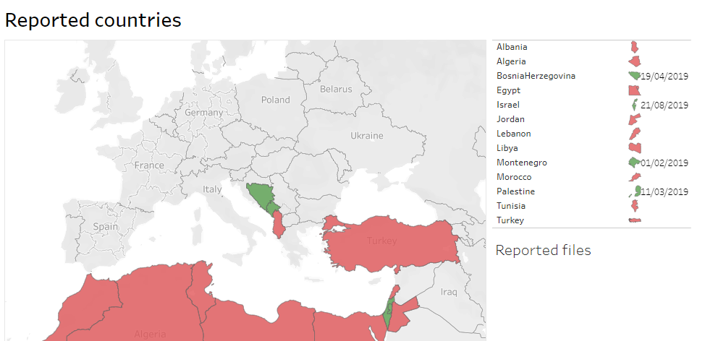
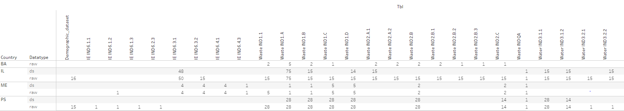
H2020 reporting state of the art (September 2019)

Slide 7
Capacity building and knowledge transfer
  Reinforcement of the national capacity to collect data, work on standards, etc.
  Technical assistance on the countries to describe the reporting process and ensure interoperability among the information systems
  Remote assistance– webinars at regional level or one to one – proposals: 1. use of the SDI for updating spatial data, 2. thematic waste, industrial emissions, water
  Helpdesk for continuous support
  Write to michael.assouline@eea.europa.eu and INFO/RAC info@info-rac.org
Country | Platform |  | Capacity development
Maroc | IDC | SDI | Technical assistance at country
Tunisie |  | SDI | Webinar

Slide 8
Communication
  ENI SEIS II South Project website https://eni-seis.eionet.europa.eu/south
  Country pages with facts and figures https://eni-seis.eionet.europa.eu/south/countries
  Factsheets and data dictionaries https://eni-seis.eionet.europa.eu/south/areas-of-work/indicators-and-assessment
  Spreadsheets and guidelines https://eni-seis.eionet.europa.eu/south/areas-of-work/data-management-and-infrastructure
  Newsletter (English, French, Arabic) https://eni-seis.eionet.europa.eu/south/communication

Slide 9
6 September 2019, Webinar
Work Package 4: Data management and infrastructure
First webinar on Infrastructure and data mangement
Questions?
Michael Assouline, PhD
NCE2: Water and Marine
ICT and Data Management (ENI) Officer

