Slide 1
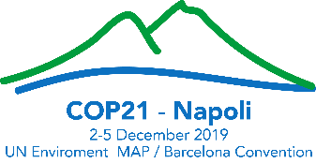



21st Meeting to the Contracting Parties to the Barcelona Convention
How environmental and oceanographic data support evidence-based decision-making in the Mediterranean?
Examples from the UN Decade of Ocean Science for Sustainable Development
and UNEP/MAP-EEA environment data reporting and assessment process
Side event co-organized by UNEP/MAP, IOC-UNESCO and EEA
Wednesday, 4 December 2019, 14.00 – 15.00, Sala Sirena
This project is funded by the European Union

Slide 2

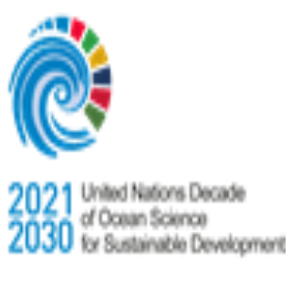
Enhancing environmental information framework 2016-2020
H2020 Initiative for a Cleaner Mediterranean
UNEP/MAP Barcelona Convention
Post-2020 commitment
Athens Declaration (May 2014)
Ecosystem approach, SEIS principles
H2020 programme of work 2015-2020
NAP implementation
IMAP – set of common indicators
MSSD
SDGs
Regional assessments production
UNEP/MAP SOED
2020/2023
Next reporting cycle
EU
Euro-MED
Global
REGIONAL
Quality Status Report
IMAP InfoSystem
H2020 indicators selection
Assessment framework
Indicator specification
Data dictionaries/standards
Reporting tools
Data collection
Ministerial Conferences
2nd H2020 indicator based assessment
Common infrastructure
2017
2018
2019
2020
Anchoring the work in
national setting
National coordination and national support through bilateral agreements
Links to other initiatives
Organise data flow
Thematic network
Appropriation methods/tools
Capacity development in support of initial data collection, handling
Data reporting
“Evidence-based policy making”
Country level assessments
Contribution to H2020 report
Reporting of indicators
“Knowledge to action”
State of environment reporting
Convergence of regional assessments
Policy briefs
NATIONAL
Link to previous activities (2010-2015) and negotiation of national work plans

Slide 3
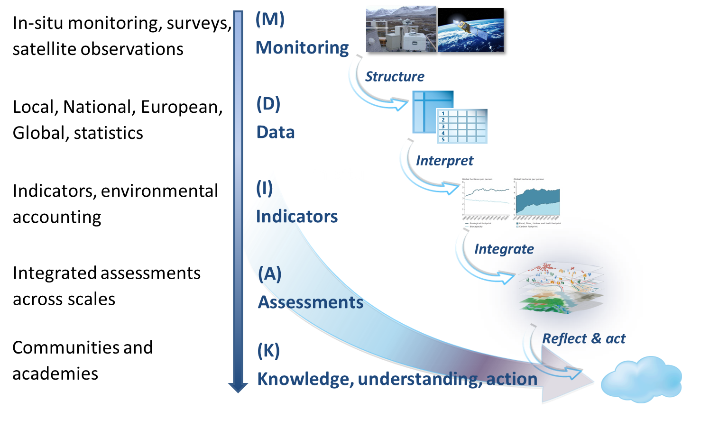


Knowledge management along the MDIAK-C chain – operative model
Communicate

Slide 4
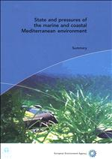
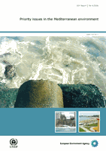
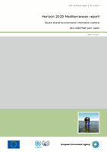
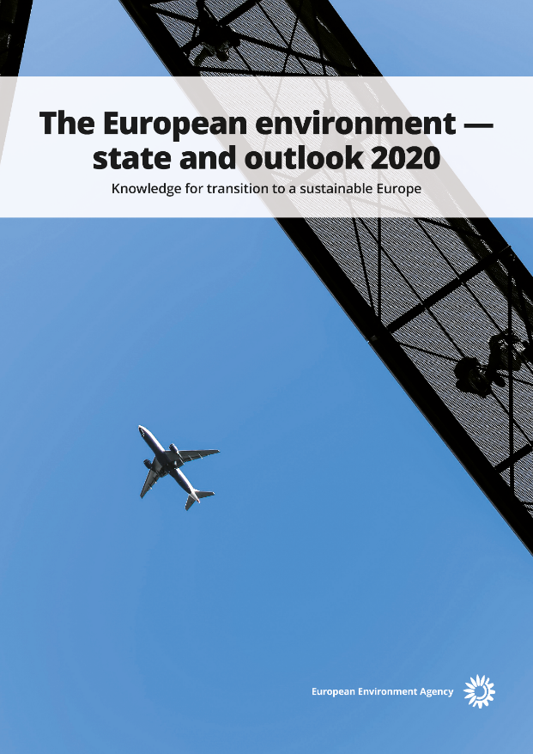

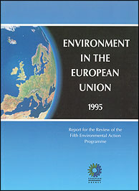
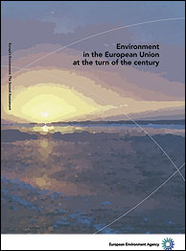
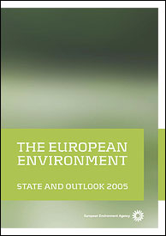
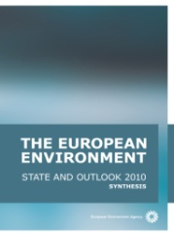
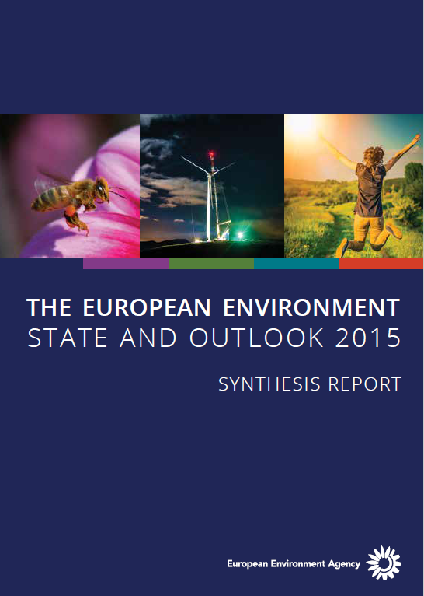
Regular EEA’s state of environment reporting in Europe
Joint EEA-UNEP/MAP reports

Slide 5
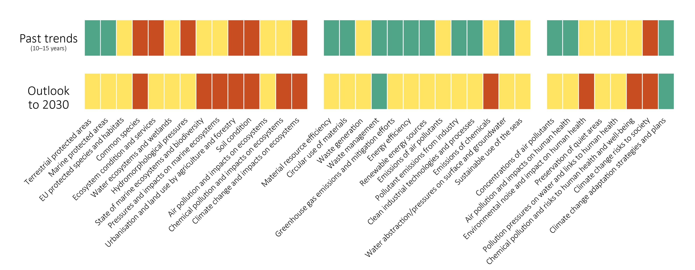
SOER 2020: some successes but a discouraging outlook
1. Natural capital
2. Low carbon and resource efficient economy
3. Health and wellbeing
Past trends
(5-10 years)
Outlook
To 2030
Notes:
When we compare past trends in these three areas with an outlook to 2030, we see a deteriorating picture. If we continue with along current trajectories, we will not achieve our goals.
Viewed against Europe’s long-term vision and complementary policy targets, it is clear that Europe is not making enough progress in addressing environmental challenges. The messages from the SOER 2020 assessment of recent trends and outlooks is clear: policies have been more effective in reducing environmental pressures than in protecting biodiversity and ecosystems, and human health and well-being. Despite the successes of European environmental governance, persistent problems remain and the outlook for Europe’s environment in the coming decades is discouraging.

Slide 6



Panelists for the side-event
The UN Decade of Ocean Science for Sustainable Development: a Mediterranean perspective, Francesca Santoro, IOC-UNESCO
A Workshop to define the contribution of the UN Decade of Ocean Science for Sustainable Development, Margherita Cappelletto, Italian National Research Council (CNR)
Mapping of MAP objectives, targets and indicators against the SDGs, Julien Le Tellier, UNEP/MAP
Monitoring and Assessment under MEDPOL umbrella, Jelena Knezevic, MEDPOL
Regional knowledge platform, latest developments in terms of regional infrastructure and tools, Giordano Giorgi, InfoRAC– ISPRA
Morocco national practice and experience in managing and reporting environmental information, Mohamed El Bouch, Secrétariat d’Etat chargé du Développement Durable
Q&A

