Slide 1
IMAP and H2020 indicators
Joint Meeting of the Ecosystem Approach Correspondence Group on Marine Litter Monitoring and ENI SEIS II Assessment of Horizon 2020/National Action Plans of Waste Indicators
Giordano Giorgi and Alessandro Lotti (INFO-RAC) 5th April 2019 - PODGORICA

Slide 2
H2020 Indicators data requirements - WASTE
H2020 Thematic Area | Indicator nr/Title |  | Indicator Specification Factsheets | Data Dictionary | IMAP | NBB/PRTR | BCRS
WASTE | 1.1 | Municipal waste composition | IND 1 EN IND 1 FR | Waste DD - EN (V1.3) | NO | 2.1 Plants for waste collection and treatment | 1.1 & 1.2 LBS NAP on marine litter and waste 2.1 &2.3 NAP Hazardous Wastes Protocol
 | 1.2 | Plastic waste generation per capita
 | 2.1 | Waste collection | IND 2 EN IND 2 FR
 | 2.2 | “Environmental control” (Waste controlled treatment or disposal)
 | 2.3 | Waste resource recovery
 | Q | “Software of waste management” (Policies) | IND Q EN IND Q FR

Slide 3
H2020 Indicators data requirements - WATER
H2020 Thematic Area | Indicator nr/Title |  | Indicator Specification Factsheets | Data Dictionary | IMAP | NBB/PRTR | BCRS
WATER | 3.1 | Share of total, urban and rural population with access to an improved sanitation system (ISS) | IND 3 - EN IND 3 - FR | Water DD - EN (V6) | 5.1 CI13: Concentration of key nutrients in water column (EO5); CI14: Chlorophyll-a concentration in water column (EO5) 5.2 CI21: Percentage of intestinal enterococci concentration measurements within established standards (EO9) | 4.1 & 4.3 Plants for municipal wastewater collection and treatments | 4.2 LBS NAP on re-use of treated municipal wastewater
 | 3.2 | Proportion of population using safely managed sanitation services (SMSS)
 | 4.1 | Municipal wastewater collected and wastewater treated | IND 4 - EN IND 4 - FR
 | 4.2 | Direct use of treated municipal wastewater
 | 4.3 | Release of nutrients from municipal effluents
 | 5.1 | Nutrient concentrations in transitional, coastal and marine waters | IND 5 - EN IND 5 - FR
 | 5.2 | Bathing water quality

Slide 4
H2020 Indicators data requirements –INDUSTRIAL EMISSION
H2020 Thematic Area | Indicator nr/Title |  | Indicator Specification Factsheets | Data Dictionary | IMAP | NBB/PRTR | BCRS
INDUSTRIAL EMISSIONS | 6.1 | Release of nutrients from industrial sectors | IND 61 English, IND 61 French | IE DD - EN (V2.1) | Link to 6.1 &6.2 with CI 17: Concentration of key harmful contaminants measured in the relevant matrix (EO9, related to biota, sediment, seawater) and CI13: Concentration of key nutrients in water column (EO5); | 6.1 Amount of nutrients released from plants and diffuse sources 6.2 Amount of toxic substances released from plants and diffuse sources | 6.1 LBS NAP on BOD/COD 6.3 LBS NAP on Mercury and POP
 | 6.2 | Release of toxic substances from industrial sectors | IND 6.2 English, IND 6.2 French
 | 6.3 | Industrial hazardous waste disposed in environmentally sound manner | IND 6.3 English, IND 6.3 French
 | 6.4 | Compliance measures aiming at the reduction and/or elimination of pollutants generated by industrial sectors | IND 6.4 English, IND 6.4 French

Slide 5
InfoMAP and H2020 data flows
IMAP Pilot InfoSystem
CI 13, 14, 17, 21
BCRS
LBS/HWP
https://idc.info-rac.org/bcrs
Migration
InfoMAP
Data Base
MEDPOL
Legacy DataBase + Reporting
CPs provide additional required info
NBB/PRTR
H2020 indicators + InfoMAP Node (SDI)
Pre-filling

Slide 6
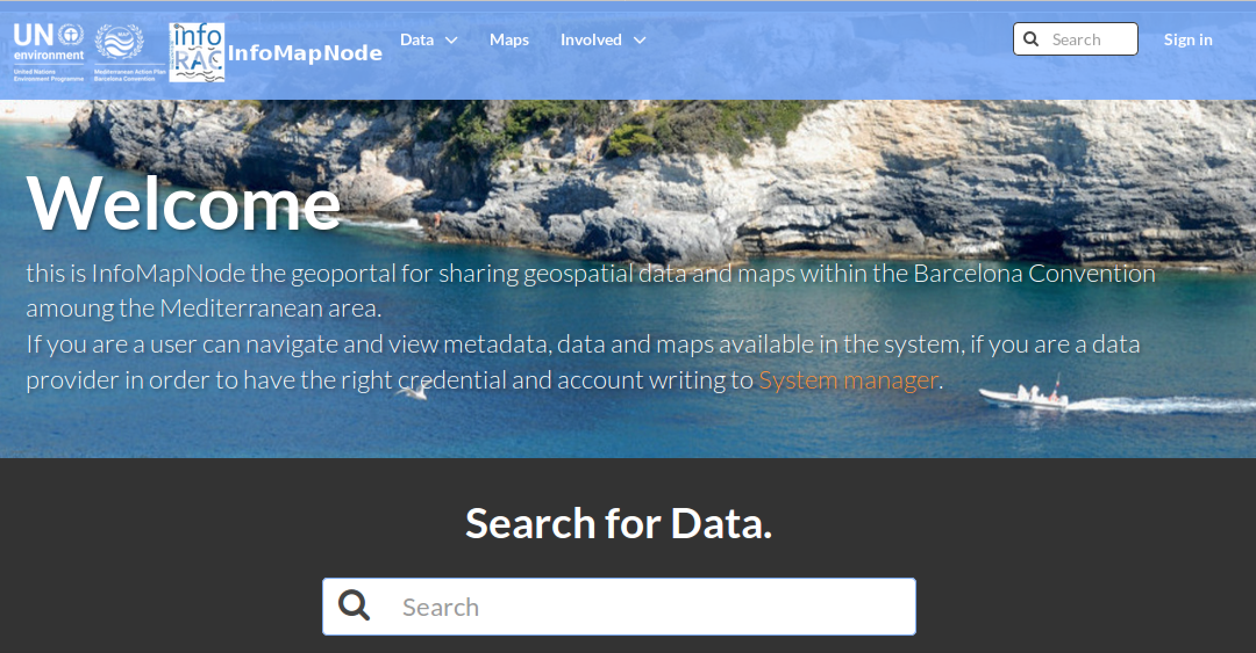
InfoMap Node - Homepage
http://infomapnode.info-rac.org
A user can easily access to main contents: Data (Layers and Documents), Maps, Involved and Search.

Slide 7
InfoMap Node – Dataset Themes

Slide 8
InfoMap Node - Layers
Through Data menu → Layers → Explore Layers

Slide 9
InfoMap Node - Documents
Through Data menu → Documents → Explore documents

Slide 10
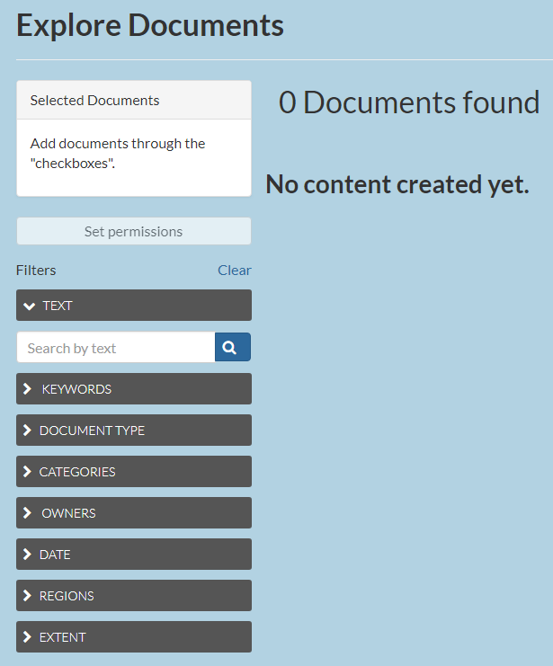
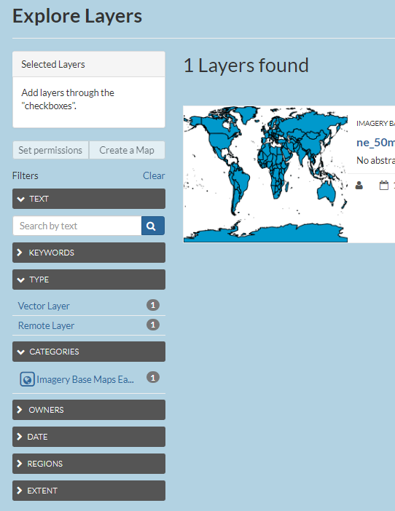
InfoMap Node – Filters
It is possible to browse documents and layers through a series of filters

Slide 11
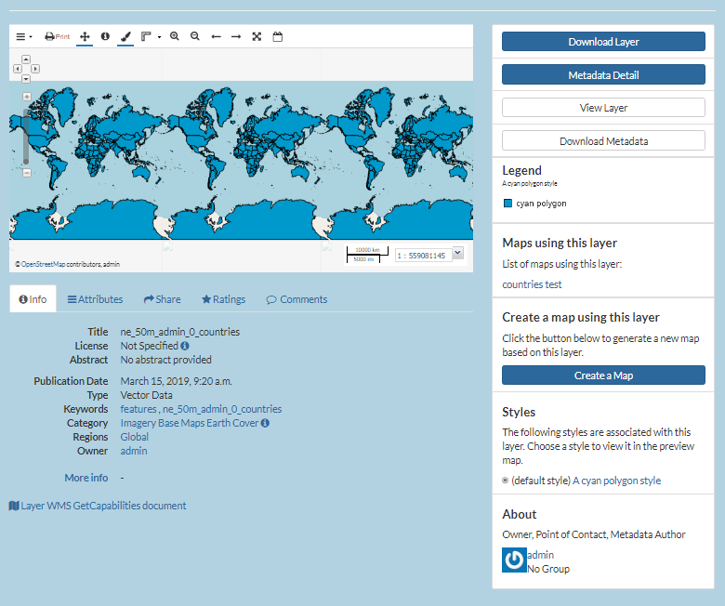
InfoMap Node - Access Layers Metadata and Details
Clicking on the layer title a user can visualize the layer, accessing more detailed information.
Clicking on “Metadata details” users have access to details
On the right side of page, there is also the Legend associated, the layer under the Maps using this Layer.
Clicking on Create Map, current layer will upload in a map or dowload metadata with Download Layer

Slide 12
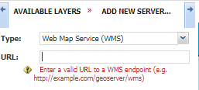
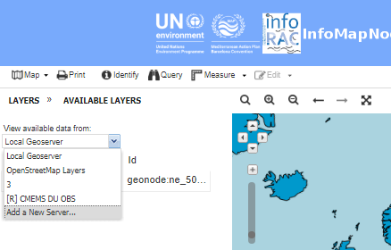
InfoMap Node – Create a Map
Clicking on the + (plus) button it is possible to add a layer on the map just created.
New Layers can be added from local geoserver or WMS services (e.g. Copernicus)

Slide 13
InfoMap Node - Maps
Through Maps menu → Explore Maps

Slide 14
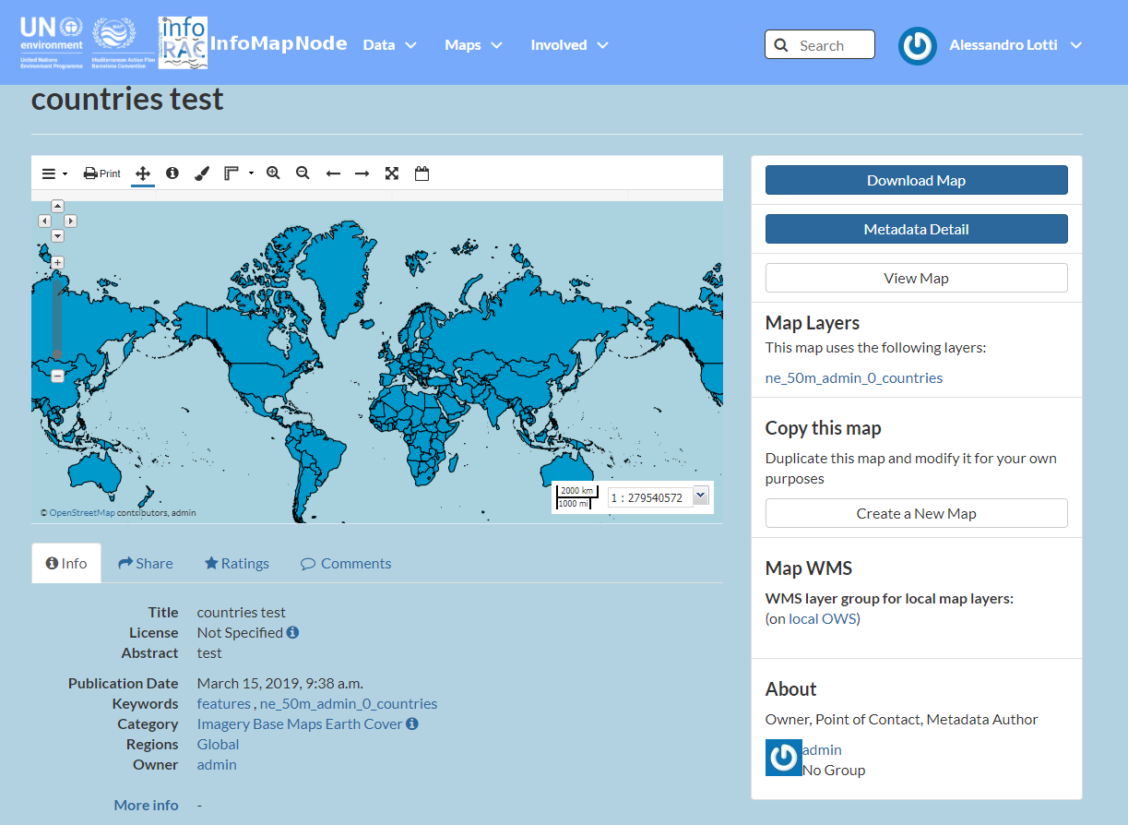
InfoMap Node - Access Metadata and Details
Clicking on the map title a user can visualize the map, accessing more detailed information.
Clicking on “Metadata details” users have access to map details
On the right side of page, there is also the Layer associated
Clicking on Create a new Map, it can be duplicated it or edited
…furthermore it can be downloaded

Slide 15
InfoMap Node – Upload Documents
Link Documents To A Layer Or Map: a user can link the document to a related Layer or map published in the platform

Slide 16
InfoMap Node – Upload Layers

Slide 17
InfoMap Node – Upload Layers
Layer Info: it allows to access the Layer View interface, editing specific layer, including changing Permissions for it.
Edit Metadata: it drives user to interface where detailed layer information are provided.
Upload Metadata: it allows to upload and existing xml file of metadata associated to the layer.
Upload SLD: it allows user to upload an existing style file, in order to associate a specific legend to a layer.
Manage Styles: it allows user to select a predefined style for your layer amongst the styles already created. This complex function should be reserved for administrators or very advanced users.

Slide 18
InfoMapNode - Metadata management
Title: Provide an explanatory name for your layer. The name should not follow the naming conventions for data files but instead correctly reflect main aspects of the data. Start the title with a geographical specification (country, region, or “Global”).
Abstract: Provide a brief description for your layer. This text will appear together with your layer e.g. in the search results.
Keywords region: Select one or more countries that the layer represents.
Keywords: Specify keywords for your layer to appear in search results.
Supplemental information: Specify what the attributes represent by giving a brief description of each attribute. The supplemental information will appear under your layer in the Layer View interface when you click Show/Hide.
Attributes: Provide further descriptions of all the attribute short names or change the display order of the attributes.

Slide 19
THANK YOU FOR YOUR ATTENTION!
Giordano Giorgi – INFO/RAC
Alessandro Lotti – INFO/RAC

