Slide 1

An output of GESAMP Working Group 40:
Sources fate and effects of marine litter and microplastics in the marine environment
Co-chairs: P. Kershaw, A Turra, F Galgani
GESAMP: Joint Group of Experts on Scientific Aspects of Marine Environmental Protection – an inter-agency body of the United Nations

Slide 2
Monitoring and assessment – the need for harmonisation
Benefits:
  Reduces uncertainty
  Allows data comparisons
  Permits data sharing
  Encourages regional cooperation
  Spreads good practice
  Helps fulfil the SDG targets & indicators
UN SDG 14.1.1 – floating plastic litter
To support raising indicator from Tier 3 (‘No internationally established methodology or standards are yet available’) to Tier 2 ('Indicator is conceptually clear, has an internationally established methodology and standards are available ……’)

Slide 3
Structure of report

Slide 4
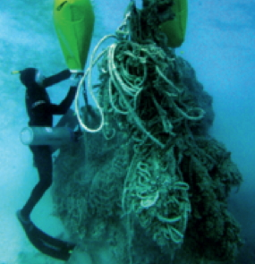
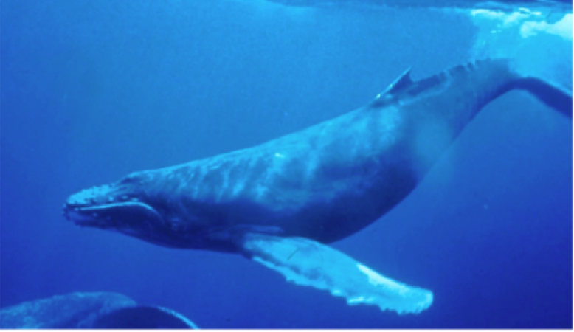

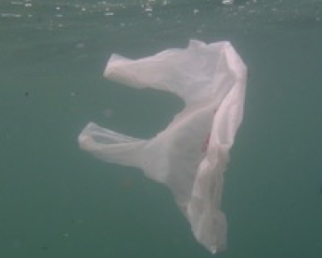
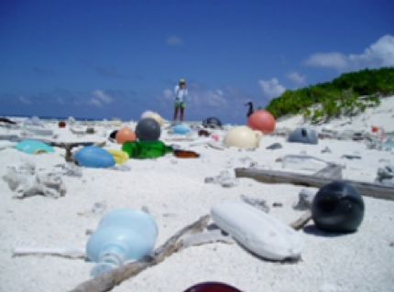
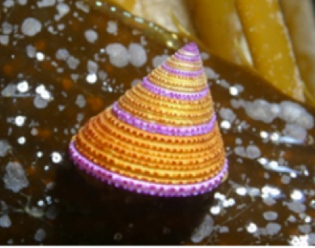
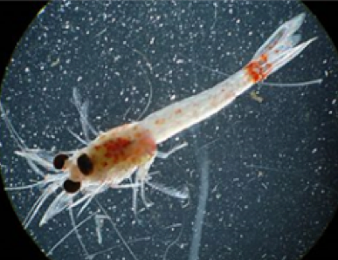
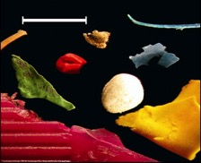
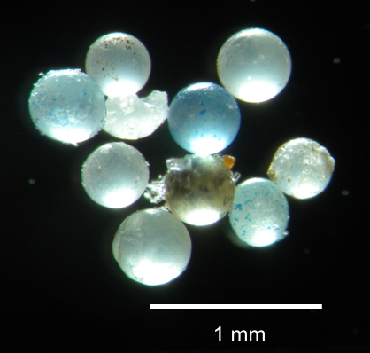

Size range included in the Guidelines
Mega
1 m
Macro
25 mm
Meso
5 mm
Micro

Slide 5
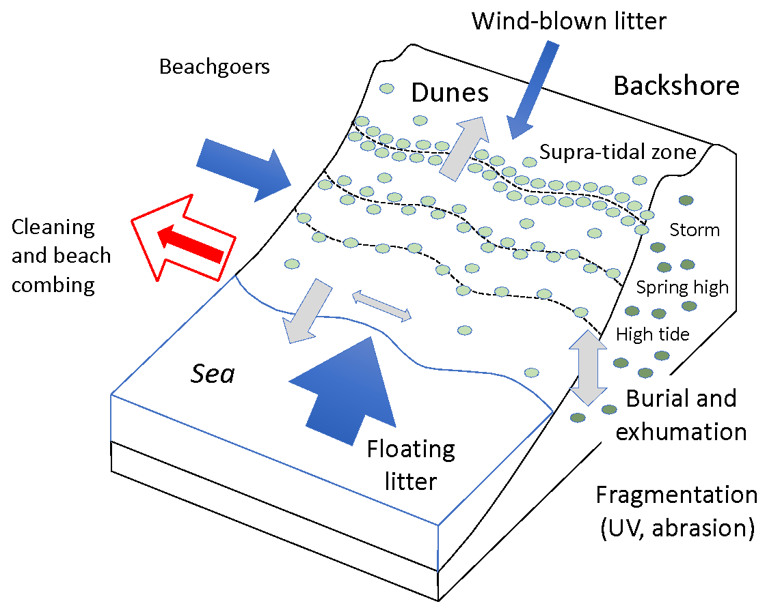
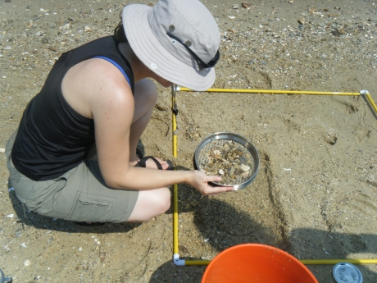
Guidance on shoreline sampling

Slide 6
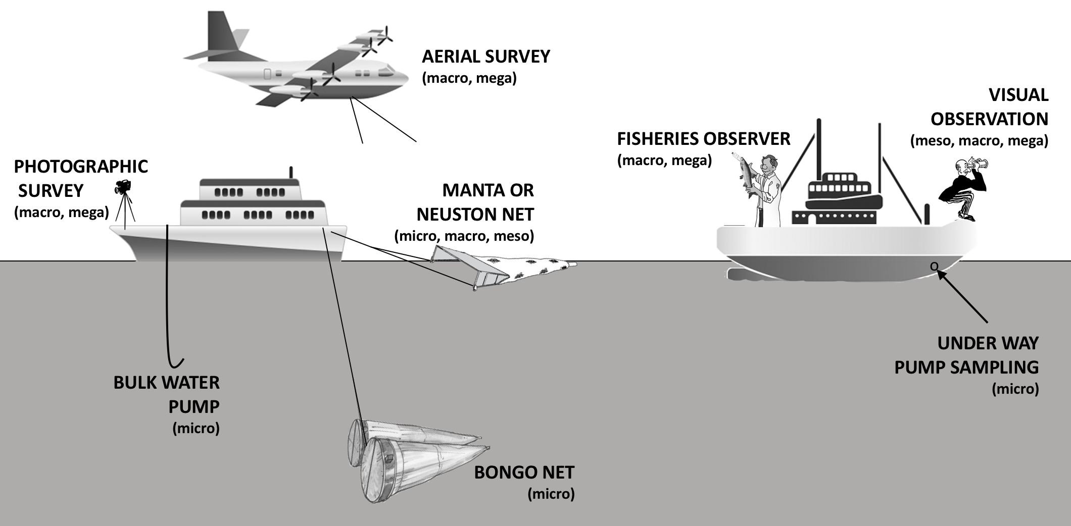
Guidance on sampling the sea surface and near-surface

Slide 7
Guidance on sampling the seafloor
Divers
Trawling
Cameras/video
Sediment sampling

Slide 8
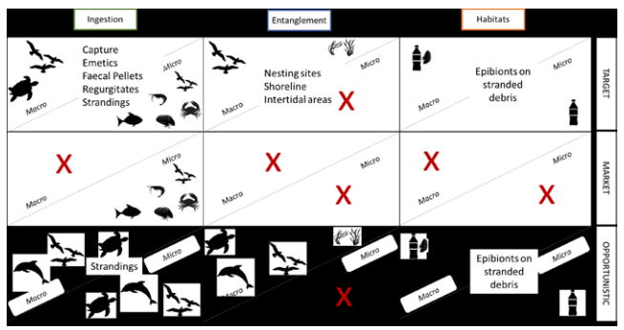
Monitoring strategies using biota

Slide 9
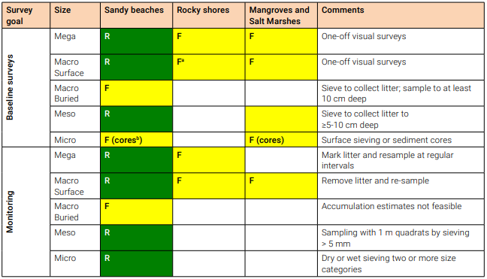
Recommendations: BeachLitter

Slide 10
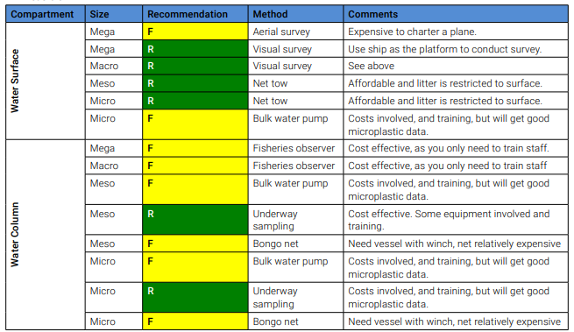
Recommendations: Floating litter

Slide 11
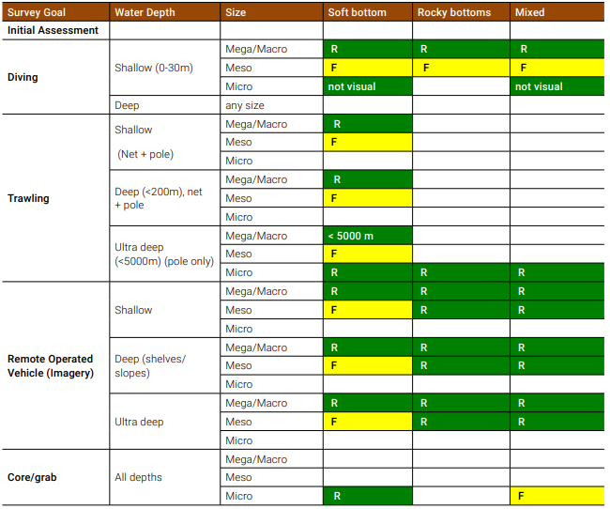
Recommendations: Sea floor Litter

Slide 12
Recommendations: physical & chemical characterisation

Slide 13
GESAMP recommendations:
compartments, litter size and sampling methods
SL – Shoreline
SF – Seafloor
B – Biota
SS – Sea surface
BE – Beach
FISH
INV – Invertebrate
SEAB – Seabird
MEG – Mega-fauna
MA – Macro-litter
ME – Meso-litter
MI – Micro-litter

Slide 14
GESAMP recommendations:
compartments, litter size and policy concerns addressed

Slide 15

Thank you!
www.gesamp.org/publications

