Slide 1
EMODnet Chemistry (EU – DG MARE) marine data initiatives – Marine Litter
Joint Meeting of the Ecosystem Approach Correspondence Group on Marine Litter Monitoring and ENI SEIS II Assessment of Horizon 2020/National Action Plans of Waste Indicators
Podgorica, Montenegro, 4-5 April 2019

Slide 2
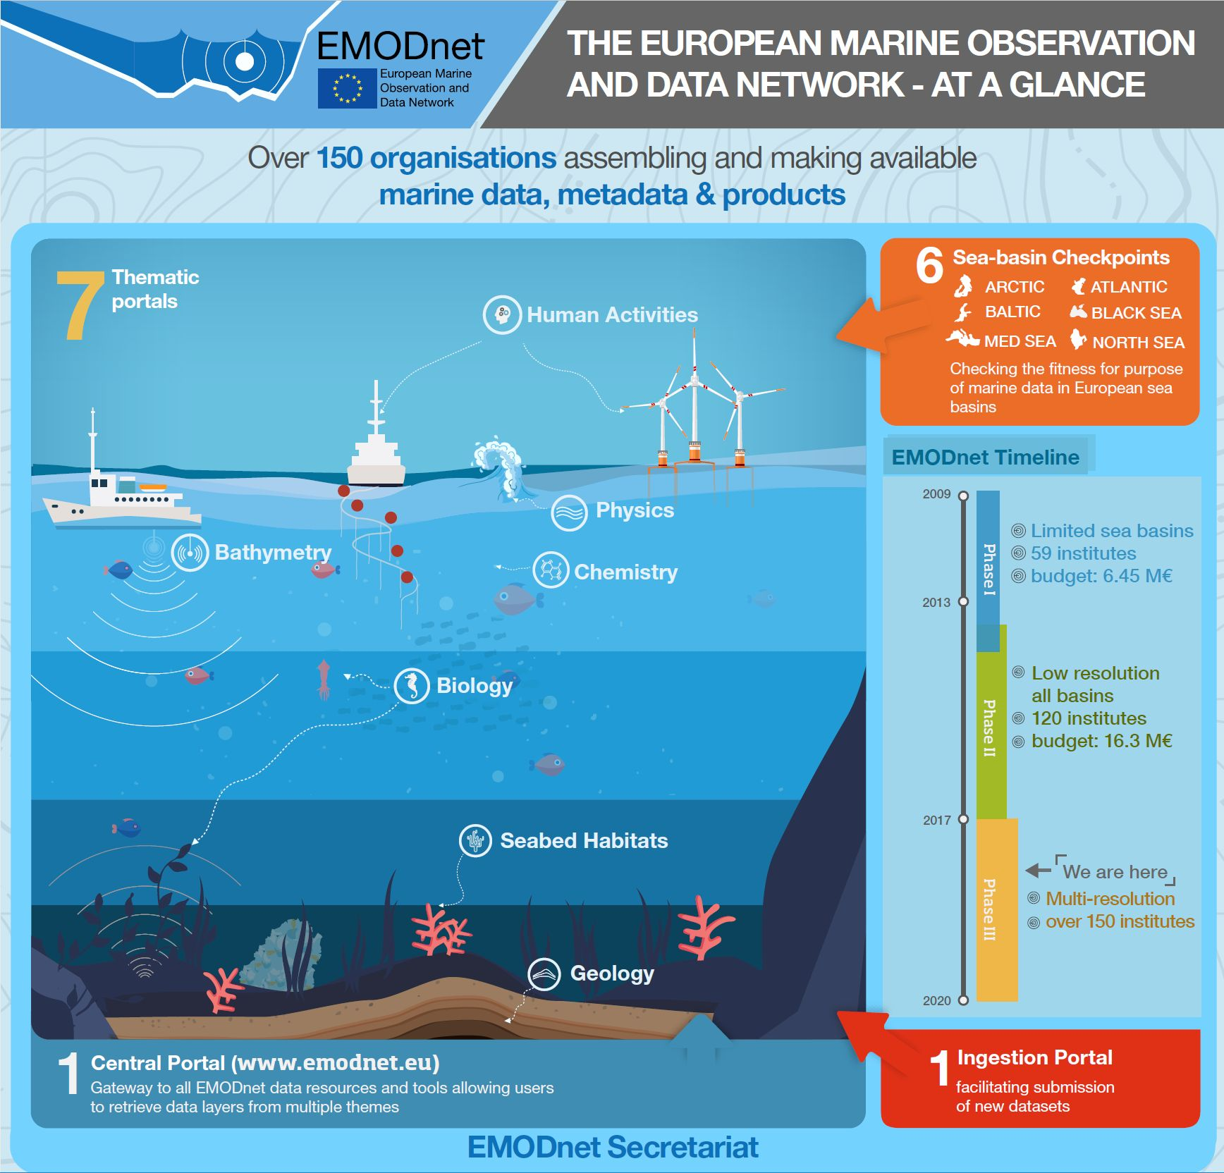
What is EMODnet?
Long-term initiative launched in 2008 by DG MARE as part of Blue Growth strategy (Marine Knowledge 2020) to unlock marine data, facilitating their access and re-use at European scale for different domains: bathymetry, geology, biology, chemistry, physics, seabed habitats, coastal mapping, and human activities

Slide 3
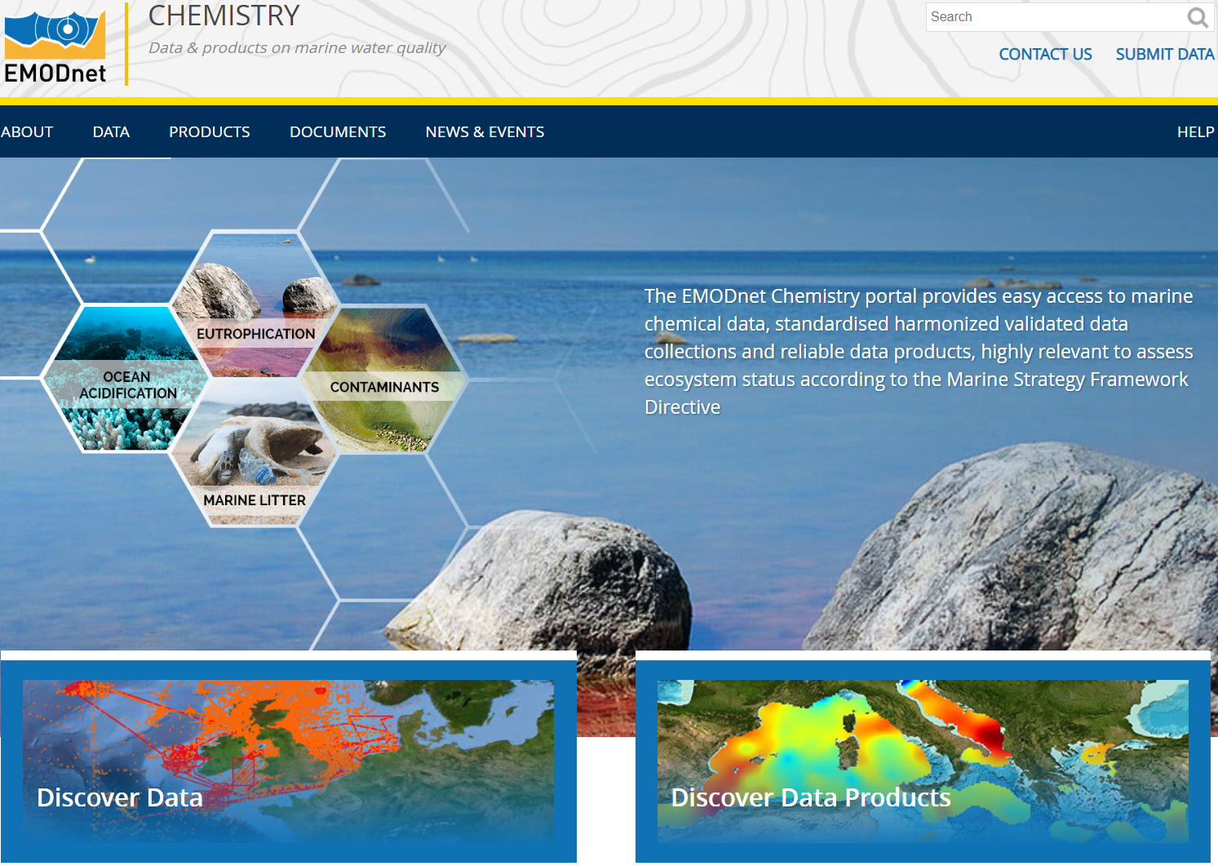
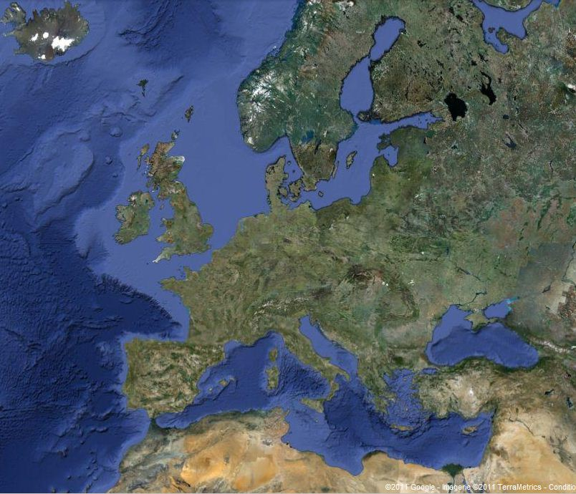
EMODnet Chemistry manages data on :
Eutrophication
Contaminants
Marine Litter
Ocean acidification
Adopts and adapts SeaDataNet approach and long consolidated Pan – European infrastructure set up and operated for ocean and marine data management
http://www.emodnet-chemistry.eu/welcome

Slide 4
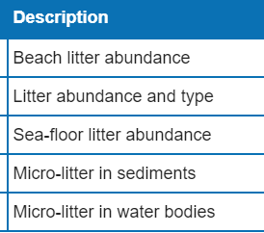
Provides access to data:

Slide 5
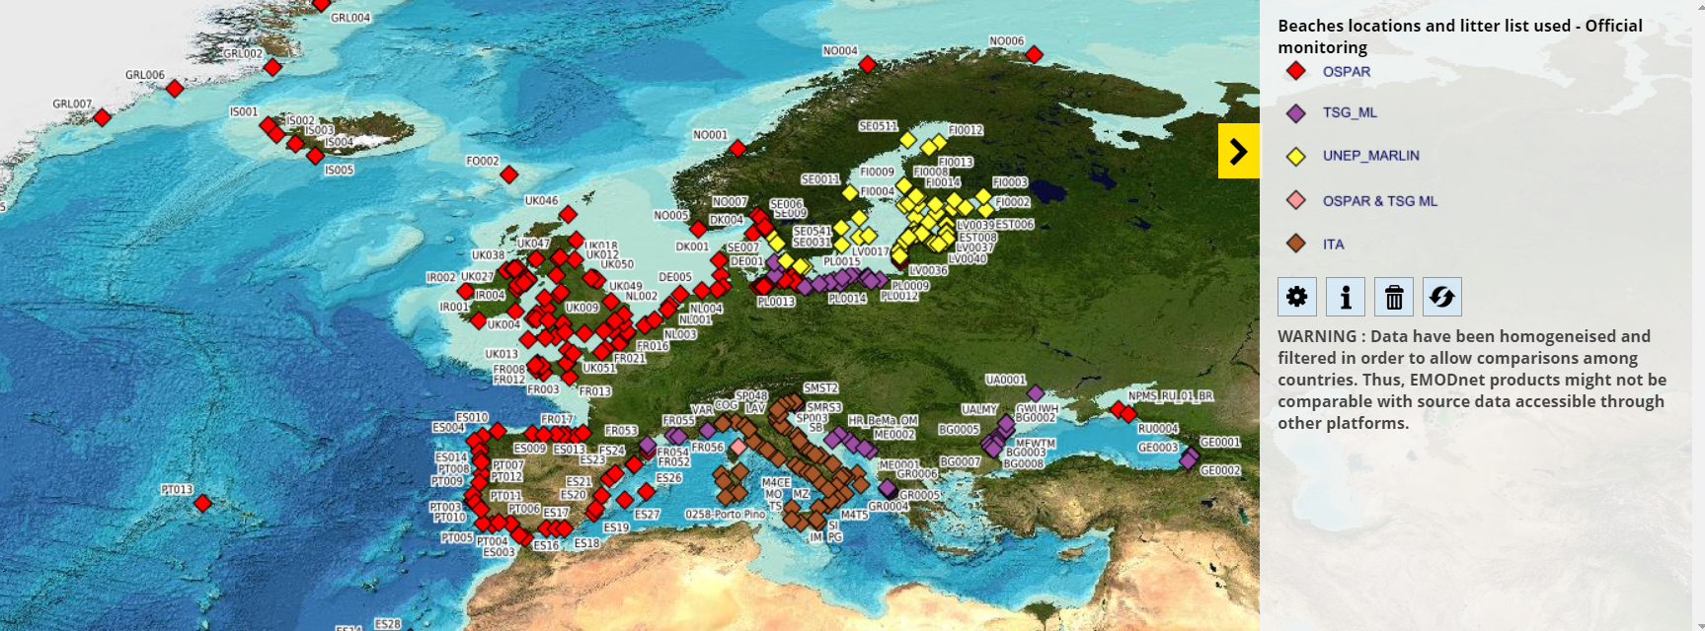
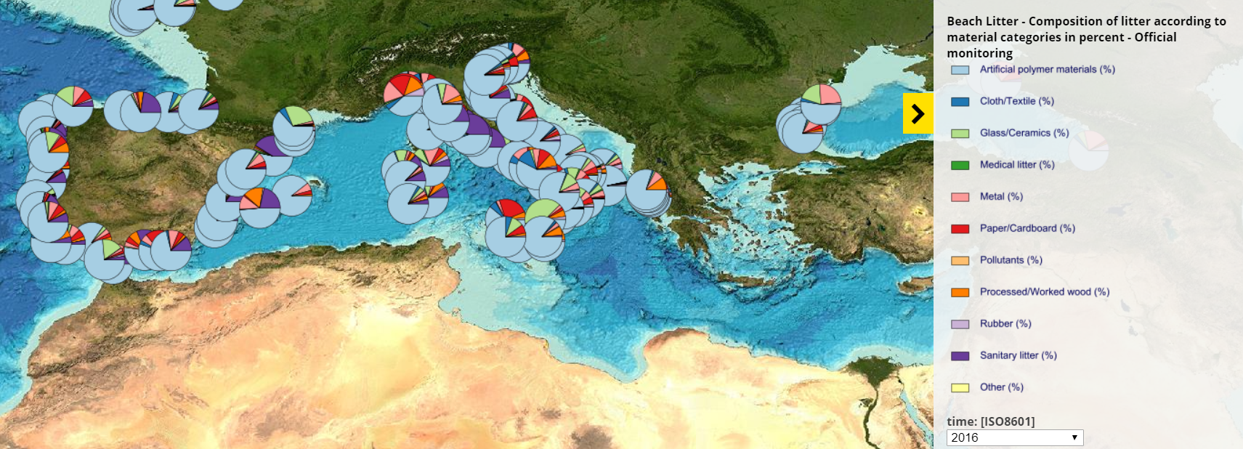
First data visualizations:
Beach litter locations and litter list used
Beach litter composition (2016)
Seabed litter density (2016)

Slide 6
Litter protocols and formats
Approach discussed at the MSFD Technical Group ML
FLOATING MICRO-LITTER
BEACH
SEAFLOOR
Consolidated protocols (OSPAR, UNEP, UNEP –Marlin, TG ML)
Consolidated protocols (ICES, MEDITS, DeFishGear)
More fragmented and heterogeneous management
New EMODnet format based on OSPAR
New EMODnet format based on ICES and MEDITS
Adapted SeaDataNet/ EMODnet data formats and infrastructure
Collect all type of data with central submission facilities, and provide open access to harmonized information

Slide 7
Database content
EMODnet
format
Marine Litter
Database
Beach | OSPAR-MCS JRC collection from Member States EMODnet partners and associates | 29 countries 599 beaches
Seafloor | ICES-DATRAS database EMODnet partners | 17 countries 2498 surveys
Floating micro-litter | EMODnet partners | 4 countries 131 surveys
Under ingestion process: Volvo Ocean Race More data in future: EEA Litter Watch, MEDITS, DeFishGear, more from EMODnet partners,
7

Slide 8
Link to EU Marine Strategy Framework Directive
EMODnet Chemistry aims at providing access to marine chemistry data and generating products relevant for the implementation of the Marine Strategy Framework Directive (MSFD)
Tight connection with EEA, RSC, JRC, ICES through MSFD Experts Board meetings to obtain feedbacks on data products useful for indicators of MSFD descriptors

Slide 9
More information on:
http://www.emodnet-chemistry.eu/welcome
https://www.seadatanet.org/

