Slide 1
H2020 indicator-based assessment report
Process, outline, timeline
Joint Meeting of the Ecosystem Approach Correspondence Group on Marine Litter Monitoring
and ENI SEIS II Assessment of Horizon 2020/NAP Waste Indicators
4-5 April 2019, Podgorica
Cecile Roddier-Quefelec,
Project coordinator ENI SEIS II South
European neighbourhood policy activities – Mediterranean Area cooperation
This project is funded by the European Union

Slide 2
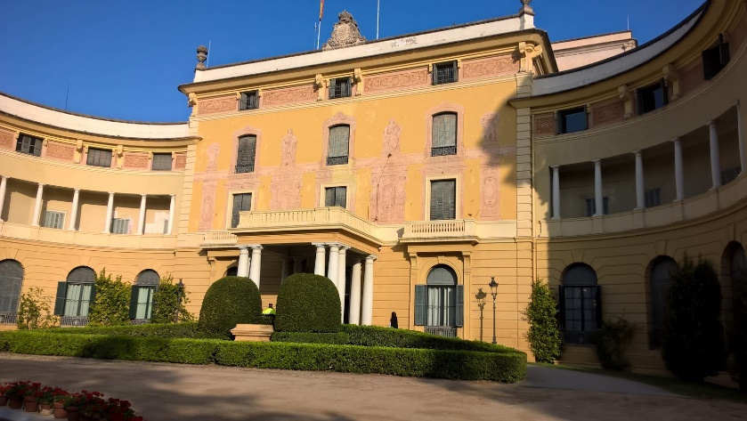
Union for the Mediterranean (UfM) – Horizon 2020 Initiative for a cleaner Mediterranean
Joint effort to substantially reducing pollution by the year 2020 by tackling main sources of pollution affecting Mediterranean Sea: municipal waste, urban waste water and industrial pollution.
Launched in November 2006 EuroMediterranean Environment Ministerial Conference held in Cairo
Reaffirmed by the UfM Ministers at the Ministerial Meeting on Environment and Climate Change in May 2014 in Athens
Key flagship initiative of the UfM since its launch in Paris in 2008, joint endeavor and commitment of all 43 UfM countries
Phase II 2014-2020:
focus on pollution prevention and to emerging issues including hazardous waste and marine litter
Commitment to apply SEIS principles in line with UNenvironment MAP Ecosystem Approach Decisions and other regional initiatives
Commitment to initiate reforms at national level to create an attractive investment environment
Commitment regarding implementation and enforcement of legislation

Slide 3
Union for the Mediterranean
(Ministerial Declaration)
flagship
Horizon2020 Initiative
for a cleaner Mediterranean
(2007-2020)
Barcelona Convention Land based Sources (LBS) Protocol and NAPs
EU-MSFD
2019-2020 objectives/targets
H2020 Steering Group
UfM Co-presidencies chair
Group
Pollution Reduction and Prevention Investments
(PRPI)
Group
Review and Monitoring
(RM)
Group
Capacity Building
(CB)
H2020 Support Mechanism Focal Points
UfM Secretariat & EIB co-chairs
EEA & UNEP/MAP co-chairs
UfM co-presidency and UNEP-MAP co-chairs
Research
EU NIF
MeHSIP-PPIF
ENPI-SEIS I
ENI SEIS-South II Support Mechanism
SWIM-H2020
LIFE
FP7/Horizon2020 Research projects
Demonstration projects
MeHSIP II
National funds
Other donors
MSSD
UfM MSESD
TAIEX/Twinning
National funds
EcAp
UfM Water Knowledge
RCCAF
IMAP
UfM SCP
IPA-ECRAN
MED EUWI

Slide 4
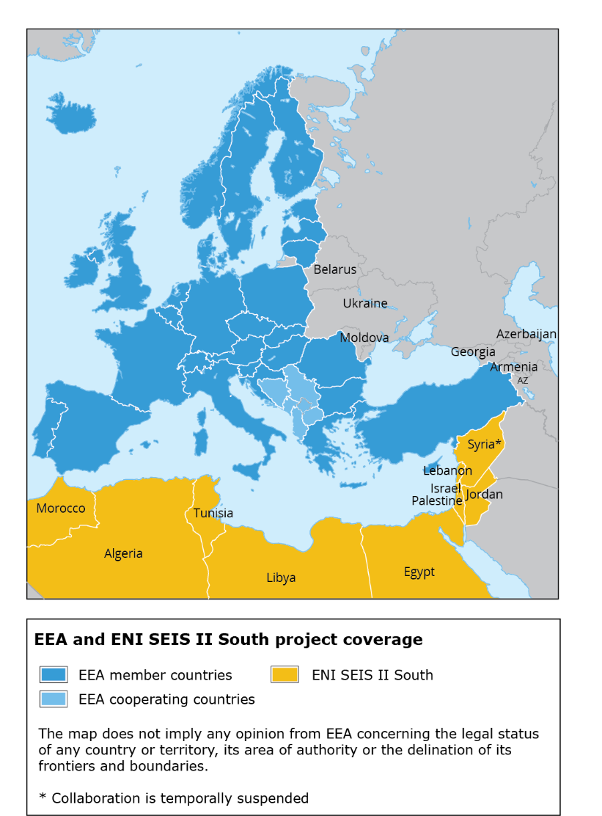
Mediterranean cooperation
EU funded regional project – supporting a long-term engagement to EU policies and external policy framework aligning to the Union for the Mediterranean and Barcelona Convention efforts on reducing marine pollution
EEA and UN environment / MAP
Co-chairs of the Review and Monitoring group of the H2020 Initiative for a cleaner Mediterranean
Joint implementation of ENI SEIS II South SM
Objective: To improve the availability and access to environmental information to the benefit of effective and knowledge-based policy-making
Indicator set, data flows 4 years (2016-2020) H2020 indicator-based assessment 9 countries
Reporting infrastructure €4.2 M

Slide 5
What is an environmental assessment?
An assessment is … the entire analytical process for undertaking a critical objective evaluation and analysis of data and information designed to meet user needs and support decision-making. It applies the judgement of experts to existing knowledge to provide scientifically credible answers to policy relevant questions, quantifying where possible the level of confidence.
Source: UNEP IEA Training Manual
An assessment is not a research project, review paper, or advocacy piece

Slide 6
Characteristics of integrated environmental assessments
In striving to be credible, salient and legitimate, integrated environmental assessments aim for the following characteristics:
(1) provide an assessment across thematic issues
(2) assess issues across geographical scales
(3) address the past, present and future
(4) include stakeholder perspectives
(5) be multidisciplinary in their analytical approaches
(6) be for the benefit for decision-making
(7) be transparent (re: values, assumptions and uncertainties)

Slide 7
How do we do it and how has this changed?
Building knowledge
Source: EEA

Slide 8
DPSIR – going beyond state of the environment
Pressures
State
Impact
Drivers
Responses
Source: EEA

Slide 9
What is the progress in depolluting the Mediterranean ?
4. What are the next steps?
What are lessons learnt?
What can we do better?
How much would that cost?
Which other sources of pollution are becoming important?
1. What is the problem?
What are the main pollution sources?
What are the levels and trends?
2. What has been done?
Which actions, measures have been carried out to tackle these pollution sources?
3. Did it work?
Can we measure the effectiveness of these actions?
Were these actions successful?
What is the comparative performance of these actions?

Slide 10
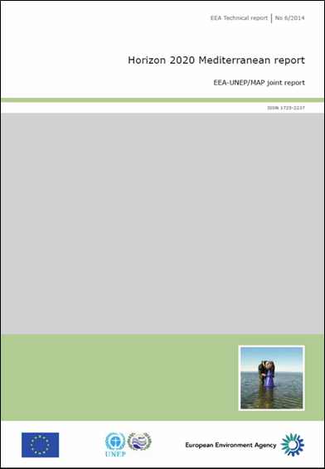
Horizon 2020 Mediterranean report – Toward shared environmental information systems
EEA-UNEP/MAP joint report, May 2014
Indicator-based assessment coordinated by EEA/ETC and UNEP/MAP under ENPI-SEIS project (2010-2015)
Focus on waste water and sanitation, solid municipal waste and industrial emissions
Country-level assessments
for 5 countries:
Israel
Jordan
Morocco
Palestine
Tunisia
Recognising efforts put by all partner countries
Report concludes that the region needs to work even harder together in order to meet its target to depollute the sea by 2020

Slide 11
H2020 thematic Indicators (Athens 2018)
Indicator mapping (streamline SDG/MSSD, IMAP, etc)
Indicator methodological guidance developed
Production based on existing data sources
Specific data collection/data flow using UNeMAP infrastructure and reporting tools
Workshops/webinars/
expert missions
Bilateral agreements

Slide 12
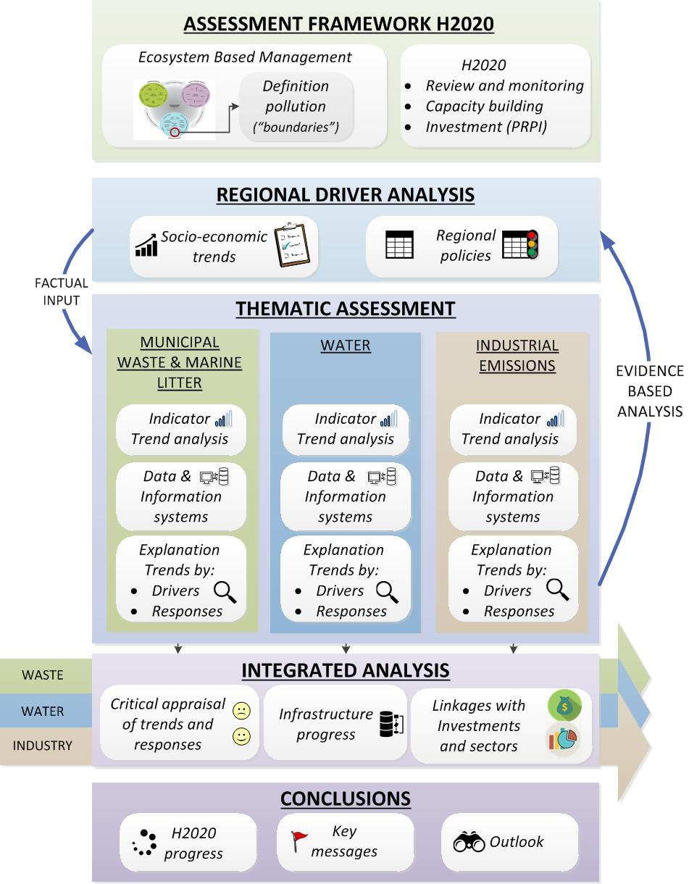
Development principles
1. Integration of various source of information - data, indicators, case studies, best practices, national assessment
2. Based on renewed H2020 indicators set
3. Coordinated approach with SoED, MSSD
4. Integrated assessment across all H2020 components
5. Highlight uncertainties , knowledge gaps
6. Full MED coverage - visibility of ENI, EU member States, West Balkans, Turkey work in synergy with other EU work and some international organisations

Slide 13
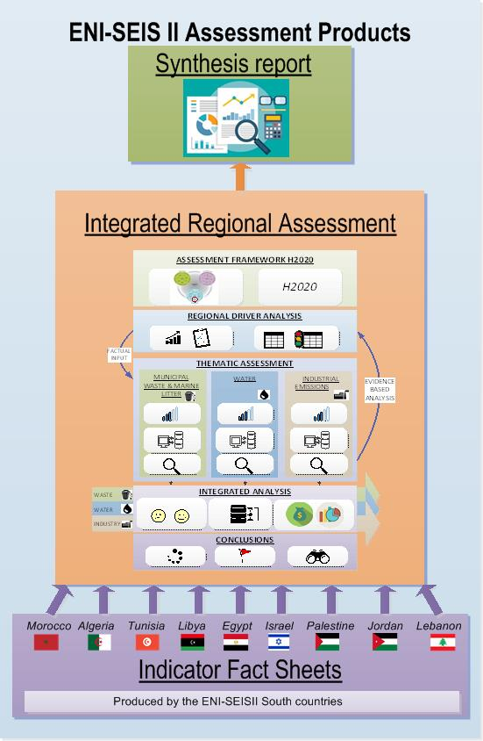
2nd H2020/NAP Indicator-Based Assessment Report main products

Slide 14
Timeline
 | Expected timing | Support
H2020 Assessment Outline prepared and agreed | April 2019 | SSFA, TA
Data collection, populate and assess H2020 indicators | Till end July 2019 | SSFA, TA Webinars Workshops
Consultation on draft H2020 assessment report | July-August 2019
Provision of national case studies (cut off date for data) | End of August 2019 | SSFA, TA
Regional H2020 assessment workshop | September 2019
H2020 Assessment Report ready for production (thematic assessment, factsheets) Synthesis | End October 2019 December 2019

Slide 15
H2020 Waste indicators
Notes:
- the H2020 cluster of indicators aims to address the waste and marine litter in holistic way. Not only focusing on assessing trends od the state of pollution in the sea, but trying to capture it from a source perspective – from a waste generation and management on land.
- the set of indicator therefore tries to make the link between marine litter and waste management, as an attempt to improve the interlinkages between pressures with state and impact.

Slide 16
H2020 Waste indicators
IND 1 - Municipal waste generation
IND 2 - Hardware of waste management
IND 3 - Software of waste management
Notes:
- the H2020 cluster of indicators aims to address the waste and marine litter in holistic way. Not only focusing on assessing trends od the state of pollution in the sea, but trying to capture it from a source perspective – from a waste generation and management on land.
- the set of indicator therefore tries to make the link between marine litter and waste management, as an attempt to improve the interlinkages between pressures with state and impact.

Slide 17
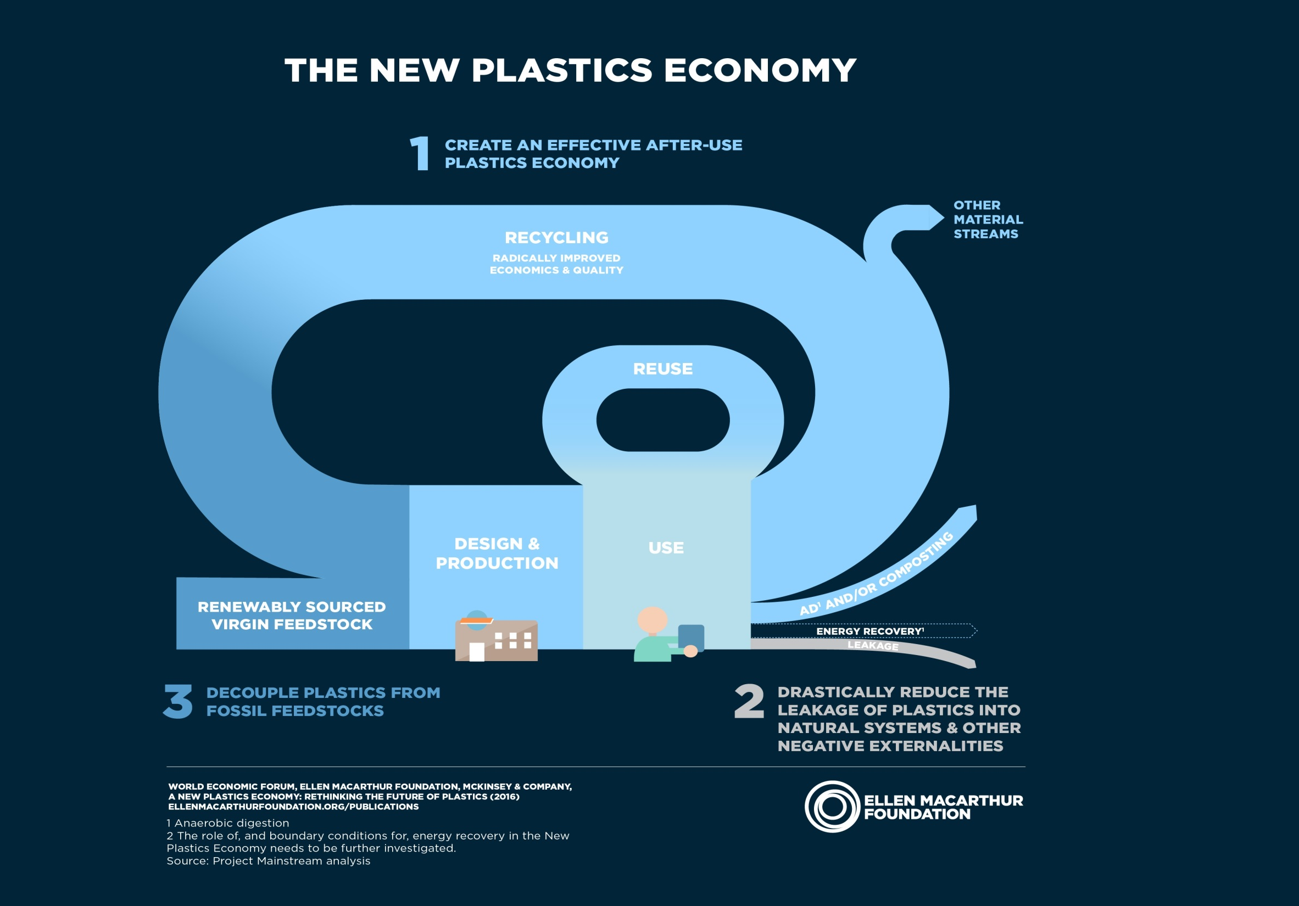

Slide 19
H2020 Waste Indicators
 | Title of indicator | Sub-indicators
IND 1 | Municipal Waste Generation | IND 1.A Municipal waste composition
 |  | IND 1.B Plastic waste generation per capita
 |  | IND 1.C % of population living in Coastal Areas
 |  | IND 1.D % of Tourists in Coastal Areas / Population in Coastal Areas
IND 2 | “Hardware” of waste management | IND 2.A Waste collection IND 2.A.1 Waste collection coverage IND 2.A.2 Waste captured by the formal waste sector.
 |  | IND 2.B Environmental Control IND 2.B.1 % of waste to uncontrolled dumpsites IND 2.B.2 Uncontrolled dumpsites in Coastal Areas IND 2.B.3 Waste going to dumpsites in Coastal Areas
 |  | IND 2.C Resource Recovery IND 2.C.1 % of plastic waste generated that is recycled.
PRESSSURE
DRIVER
RESPONSE
PRESSSURE
RESPONSE
Notes:
special focus of plastic across the defined indicators: largest fraction of marine litter but also the material that raises more concern
Special focus on the coastal areas, due to the proximity of sources, the density of population in this area and the importance of economic activities such as the tourism sector. National figures say very few things on the leakages of waste that ends up as ML. Mapping the coastal cities and their performance, to assess their leakages and provide them suggestions for improvement. The geographical scale in which monitoring and indicators will be applied is a crucial and urgent issue.
Assuming that there is a direct link between coastal dumpsites and ML quantities, as a source “hotspot”, these have been particularly considered in this set of indicators. Dumpsites are uncontrolled disposal sites, with no environmental protection

Slide 20
Xxx
 | Title of indicator | Sub-indicators
IND Q | “Software” of waste management (15 Y/N Questions) | 3.Q.A MARINE LITTER & WASTE MANAGEMENT FRAMEWORK (6) Is there a National Assessment for ML and its impacts? Is there a National Plan or Strategy for ML? Is there a National Plan or Strategy for Waste Management? Is there a national plan or target to close the dumpsites before 2030? Q.B RESOURCE RECOVERY (5) Is there a National Plan or Strategy for Waste Prevention? Are there mandatory targets for recycling - recovery of packaging waste? Are there EPR or Deposit- Return schemes for packaging waste? Are there national policies to eliminate or reduce single-use plastics? Are there financial incentives for reuse – resource recovery activities? Q.C SUSTAINABLE CONSUMPTION AND PRODUCTION (4) Are there Sustainable Consumption and Production plans or strategies? Are there green procurement rules for the public sector in place? Are there policies to support sustainable tourism? Are there policies to support eco-labelling and eco-design?
RESPONSE

Slide 21
PRESSURES
IND 2.A.1 Waste collection coverage
RESPONSES
IND 2.A.2 Waste captured by the formal waste sector
IND 1.B Plastic waste generation per capita
IND 2.C.1 % of plastic waste generated that is recycled
IND 1.A Municipal waste composition
PRESSURES
IND 1.D % of Tourists in Coastal Areas
IND 2.B.1 % of waste to uncontrolled dumpsites
IND 1.C % of population living in Coastal Areas
IND 2.B.2 Uncontrolled dumpsites in Coastal Areas
DRIVERS
IND 2.B.3 Waste going to dumpsites in Coastal Areas
STATE
CI 22 Litter washed ashore and deposited on coastlines
IMPACTS
CI 23 Litter in the water column inc microplastics and on the seafloor
CI 24 Litter ingested by or entangling marine organisms

Slide 22
Group work
Notes:
- the H2020 cluster of indicators aims to address the waste and marine litter in holistic way. Not only focusing on assessing trends od the state of pollution in the sea, but trying to capture it from a source perspective – from a waste generation and management on land.
- the set of indicator therefore tries to make the link between marine litter and waste management, as an attempt to improve the interlinkages between pressures with state and impact.

Slide 23
Group work
UfM is preparing it’s post 2020 agenda for Environment and CC. H2020/thematic assessment to contribute to inform and support this process
TASKS:
Review the key questions to be addressed by the thematic assessment
- Are they enough to cover critical waste and marine litter issues?
- What would you propose to complement this assessment?
How could you help/support to respond to those questions?
- Data, supplementary analysis,
- Case studies
Take attention to cover : thematic interrelations, scales; past, present and future; include stakeholder perspectives; multidisciplinary analytical approaches; be for benefit of decision making and be transparent.

Slide 24
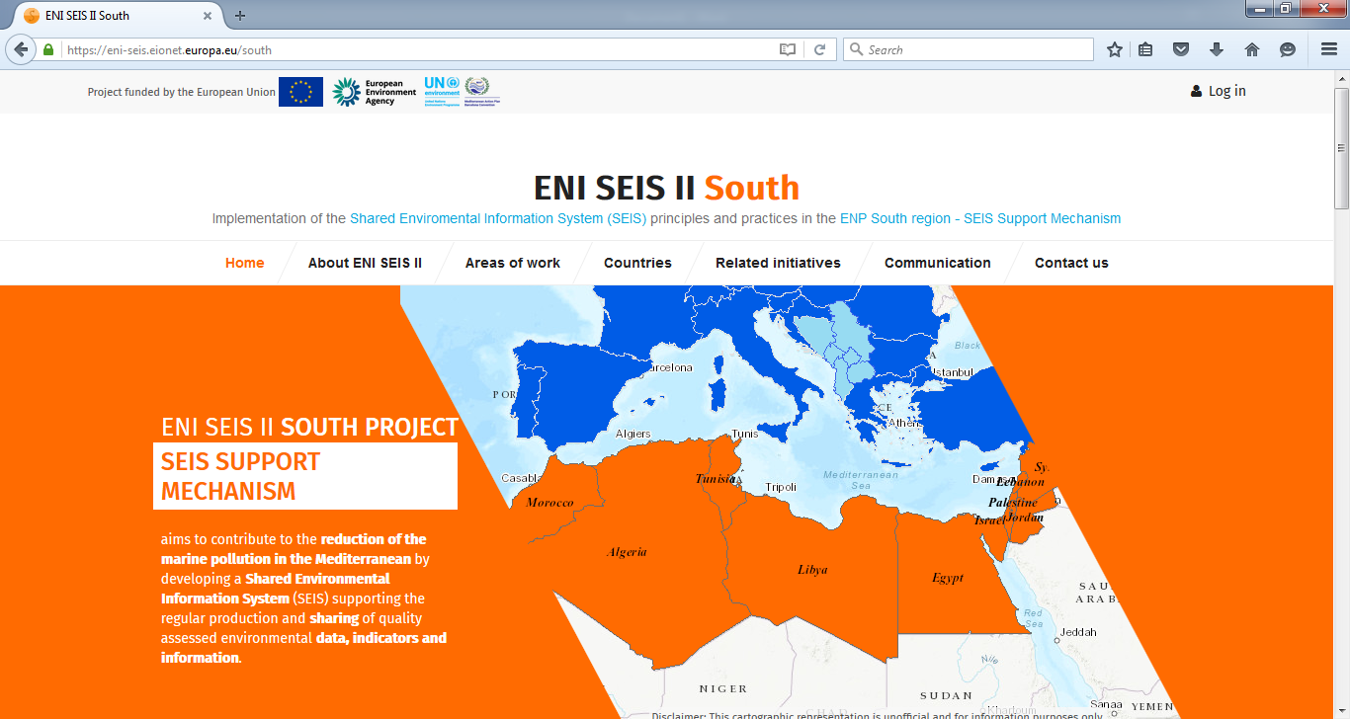
Thank you for your attention!
United Nations Environment Programme
Coordinating Unit for the Mediterranean Action Plan
Vassileos Konstantinou 48
Athens 11635, Greece
www.unepmap.org
European Environment Agency (EEA)
Kongens Nytorv 6
1050 Copenhagen K, Denmark
E-mail: ENI-SEIS2@eea.europa.eu http://www.eea.europa.eu/
http://eni-seis.eionet.europa.eu/south
This project is funded by the European Union

