Slide 1
MedBioLitter
Mediterranean marine litter and biodiversity interactions database
Dania Abdul Malak
Director ETC-UMA, University of Malaga
Joint Meeting of the Ecosystem Approach Correspondence Group on ML Monitoring and ENI SEIS II Assessment of Horizon 2020
4-5 April 2019
Podgorica, Montenegro

Slide 2
Main messages
The Biodiversity Protection community : a relevant Mediterranean platform for action (2016 – 2019) and roadmap towards (2019-2022)
Major achievements linked to ML : supporting the consolidation of knowledge & tools and identification of needs and gaps for better regional responses
MedBioLitter: Mediterranean marine litter and biodiversity interactions database (establishment, consolidation, and regular updates)
Notes:
DPSIR
Environmental and socio-economic harm

Slide 3
The Biodiversity Protection community’s priorities
The community is guiding two types of processes for an uptake by regional policies to support them reaching their targets to 2020 and to prioritise their policy aspirations beyond 2020.
Enforced and well managed PAs are powerful tools for effective biodiversity conservation and protection, though PAs’ management should be strengthened to ensure ecological connectivity through network design and best practice management.
Working beyond MPAs with an ecosystem approach helps addressing transboundary impacts. For new PAs ecological sensitivity and function are key criteria to consider.

Slide 4
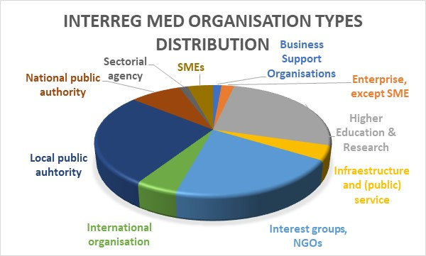
Typology of actors and territorial coverage
189 entities
12 Interreg MED projects
18 participating countries
70 protected areas
covering around 100.000 Km2
N2k and MPA of national status 26.212 Km²
Pelagos Sanctuary (87.338 Km²)
Notes:
In terms of MPAs status and functioning:
do we have enough knowledge on the biodiversity, habitats and the pressures impacting on them?
Is this information adequately considered in the management practices?
1. introduction to the topic
2. how this was handled in the cohenet contract
3. your reflections from own research
4. conclusions and lessons learned

Slide 5
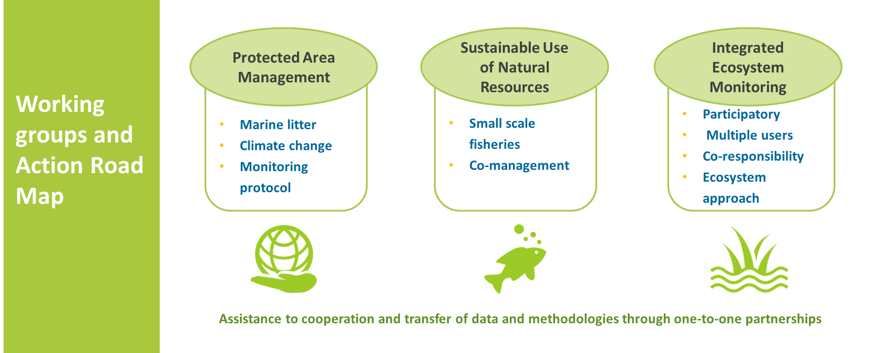
Action Plan 2016-2019
Notes:
DPSIR
Environmental and socio-economic harm

Slide 6
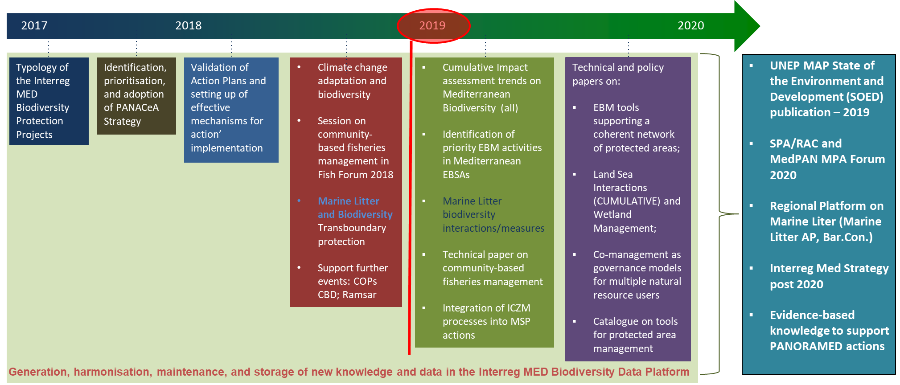
Actions and Outlook
Notes:
In terms of MPAs status and functioning:
do we have enough knowledge on the biodiversity, habitats and the pressures impacting on them?
Is this information adequately considered in the management practices?
1. introduction to the topic
2. how this was handled in the cohenet contract
3. your reflections from own research
4. conclusions and lessons learned

Slide 7
Main achievements
Joint Policy Brief & Factsheet
Content: Consolidation of knowledge and tools generated by the community pinpointing most pressing need and gaps to be addressed by EU and Med Policy and Frameworks.
MPA perspective.
Factsheet & DB: Impact of ML on aquatic life
Content: Update of the ML biodiversity interactions database and report on state of the art. Classifications (ej. EUNIS, Ecosystem functions, Pressures, Categories, Indicators) and Spatial Analysis.
Mediterranean Sea perspective
Notes:
In terms of MPAs status and functioning:
do we have enough knowledge on the biodiversity, habitats and the pressures impacting on them?
Is this information adequately considered in the management practices?
1. introduction to the topic
2. how this was handled in the cohenet contract
3. your reflections from own research
4. conclusions and lessons learned

Slide 8
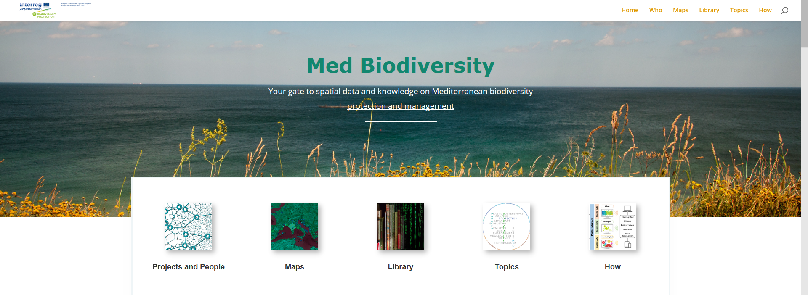
The Mediterranean BP knowledge platform
BIODIVERSITY.UMA.ES
Biodiversity
Cumulative pressures
Marine Litter
MedBioLitter DB
Coastal and marine tourism
Fisheries and aquaculture
Climate change
Marine Protected Areas
Maritime transport

Slide 9
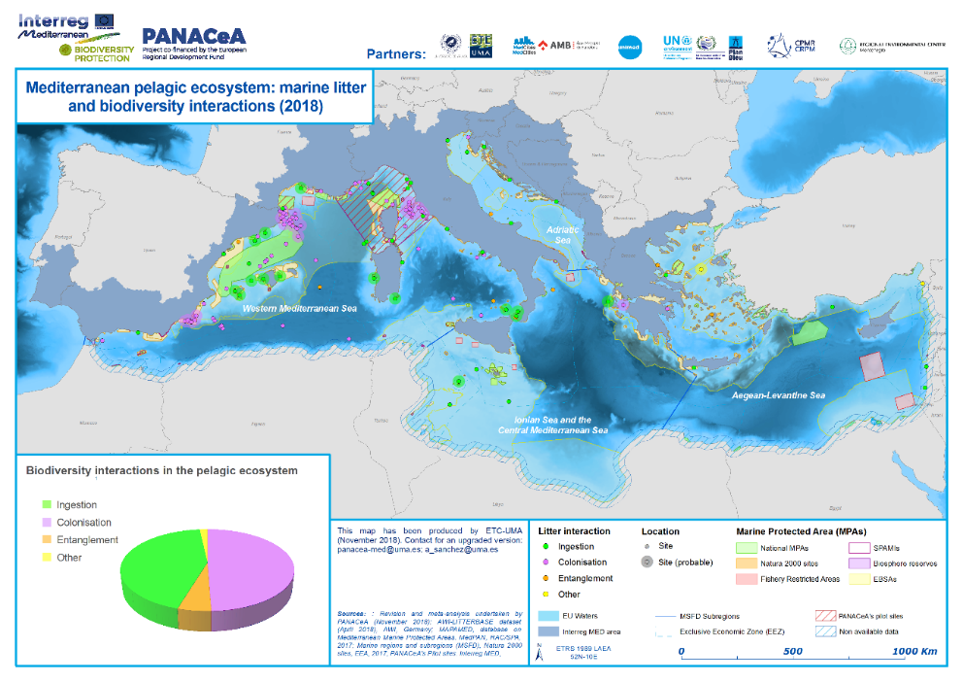
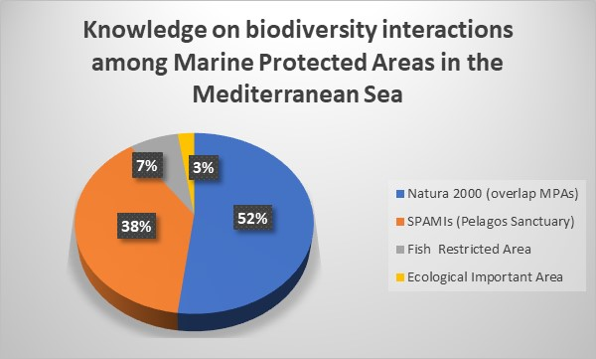
The Mediterranean BP knowledge platform
BIODIVERSITY.UMA.ES
Meta-analysis on presence of ML (pressure) and link with biodiversity (latest update February 2019) – Peer reviewed articles & categories in compliance with the global litterbase
Location | Ecoregion | Habitat type | Tax. group | Species name & classification | Conservation status | Trophic level | Type of litter | Type of Impact | Policy relevance (MSFD, IMAP) | Title | Authors | doi | Date
Notes:
The interactions between marine litter and organisms are classified by PANACeA in four categories for the developed work on georeferenced, spatial assessment and meta-analysis from literature data sources:
Ingestion – plasticized animal species
entanglement,
colonization and others.
This classification follows the original approach by the AWI-LITTERBASE Project (https://litterbase.awi.de) from the Alfred Wegener Institute (AWI, Germany); which matches with international frameworks in general terms, such as the reported categories proposed in the review and synthesis work undertaken by the Convention on Biological Diversity (CBD, 2012 and 2016).

Slide 10
Thank you for your attention
For more information
Dania Abdul Malak
ETC-UMA Director
daniaabdulmalak@uma.es
www.etc.uma.es
Notes:
To adapt

