Slide 1
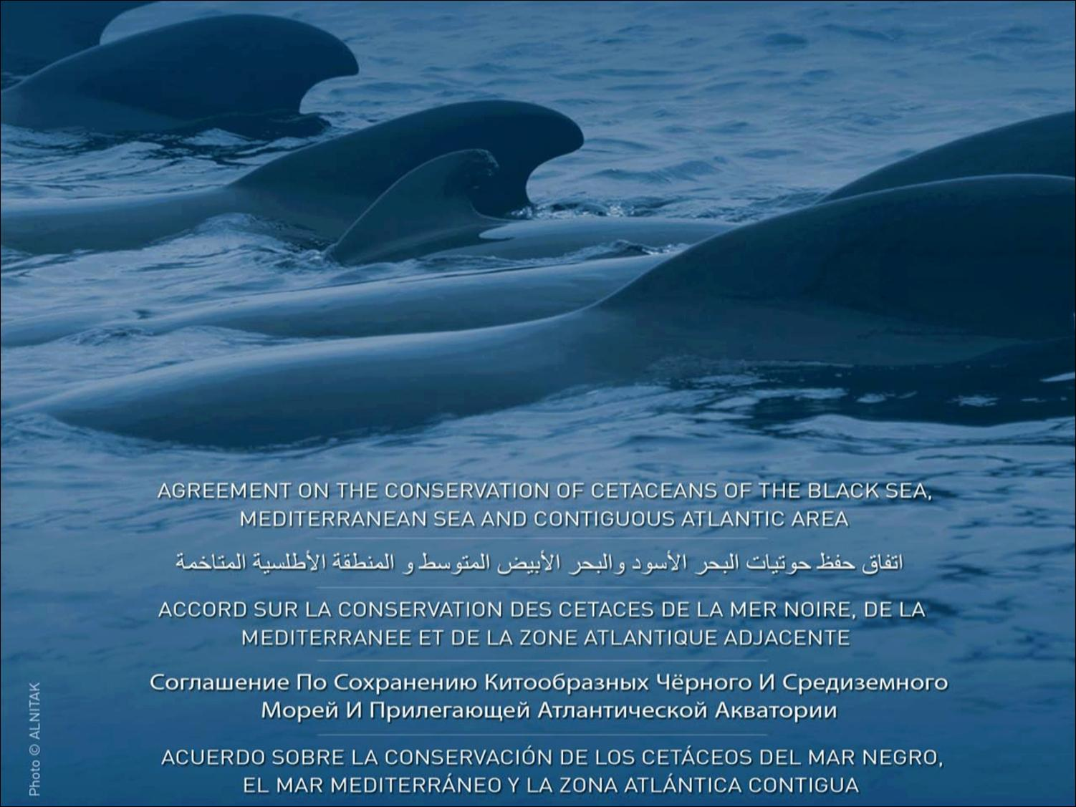

ACCOBAMS Survey Initiative
- Preliminary results on marine litter -
CORMON Meeting on Marine Litter
Podgorica, Montenegro, 4-5 April 2019

Slide 2

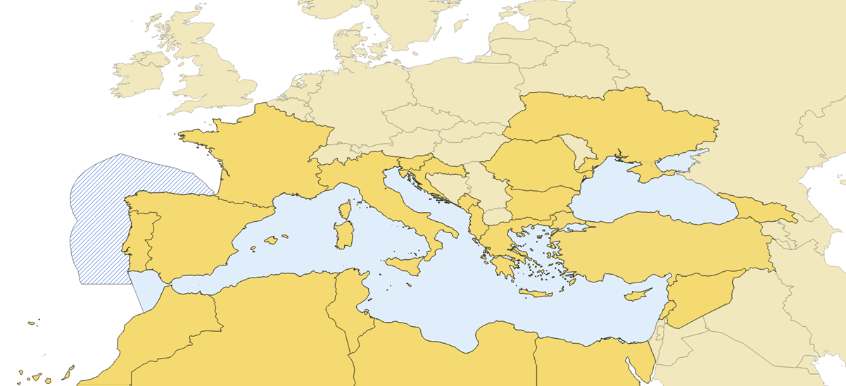


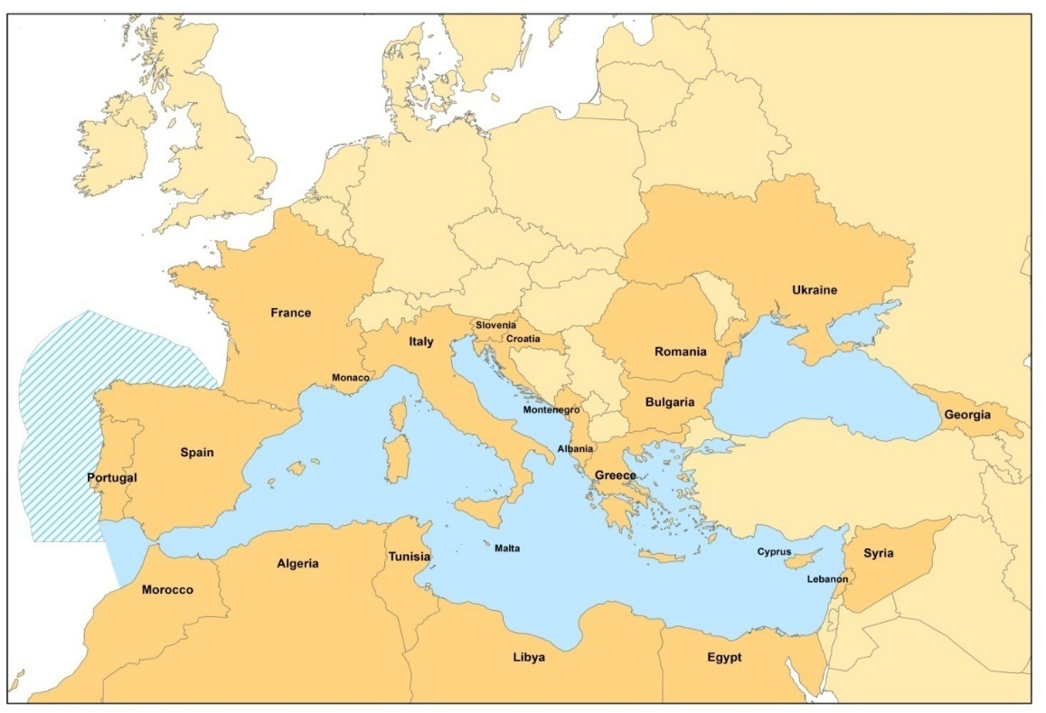


ACCOBAMS
Agreement on the Conservation of Cetaceans of the Black Sea, Mediterranean Sea and contiguous Atlantic Area
Established under the aegis of the UNEP/CMS Convention on
Migratory Species
September 2018
24 Parties to ACCOBAMS
The designations employed and the presentation of the information on this document do not imply the expression of any opinion whatsoever on the part of ACCOBAMS concerning the legal status of any country, territory, city or area or of its authorities, or concerning the delimitation of its frontiers or boundaries.
Notes:
The Agreement Area represents all the maritime waters of the Black Sea, the Mediterranean and the contiguous Atlantic area west of the Straits of Gibraltar.
24 countries over the 27 riparian states are members of the ACCOBAMS

Slide 3

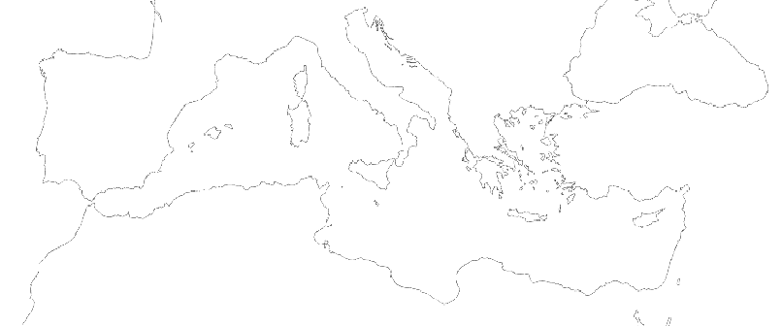
“ACCOBAMS SURVEY INITIATIVE” PROJECT
THE FIRST CETACEAN LARGE-SCALE SURVEY
IN THE MEDITERRANEAN
June – August 2018

Slide 4


THE ACCOBAMS SURVEY INITIATIVE
Main objective:
To establish a baseline for cetacean populations abundance and distribution, at the Mediterranean sea and black sea macro regional level, and ensure their long-term monitoring
support to the countries to meet their international and regional commitments (IMAP implementation, EU MSFD & Habitat Directives…)
Coordinated by the ACCOBAMS Secretariat, in coordination with all riparian countries, and with the support of many national partners
Funded by: France, Italy, Monaco, Spain and private funders (MAVA Foundation, Prince Albert 2 Foundation, IFAW)
Duration: 4 years (2016 – 2020)

Slide 5

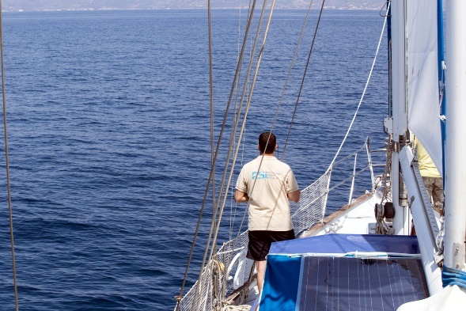
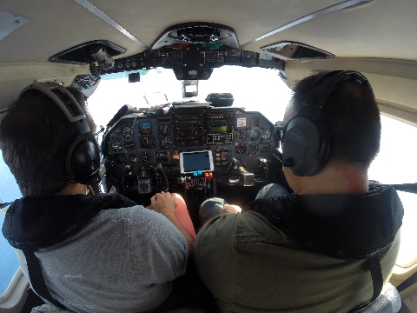
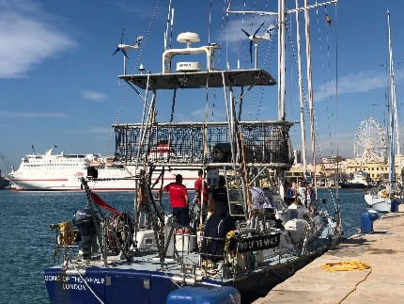
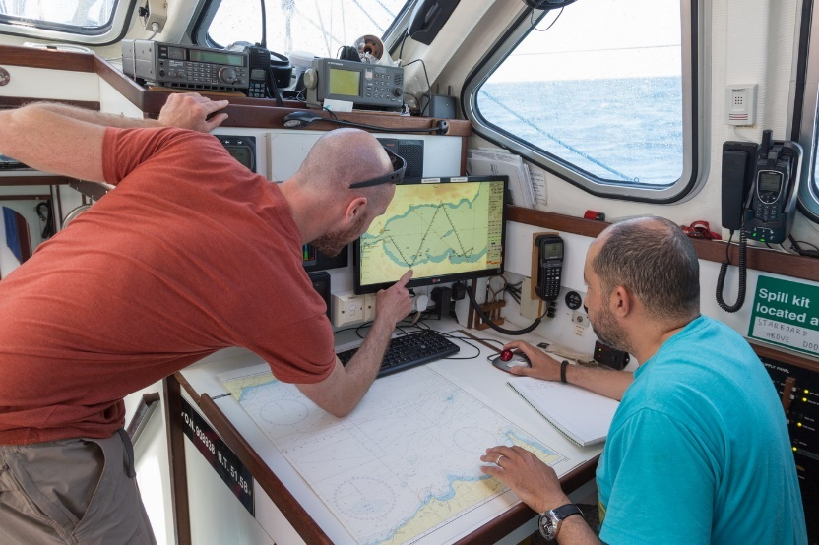
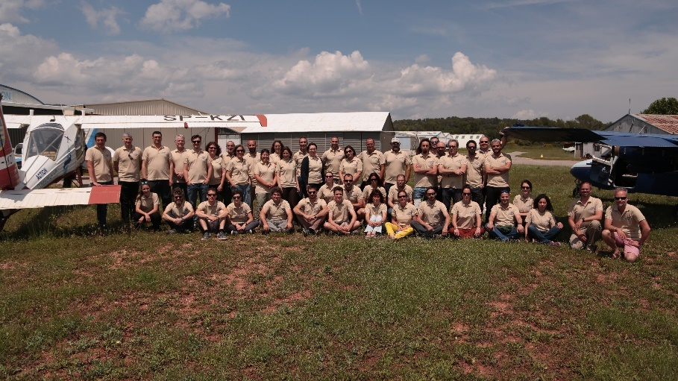
A coordination challenge
8 planes
5 research vessels
90 observers
-> Visual observations
-> Passive Acoustic Monitoring with vessels
© ACCOBAMS
© Saley Dyriag/ACCOBAMS
© Mathieu Cellard/ACCOBAMS
© MCR/ACCOBAMS
© Mathieu Cellard/ACCOBAMS

Slide 6
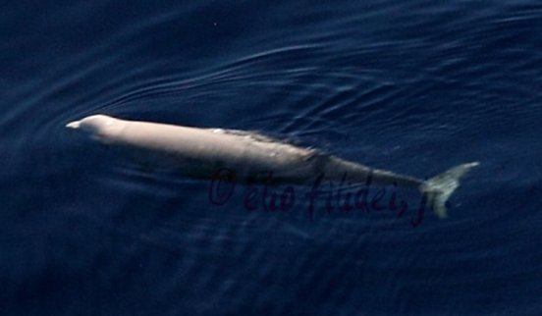
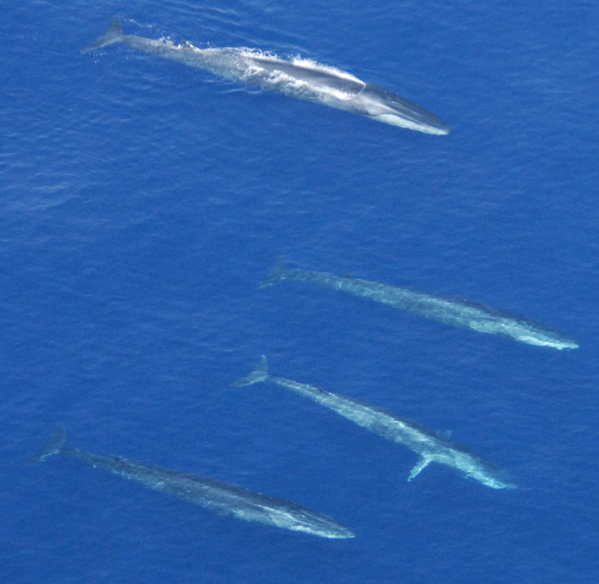
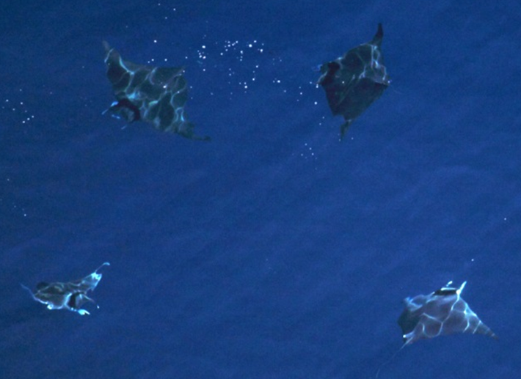
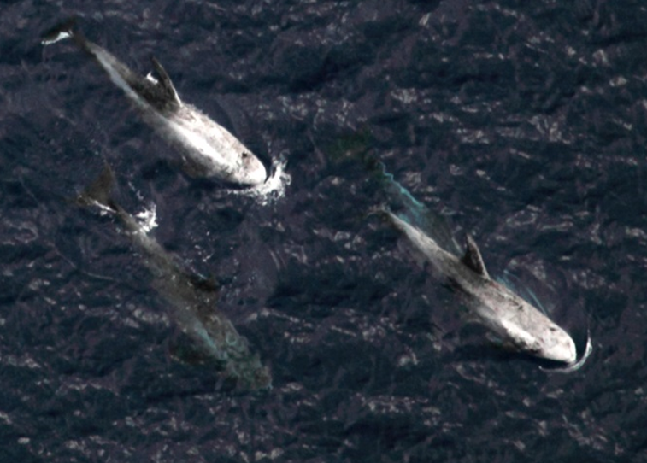
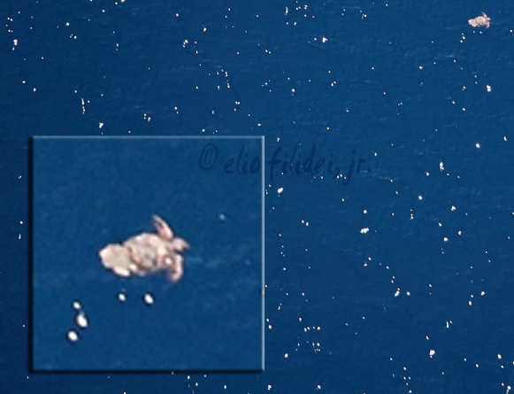
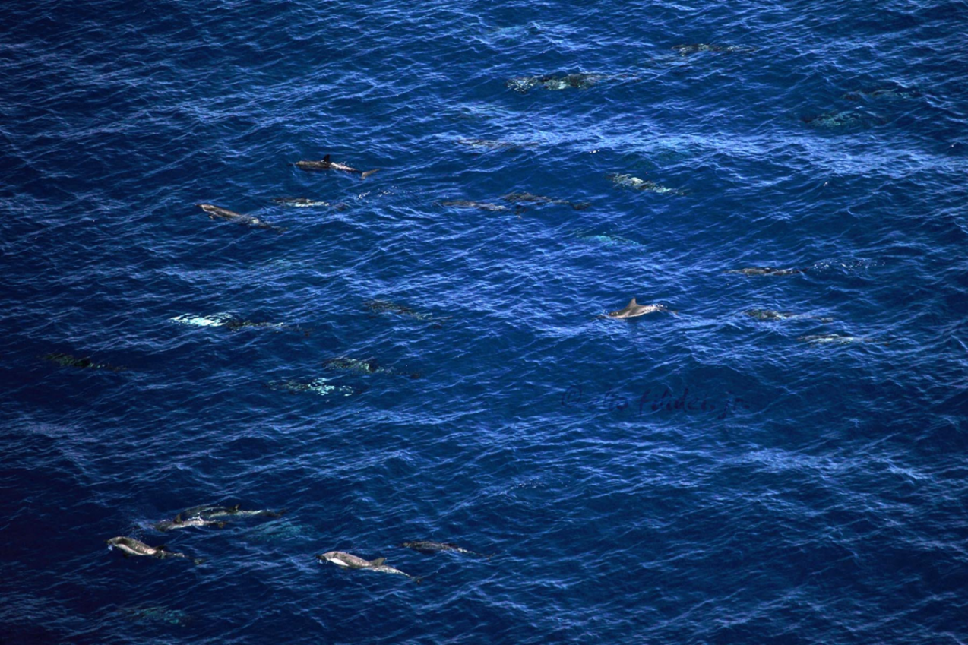
Multi species approach & other items
Copyright: Elio Filidei ; Giancarlo Lauriano, ISPRA

Slide 7
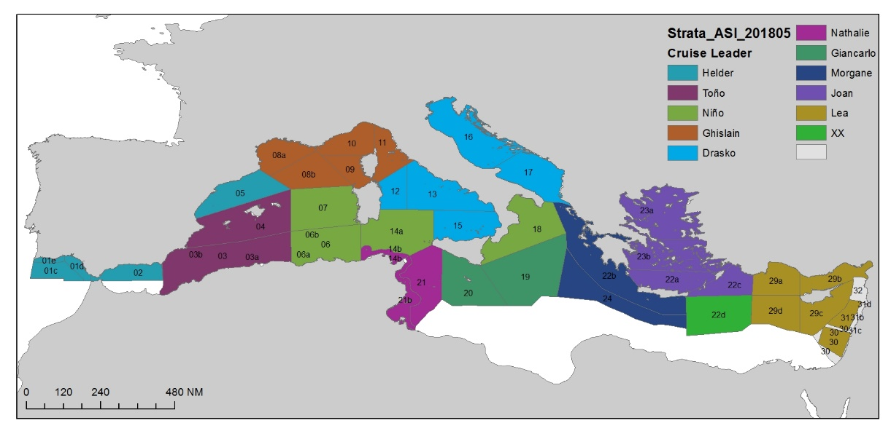
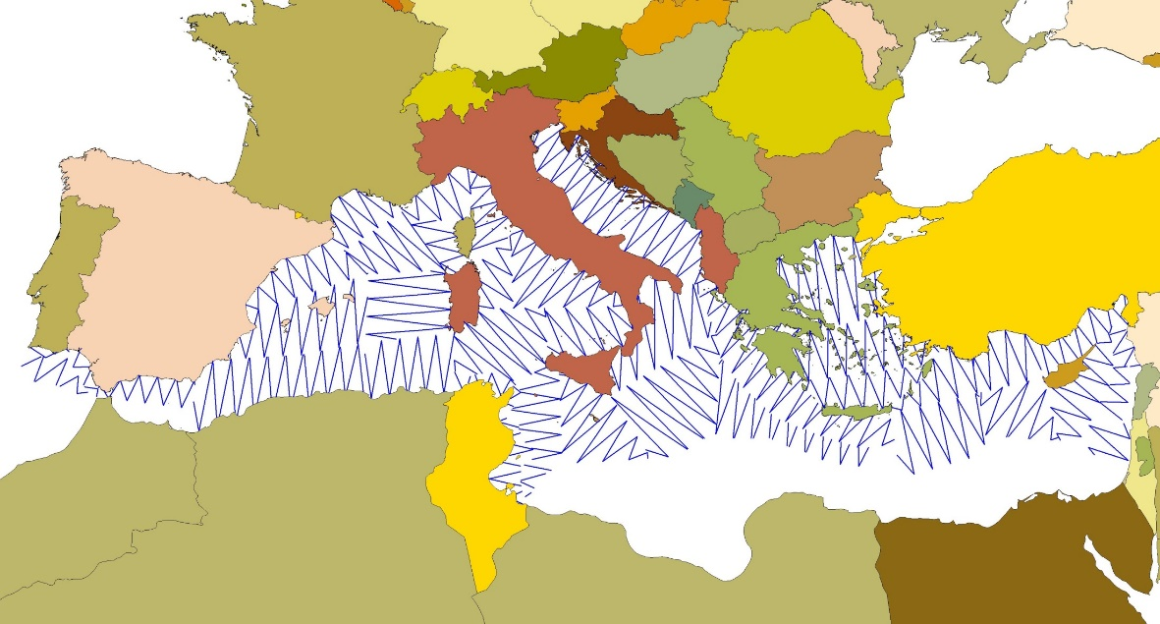
ASI aerial component
planned effort
Line Transect Distance sampling for cetaceans and turtles; design ensuring 3% coverage of the area
Strip transect for seabirds, large fishes and floating marine litter
31 blocks defined, 8 Planes
  40 observers & Team Leaders
  70 000 km of effort
  800 hours flight

Slide 8
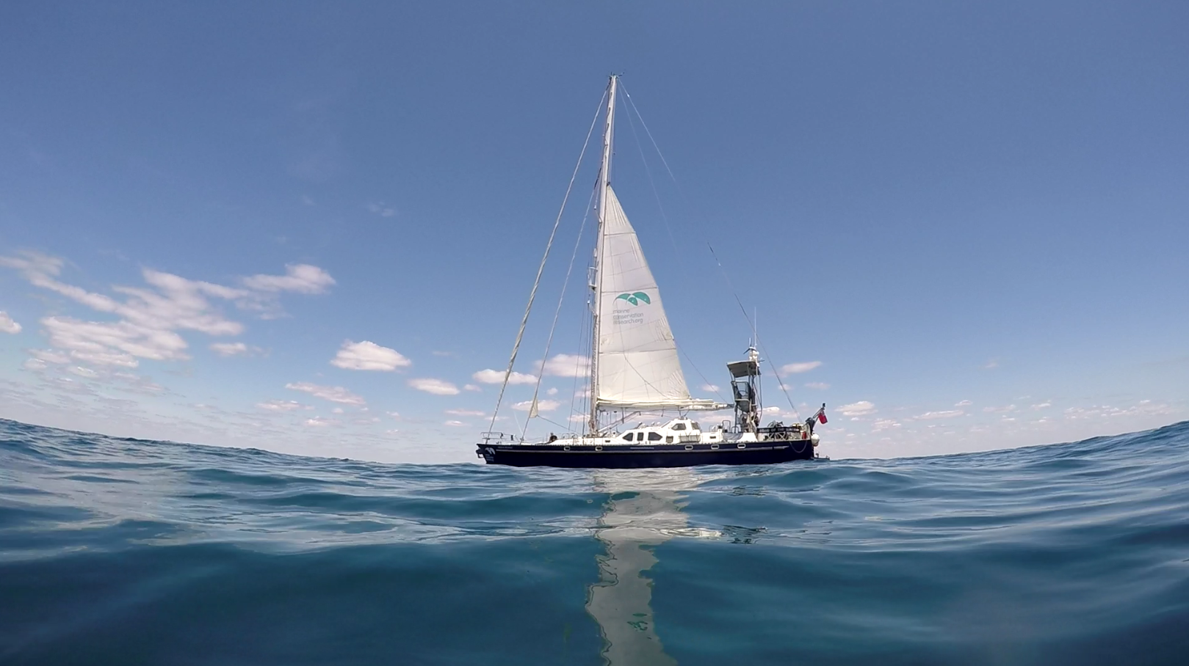

N/R SONG THE WHALE
Passive Acoustic Monitoring (PAM)
Visual observations (including marine litter)
Opportunistic microplastic sampling (in collaboration with 5Gyres)

Slide 9
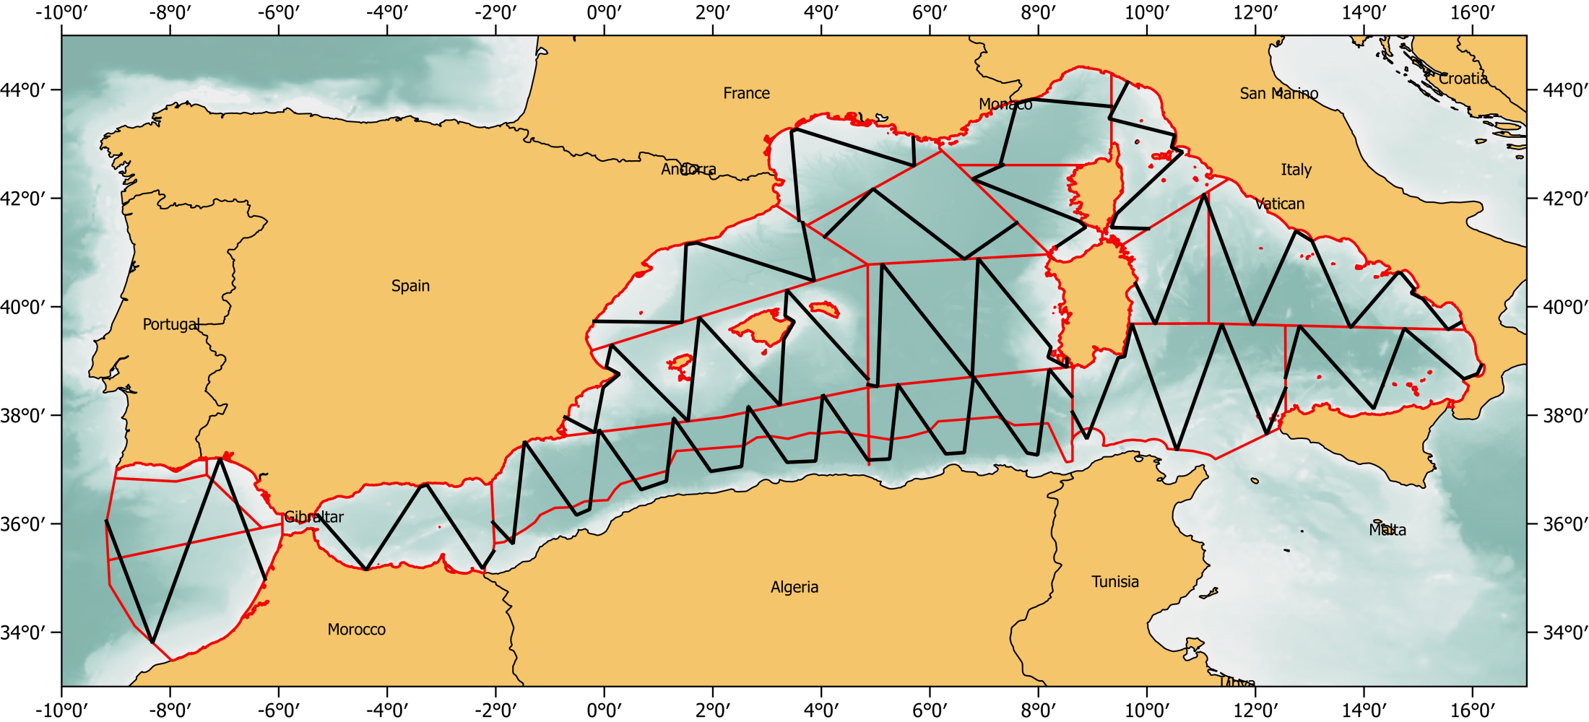
Boat-based campaign
SOTW planned effort
+ Hellenic Trench
+ Off shore Libya
+ finalisation Algeria
© MCR for ACCOBAMS
13,586 km of transects
+ Hellenich Trench
+ Lybian offshore waters

Slide 10
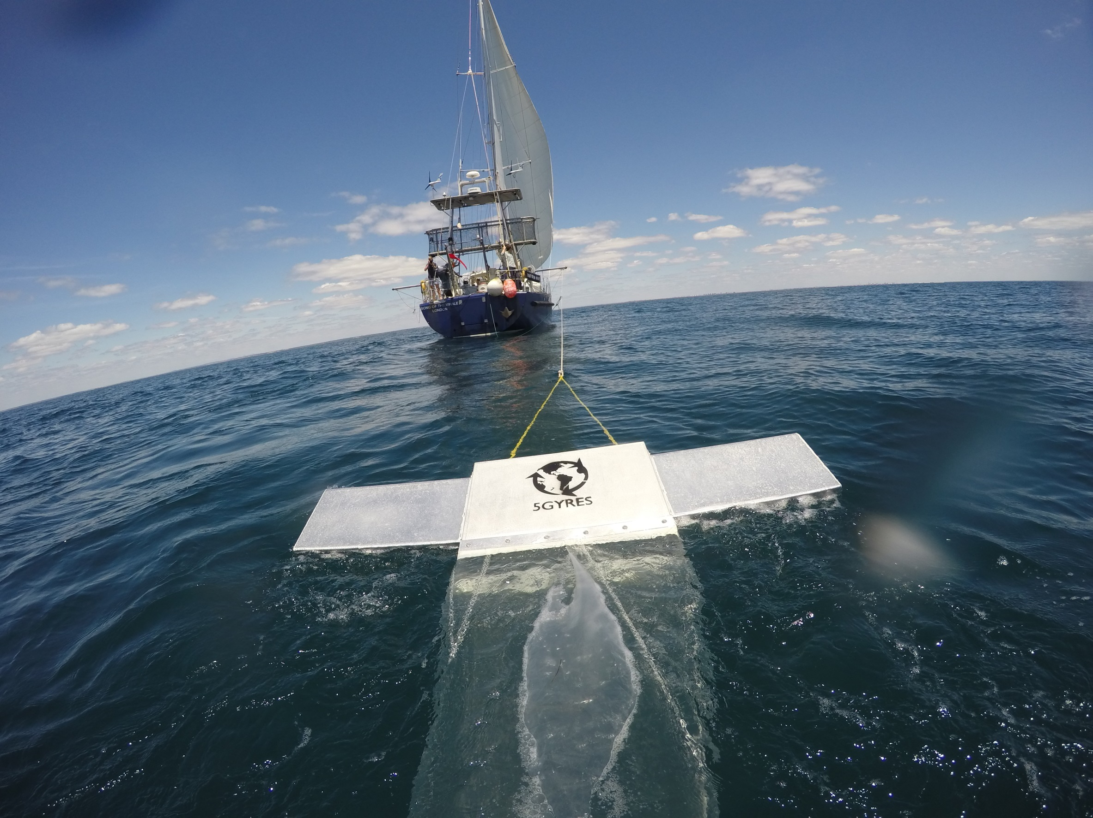
© MCR for ACCOBAMS

Slide 11

ASI aerial component
planned effort
The designations employed and the presentation of material in this publication do not imply the expression of any opinion whatsoever on the part of ACCOBAMS concerning the legal status of any country, territory, city or area or of its authorities, or concerning the delimitation of its frontiers or boundaries.

Slide 12
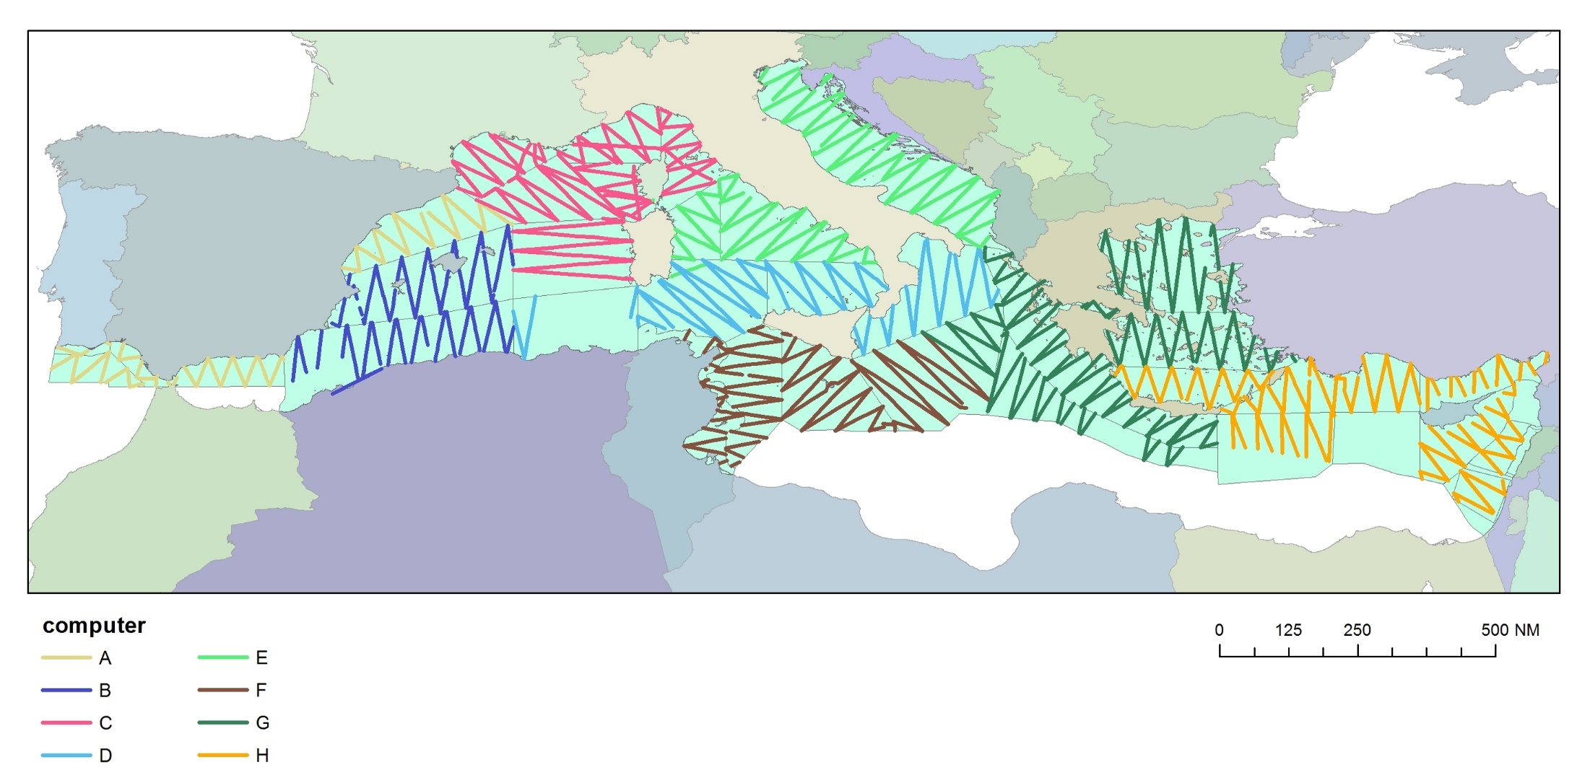
ASI aerial component
Effort carried out
© ACCOBAMS
Note: This map shows the aerial effort made during the ASI campaign. The different colors of transects correspond to the different teams involved. The areas appearing white are covered by boat.
For reasons of logistical or technical constraints, some areas could not be overflown.

Slide 13
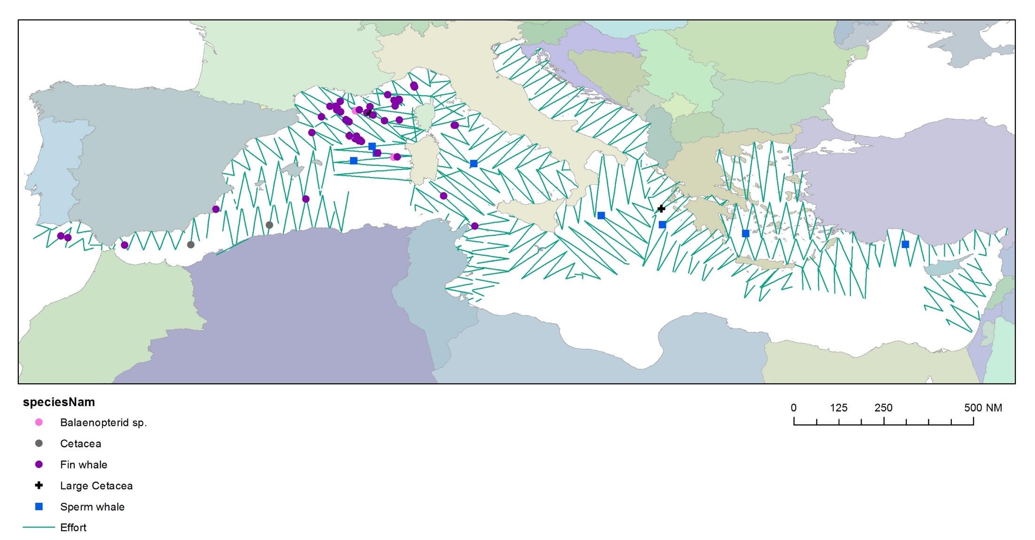
AERIAL SURVEY
Large cetaceans
© ACCOBAMS
Fin whales have been regularly sighted in the Ligurian Sea, Gulf of Lions and Gulf of Cadiz.
Sperm whales have been sighted along the Hellenic Trench and in the offshore waters of the Sardinia Sea.
One rare sighting of a minke whale occurred close to the Balearic Islands.
The Strait of Gibraltar offered a great sighting of killer whales.
Notes:
Fin whales have been regularly sighted in the Ligurian Sea, Gulf of Lions and Gulf of Cadiz. Sperm whales have been sighted along the Hellenic Trench and in the offshore waters of the Sardinia Sea. One rare sighting of a minke whale occurred close to the Balearic Islands. The Strait of Gibraltar offered a great sighting of killer whales.

Slide 14
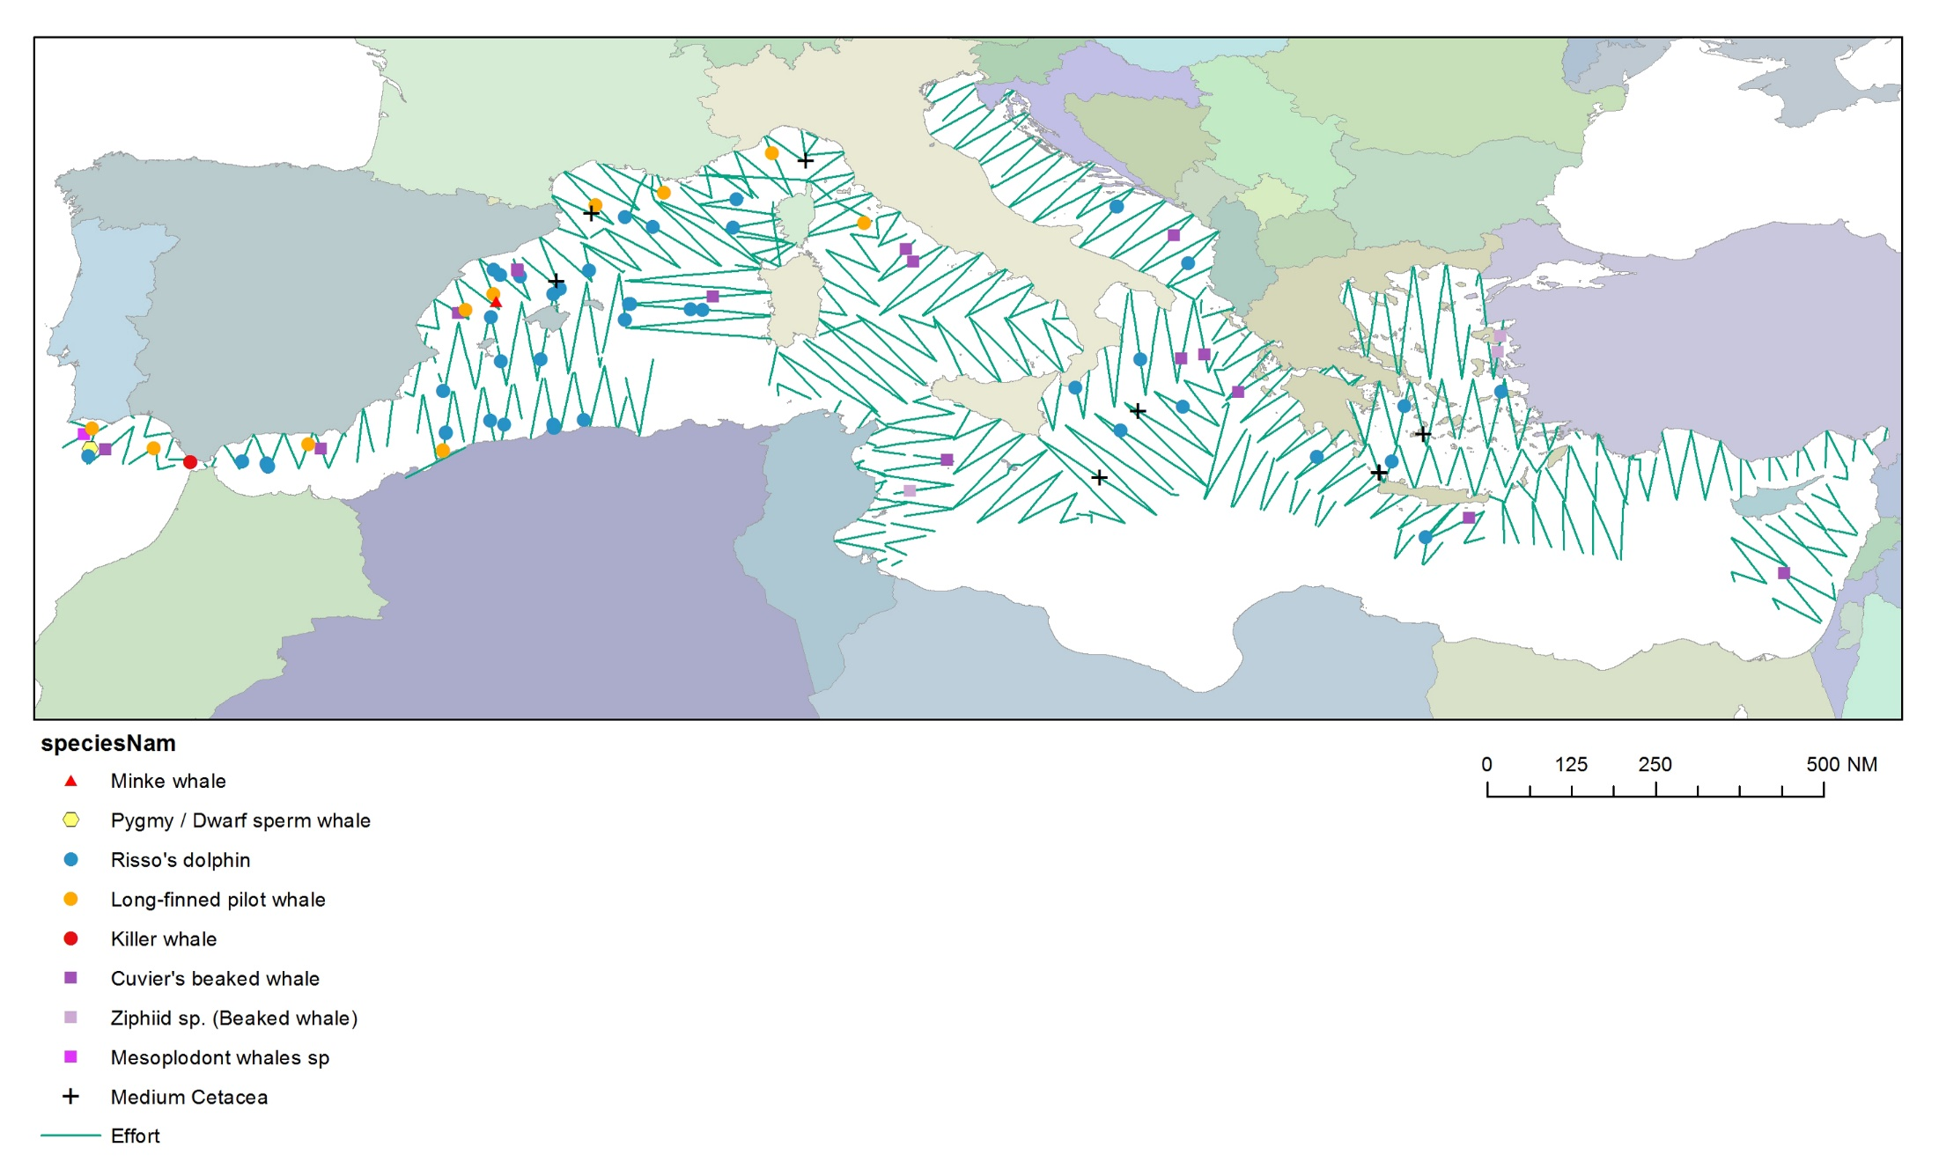
AERIAL SURVEY
Medium sized cetaceans
© ACCOBAMS
Risso’s dolphins have been sghted more offshore than originally expected for a species which prefers slope areas.
Pilot whales have been observed all along the Western Mediterranean, more in the northern portion, while Cuvier’s beaked whales have been mostly sighted in canyon areas, as expected.
Notes:
Risso’s dolphins have been sghted more offshore than originally expected for a species which prefers slope areas. Pilot whales have been observed all along the Western Mediterranean, more in the northern portion, while Cuvier’s beaked whales have been mostly sighted in canyon areas, as expecyed.

Slide 15
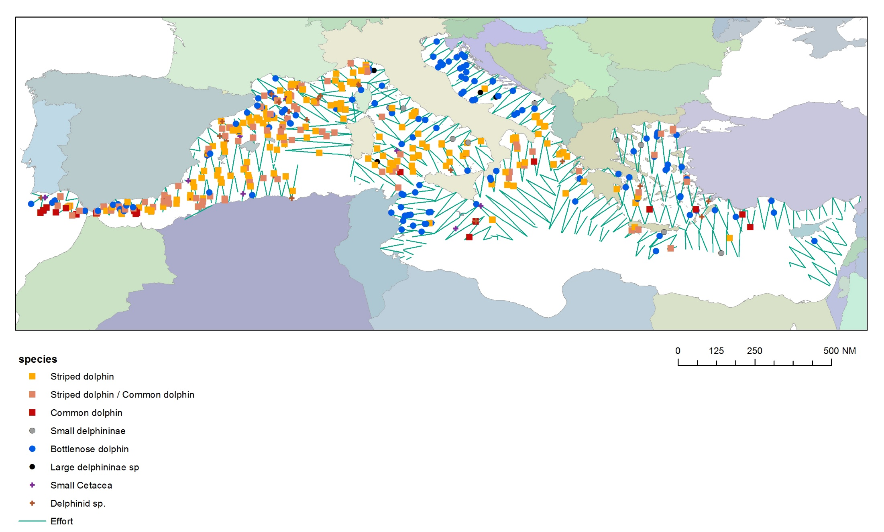
AERIAL SURVEY
Small cetaceans
© ACCOBAMS
Common dolphins have been mostly sighted in the Western portion of the Basin and in the Strait of Sicily.
Bottlenose dolphins appear to be very common in the northern portion of the Adriatic Sea, in the Strait of Sicily and along the coast, with some sighting more offshore.
Striped dolphins are mostly distributed in the offshore waters and appear to be the most abundant species.
Notes:
Common dolphins have been mostrly sighted in the Western portion of the Basin and in the Strait of Sicily. Bottlenose dolphins appear to be very common in the northern portion of the Adriatic Sea, in the Strait of Sicily and along the coast, with some sighting more offshore. Striped dolphins are mostly distributed in the offshore waters and appear to be the most abundant species.

Slide 16
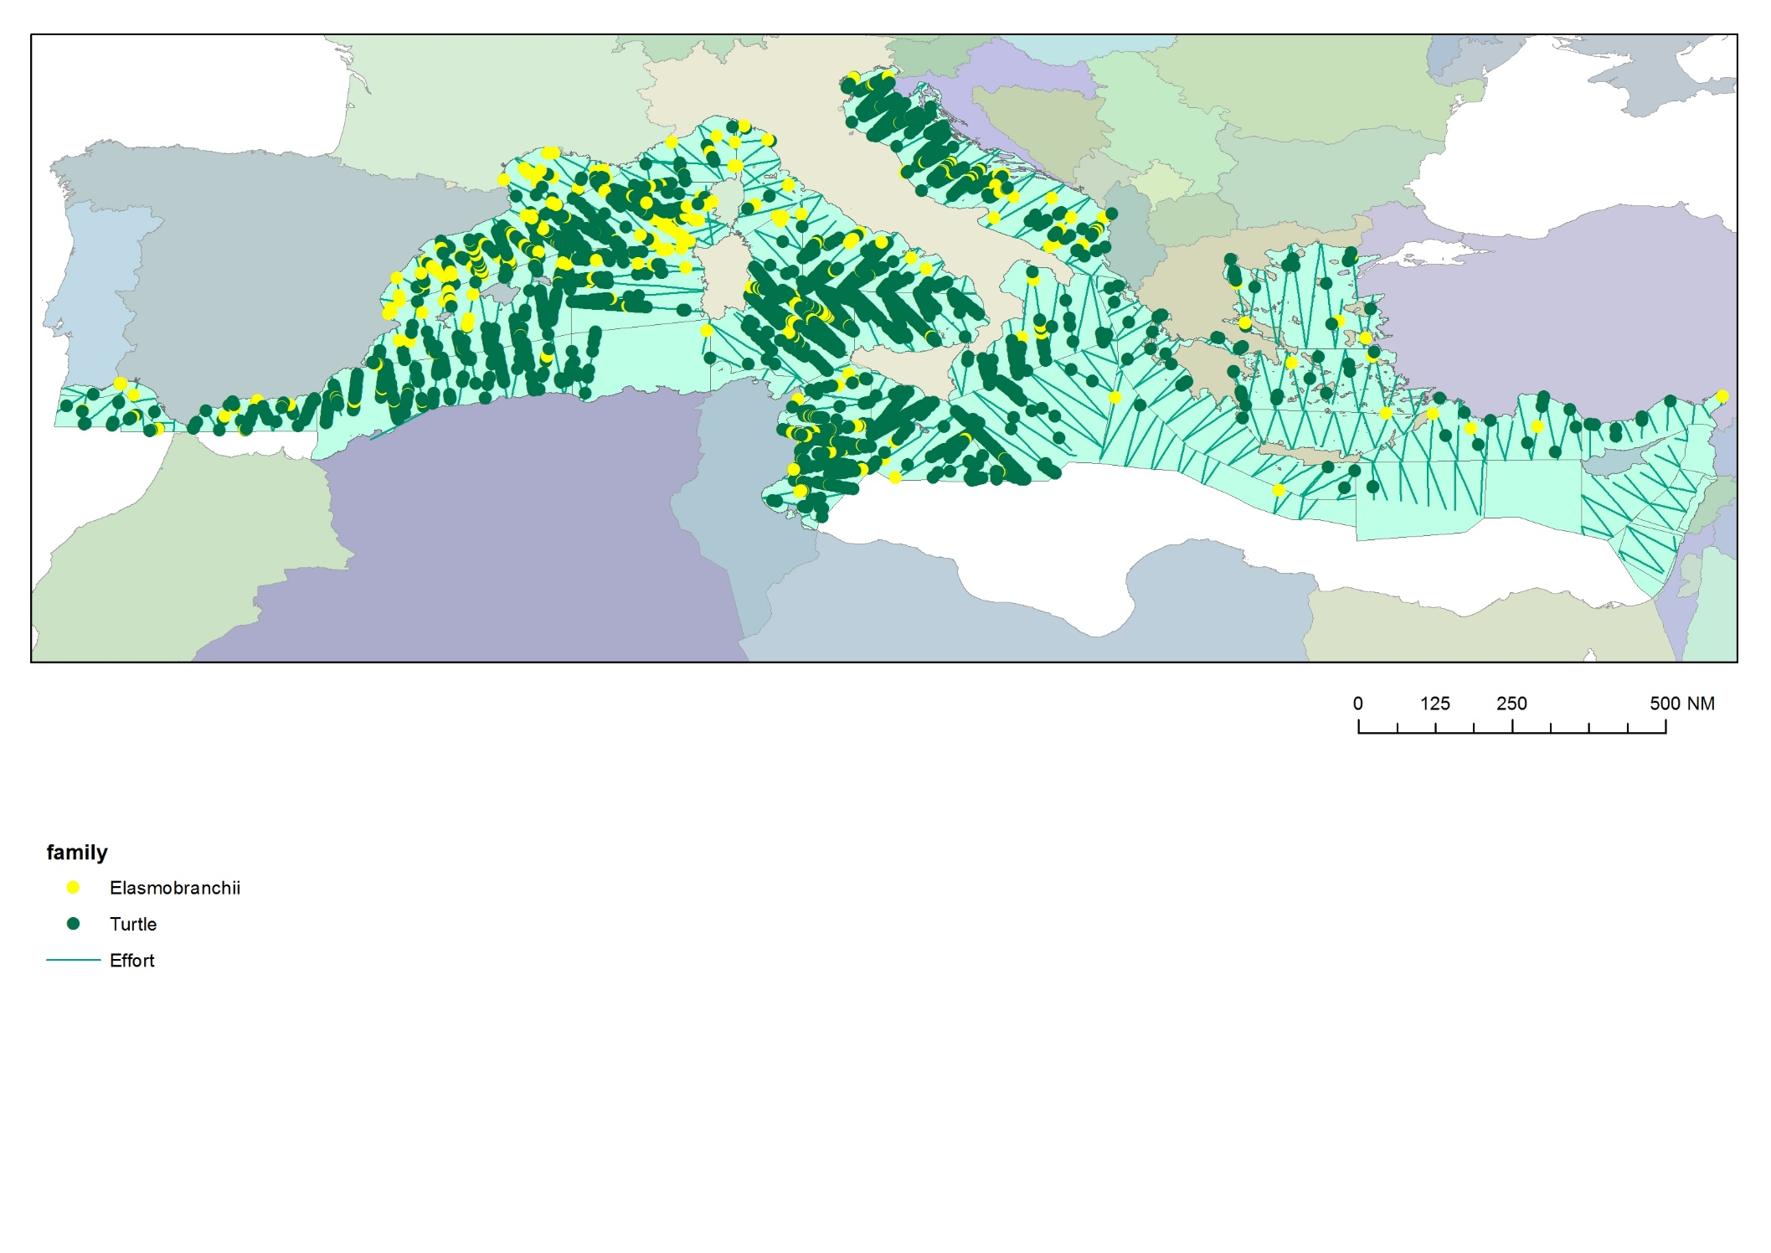
AERIAL SURVEY
Sea turtles and Elasmobranches
© ACCOBAMS
Large marine megafauna has been regularly observed during the flights, with a predominance of turtles, Atlantic sun fishes and giant devil rays, confirming how these species are frequent and abundant throughout the Mediterranean Basin.
© S. PANIGADA for ACCOBAMS
Les tortues marines ont été régulièrement observées durant les vols, confirmant la fréquence et l'abondance de cette espèce
dans tout le bassin méditerranéen.
Notes:
Large marine megafauna has been regularly observed during the flights, with a predominance of turtles, Atlantic sun fish and giant devil rays, confirming how these species are frequesnt and abundant throughout the Mediterranean Basin.

Slide 17
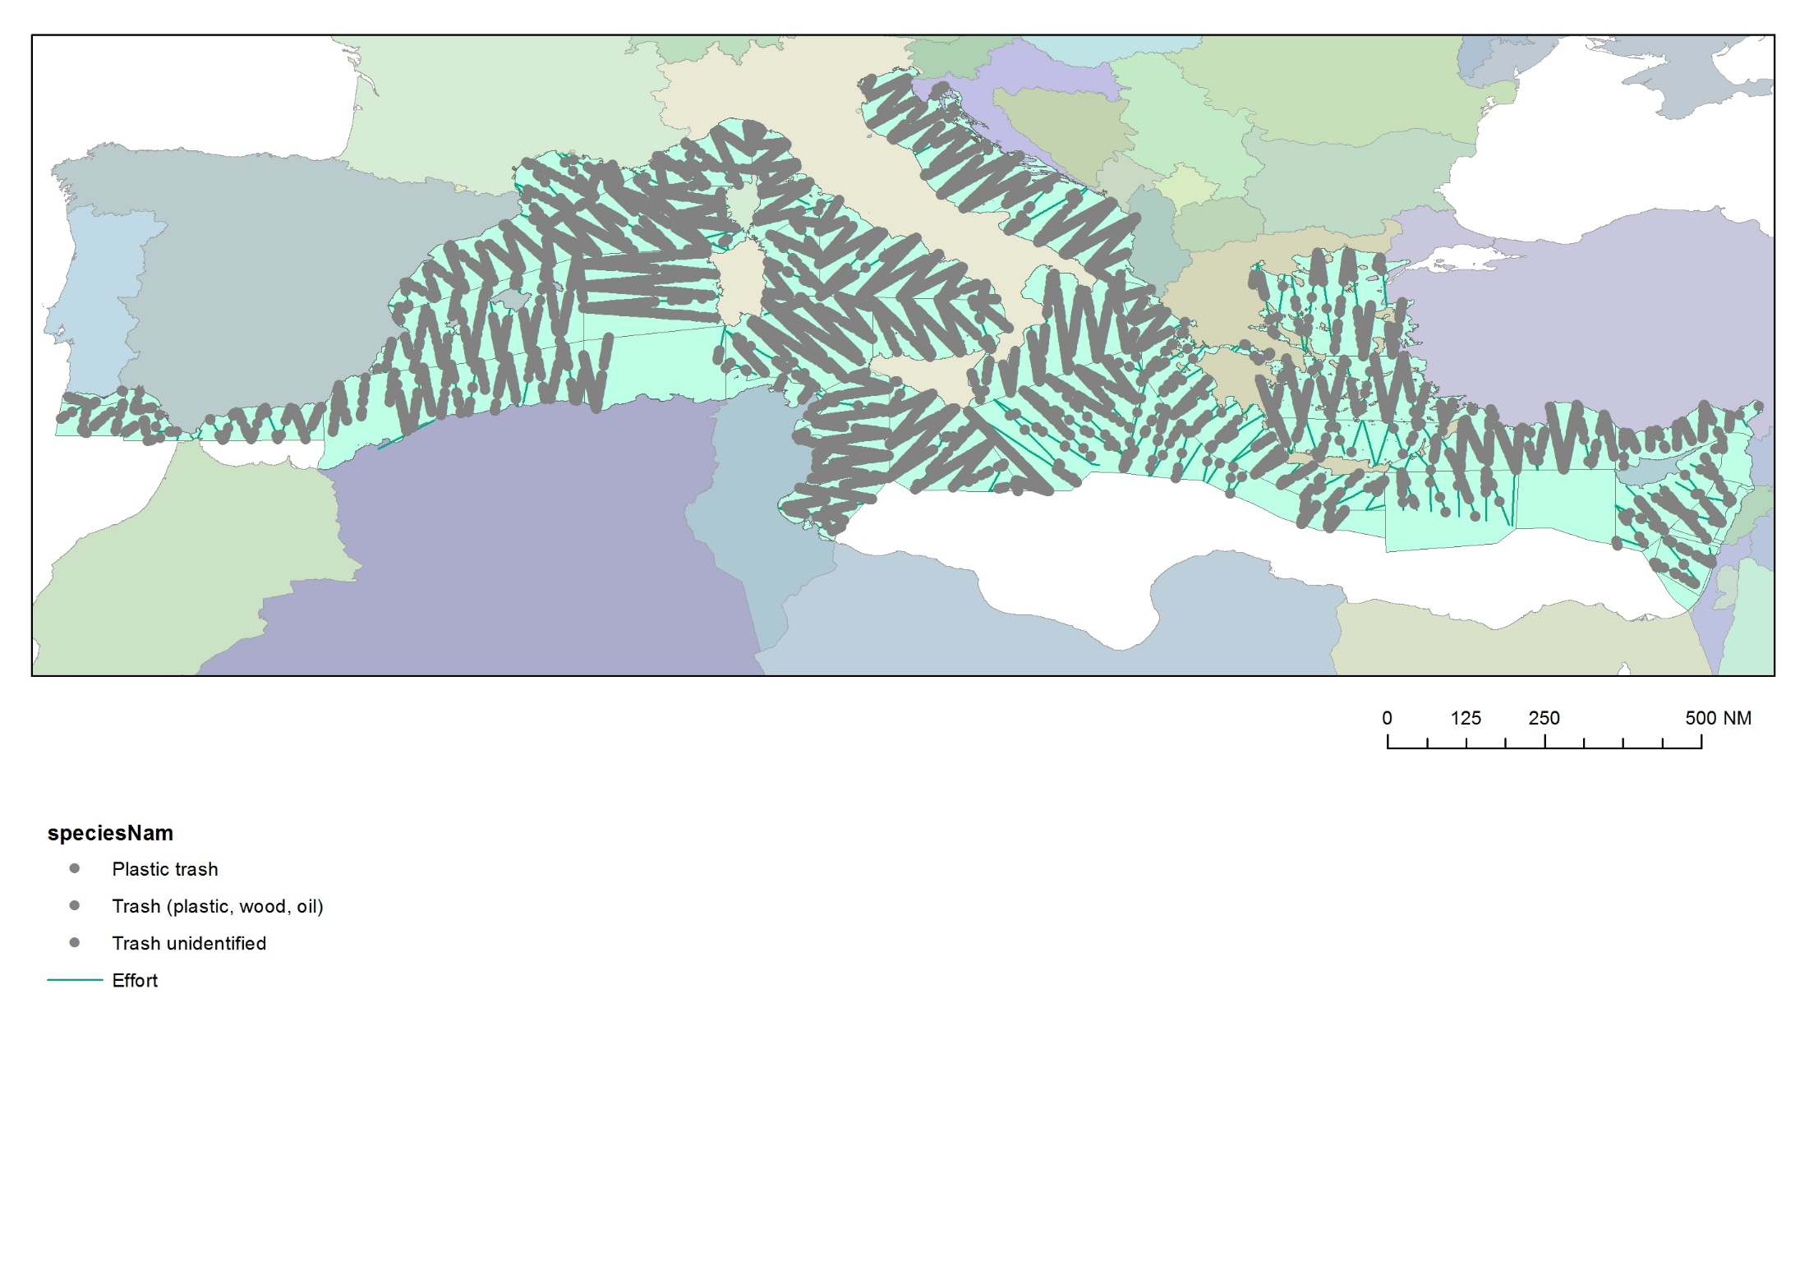
AERIAL SURVEY
Marine litter – plastic and other
more than 11 000 items
© ACCOBAMS
Data collected : number and type of Marine litter (plastic, wood, fishing, indetermined), size > 30 cm. In some areas : Color and 3 categories of sizes (small, medium, large).
Data are being pre-treated to correct the sighting biases between the teams. Dataset will be available in Mai/June 2019.
Notes:
Marine litter, here represented by plastic and general trash is widely distributed in every area of the Mediterranean Sea and unfortunately resulted to be the most sighted item.

Slide 18
Next steps
ASI DATA ANALYSIS - SCHEDULE
First results on cetaceans distribution and abundance available in Sept 2019
ASI Special Event just before MOP7 (on 4 November 2019)
3 sub-regional workshops (end of 2019 and 1st semester 2020)
Consolidated final report available in Autumn 2020
Workshop for interpreting the results & recommendations (end of 2020)
ASI DATA AVAILABILITY & USE - PROPOSALS
ASI Contact group members and ACCOBAMS Focal Points to be consulted

Slide 19
Next steps
ASI DATA ANALYSIS - SCHEDULE
First results on cetaceans distribution and abundance available in Sept 2019
ASI Special Event just before MOP7 (on 4 November 2019)
3 sub-regional workshops (end of 2019 and 1st semester 2020)
Consolidated final report available in Autumn 2020
Workshop for interpreting the results & recommendations (end of 2020)
ASI DATA AVAILABILITY – PROPOSALS
COLLABORATIONS!!!
Data are available at the ACCOBAMS Secretariat level upon request
Exchange data will be made publicly available for the ASI Special Event in November 2019
Raw data will be made available upon request

Slide 20
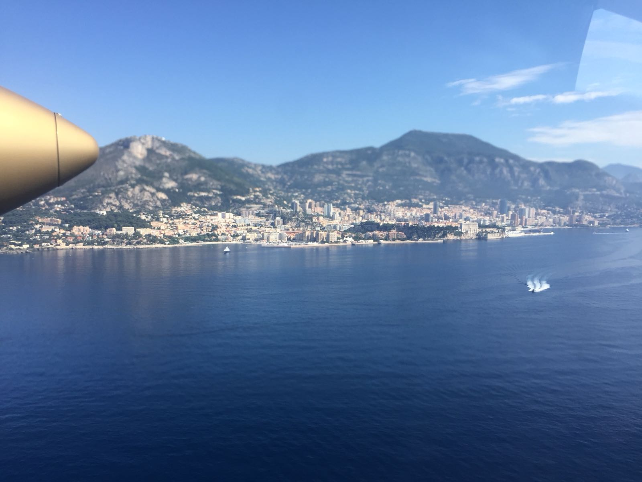


@ACCOBAMS
ACCOBAMS – Dolphin & Whale Conservation
www.accobams.org
© G. Dorémus pour ACCOBAMS

