Slide 1
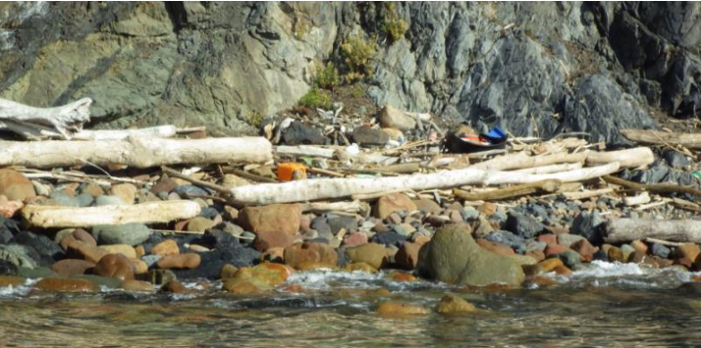
MONITORING AND ASSESSMENT GUIDELINES FOR MARINE LITTER IN MEDITERRANEAN MPAS
INTERREG/ MED, project AMARE
Galgani F., A. Deidun, S. Liubartseva, A. Gauci, B. Doronzo, C.Brandini, O.Gerigny

Slide 2
AMARE (CoNISMa, 5 MPAs, CMCC, CNR-ISMAR, University of Malta, NRC, HCMR, IFREMER)
- To develop shared methodologies and geospatial tools for multiple stressors assessment, coordinated environmental monitoring, multi-criteria analyses and stakeholders' engagements.
- To develop concrete pilot actions and coordinated strategies in selected Marine Protected Areas (MPAs)
MARINE LITTER in AMARE : Cases studies, guidelines, protocols (entanglement)
A Report building on MSFD, UN MAP/ IMAP and GESAMP guidelines
1. INTRODUCING THE MONITORING AND ASSESSMENT GUIDELINES FOR MARINE LITTER IN THE
MEDITERRANEAN MARINE PROTECTED AREAS
2. MONITORING AND ASSESSMENT METHODOLOGICAL GUIDANCE FOR MARINE LITTER IN MARINE
PROTECTED AREAS
3. NEW TOOLS FOR MONITORING MARINE LITTER IN MPAS (CASE STUDIES)
4. RECOMMENDATIONS AND PERPECTIVES

Slide 3
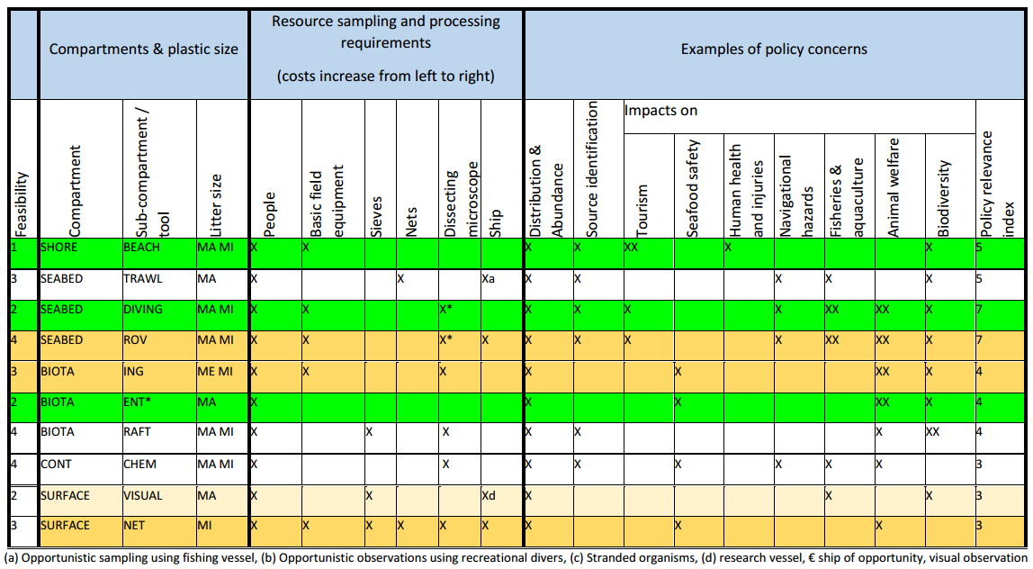
RECOMMENDATIONS (After GESAMP, 2019)

Slide 4
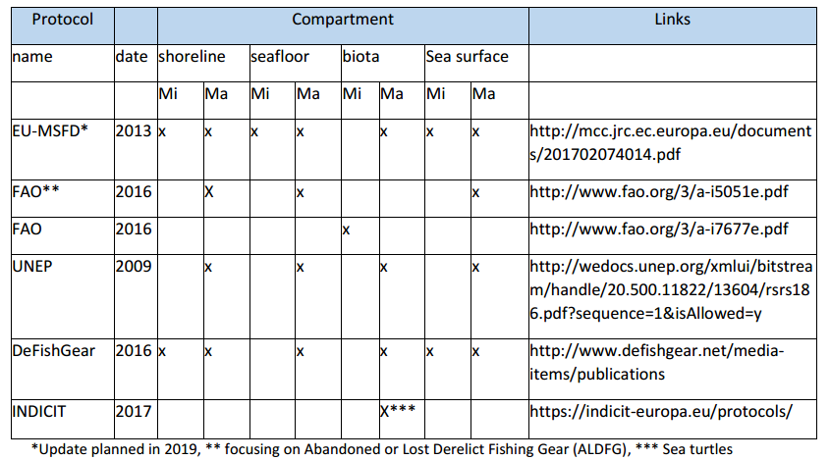
AVAILABLE PROTOCOLS

Slide 5
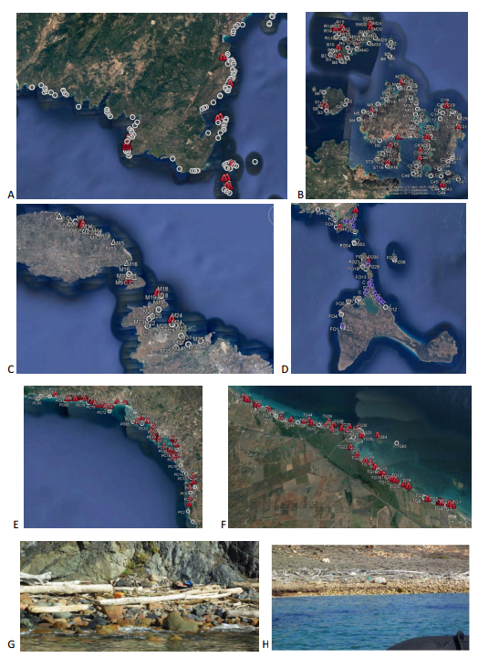
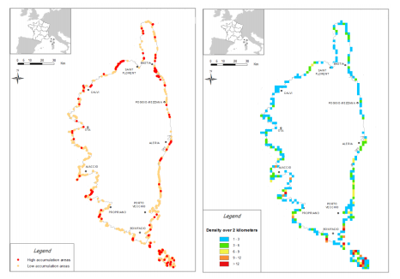
A protocol for mapping litter accumulation along the coastlines

Slide 6
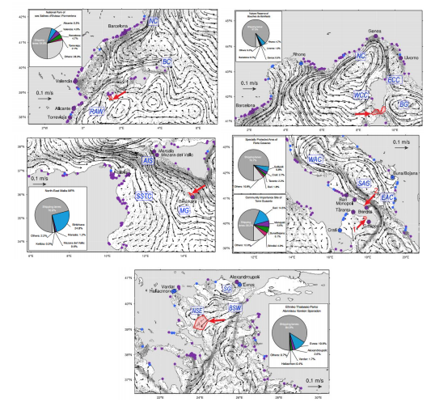
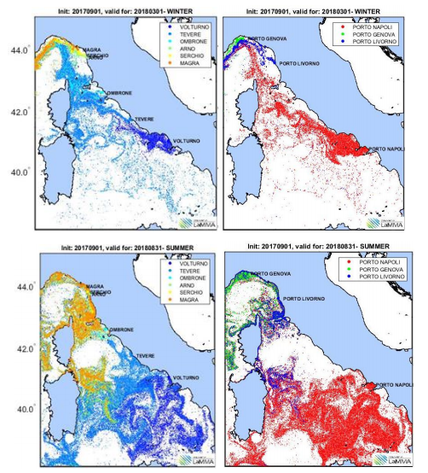
Modelling the transport of marine litter in MPAs

Slide 7
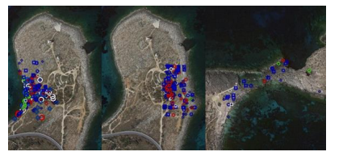
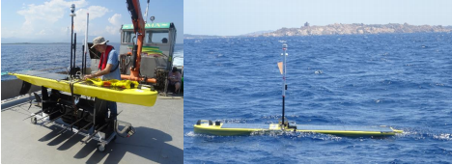
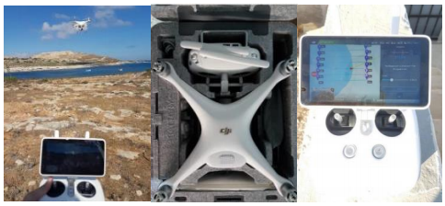
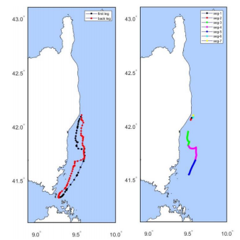
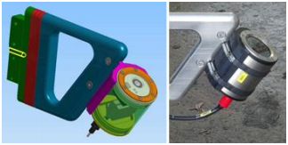
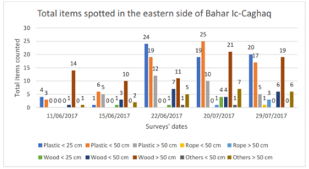
NEW TOOLS FOR MONITORING MARINE LITTER
Aerial surveys / Drones
Wave-glider

Slide 8
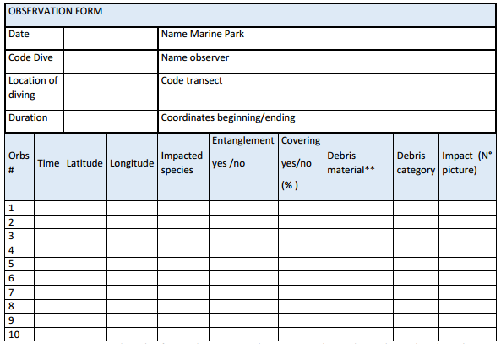
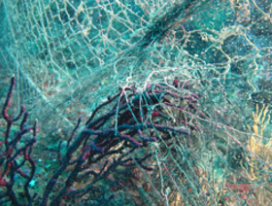
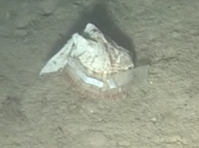
Monitoring entanglement by Marine Litter in MPAS
A basic protocol for the analysis of interactions between marine Litter and invertebrates

Slide 9
Many thanks for your attention

