Slide 1


H2020 Review and Monitoring (RM) workshop on Assessment
10th meeting of the Horizon 2020 Review and Monitoring (RM) Group
23-24 September 2019 in Athens, Greece
Guidance template
Sabah Nait , Environment Agency Austria,
This project is funded by the European Union

Slide 2

COUNTRY CONTRIBUTION
1- Overall national Key Messages
Based on expert knowledge / or country specific data analysis,
country representatives are kindly asked to prepare 9 slides on assessment.
Ministerial Meeting (tentatively early 2020):What message you want to convey to your Minister/decision makers?
key messages related to the assessment of H2020 thematic areas: countries are requested to draft a very short text, which gives understanding of positive or negative development in the sector /field (see example on slides ).

Slide 3
Country contribution
2- Thematic Analysis
should feature a trend (over a certain period of time) towards a target, highlight issues preventing for attaining the target.
For example why the trend of emissions is increasing, what does it lead to? And what are possible consequences (relevance with other sectors and in what way)? Reasons for attaining or not attaining the targets can be but are not limited to the following:
Poor interest on the subject – indicate high or low priority on political agenda
Can highlight main challenges related to the management of the h2020 sectors/thematic area (financial, organizational, institutional set up (roles and responsibilities), regulatory framework, knowledge-data availability for planning business model/ adequate infrastructure).

Slide 4
Country contribution
To help communicate the key messages countries are requested to use data tables or data plots and to give an overview of identified data gaps.

Slide 5
Country contribution
3-Process and progress
Data collection: Countries are requested to provide information on the state of play regarding data collection, difficulties encountered collecting data (availability, accessibility, institutional cooperation, etc..) how in your opinion can the situation be improved in the future? Which of the improvement is the easiest to activate, where should we invest to trigger the positive change?
Give an overview of identified data gaps.
Indicator assessment factsheet: what is the current status by indicator?
What processes are put in place to ensure regular assessment?

Slide 6
Thematic Analysis (example-waste)
Municipalities are responsible for waste management, collection, transport and disposal of waste but due to insufficient budget and the low priority on the political agenda waste management is approached only partially. The decision makers ignore lasting, efficient and higher costs solutions in favor of random dumping with negative impacts on scarce water resources. Current waste management practices are not adequate for managing different waste streams from growing population.
The only positive trend registered in the recent years is the increase in recycling rate (mainly plastic and paper) due to private investment.

Slide 7
Waste Management (examples)
Waste generation rates continue rising (from 60 Million tones in 2003 to 80 Million tones 2018), and dumps remain the only common disposal practice, thus constitute a source of groundwater contamination and importance loses of valuable raw material.
In the recent years, and due to the political situation (refugee influx) the proliferation of waste has led to more significant health and environmental impacts such as soil and groundwater pollution.
Significant progress has been made in increasing recycling rates. The percentage of municipal waste which is recycled and composted has risen from 3 per cent in 2014 to 10% in 2018

Slide 8
Waste water Example
To overcome water scarcity and increasing demand for fresh water, a national wastewater reuse plan was adopted setting a target of 60% by 2030, currently the reuse of treated water has reached 15% and is utilize for watering
green spaces.
Source: Morocco-SEIS baseline report
Source: Morocco-SEIS baseline report

Slide 9
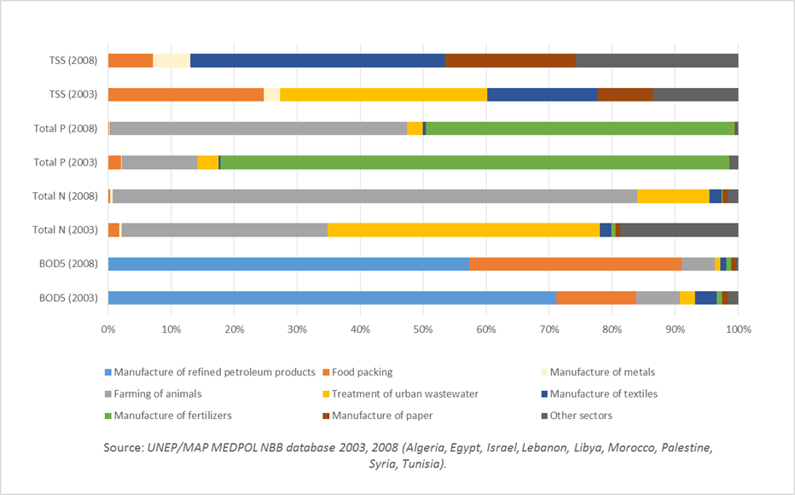
Industrial emissions (examples)
Emissions of nutrients and oxygen depleting substances (BOD5, Total N, Total P, TSS) in the ENP Southern countries have increased from 2003 to 2008 due to nutrients from the farming of animals; TSS from the manufacture of textiles and the manufacture of paper, and BOD5 from food packing.(source: UNEP/MAP MEDPOL NBB database 2003 and 2008 )

Slide 10
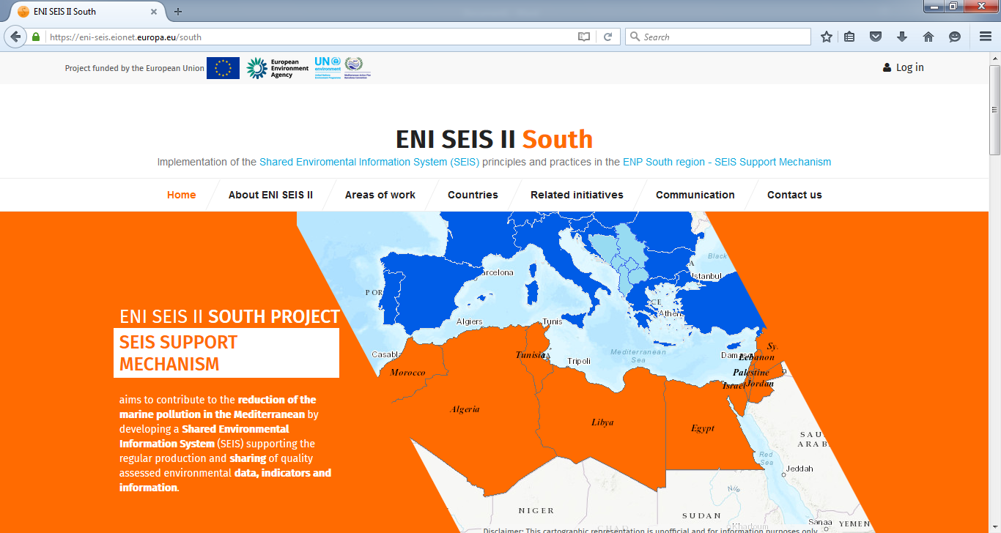
Thank you for your attention!
United Nations Environment Programme
Coordinating Unit for the Mediterranean Action Plan
Vassileos Konstantinou 48
Athens 11635, Greece
www.unepmap.org
European Environment Agency (EEA)
Kongens Nytorv 6
1050 Copenhagen K, Denmark
E-mail: ENI-SEIS2@eea.europa.eu http://www.eea.europa.eu/
http://eni-seis.eionet.europa.eu/south
This project is funded by the European Union

