Slide 1
The Italian PRTR
Rome, 7th February 2017
Andrea Gagna
ISPRA – Italian National Institute for Environmental Protection and Research
Italian National Institute for Environmental Protection and Research

Slide 2
What is a PRTR?
Pollutant Release and Transfer Register
It is a database, possibly in electronic format, including the information related to releases and transfers of pollutants and wastes originated by specific industrial activities. Releases and transfers to air, water, wastewater, land and waste are concerned. The data are directly linked to the sources located at country level or at the level of an economic region (e.g. the EU) and are updated every year.
PRTRs allows for public access to the information related to the environmental impacts of industry.

Slide 3
Legislation (EU, UNECE)
“IPPC” Directive (96/61/EC)
UNECE Aarhus Convention (Aarhus, 1998)
Protocol on PRTRs (Kiev, 2003)
“EPER” Decision (2000/479/EC)
EPER Register
(emissions to air; water)
Official implementation at EU level
“EPRTR” Regulation (CE n.166/2006)
European PRTR Register
(air, water, land, wastewater, waste)

Slide 4
Objectives at EU
EPRTR Register
Data collection, based on an integrated approach, at EU level available for the public and related to industry’s impacts on air, water, land, wastewater and wastes. Updated every year.
Implementation at EU level of the UNECE Protocol on PRTRs
Public access to environmental information concerning industrial facilities in the EU ( > 30.000 facilities, 27 EU MS+Norway, Iceland, Serbia, Liechtenstein, Switzerland)
To survey the largest contributions to the industrial pollution

Slide 5
Legislation (Italy)
Reporting years 2002-2006
“INES” (Italian EPER) legislation: replaced by PRTR legislation.
INES Register about 700 reporting facilities
Reporting years 2007 up to now
Italian PRTR legislation:
Regulation EC n.166/2006
DPR n.157/2011
Dlgs 46/2014 (art. 30)
PRTR Register, about 4000 reporting facilities

Slide 6
Use of PRTR data in Italy?
Indicators to schedule inspection at industrial facilities
Reporting to EU (EC/EEA)
National air emissions inventory
Technical reports
Point of orders (the houses of the Italian Parliament)
Italian PRTR Register
It is the unique database currently available including pollutant/waste emissions/transfers from industrial facilities, yearly updated.
… other
Answers to questions raised by the Public
Environmental Data Yearbook
Barcelona Convention
(MED POL; LBS Protocol; NBB …)
Marine Strategy Framework Directive

Slide 7
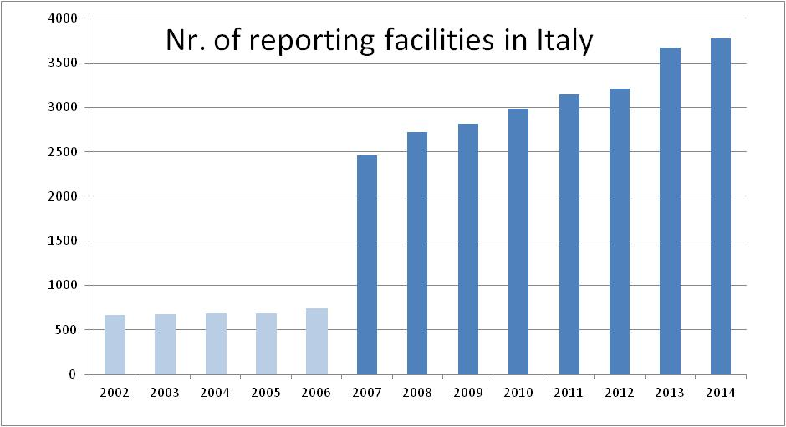
Reporting facilities in Italy: trend
“INES” reporting years
Moving from EPER to EPRTR
Cooperation with industrial associations: intensive animal farming sector
Entry into force of the penalty system for PRTR reporting obligation
Cooperation with industrial associations: awareness raising

Slide 8
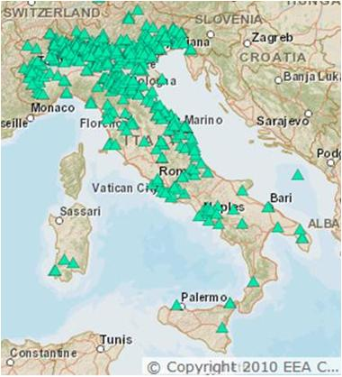
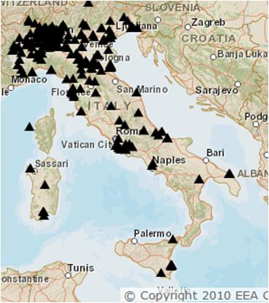
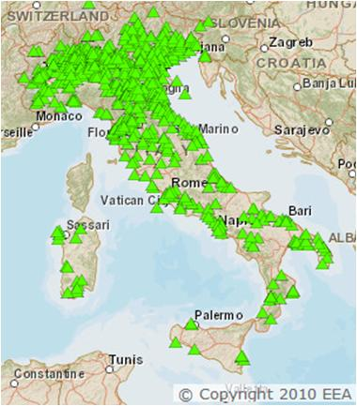
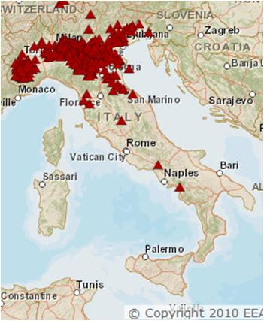
PRTR reporting facilities
Energy sector
Mineral products
Metal Industry
Chemical Industry
Waste&Wastewater
Intensive livestock production

Slide 9
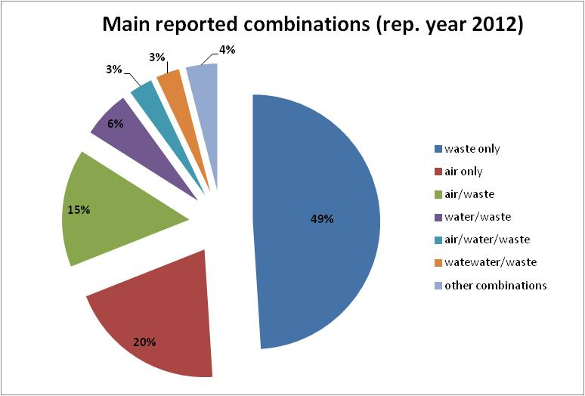
What is included in PRTR reports?

Slide 10
PRTR reporting criteria, DB size
65 activities, grouped into 9 sectors
91 substances
Reporting criteria:
Exceedance of both:
Capacity/Treatment thresholds
Total releases and total transfers thresholds
Database size (main tables, 7 reporting years, 2007-2014):
Waste records= 39,161
Total releases records= 30,159
Activity records= 25,316
Facility reports records= 22,670
As for 2015 a separate DB is under construction due to the different way of collection for 2016 data flow /reporting year 2015)

Slide 11
The role of ISPRA
Provides technical support to IMELS in making the national legislation and designing the national register
Provides technical support to IMELS in attending the EPER/EPRTR working group of experts at EU level and the UNECE Protocol on PRTRs WG
Manages yearly the PRTR data collection at national level
Summarizes the information related to quality assessment activities by local competent authorities (Regions and Provinces)
Provides technical support to assess the quality of the reports under the IMELS scope
Carries out an overall assessment of the quality of the whole national dataset
Checks for completeness of the reporting facilities
Submit on behalf of the IMELS the national dataset to the EC/EEA
Is expected, with the IMELS, to grant the public with access to the national dataset

Slide 12
How does ISPRA carry out its role?
Web based reporting procedure available at:
http://www.eprtr.it
Data entry: the reporting facilities can access to a restricted area where the reporting procedure is available together with records of all the previous reports. Data entry actions are tracked. Electronic signature is needed to submit officially the facility reports (only “.p7m files” are accepted by the system)
Quality assessment of the data: competent authorities (IMELS, Regions/Provinces) and ISPRA can access a restricted area where facility reports can be searched, displayed and then approved or rejected.
Summary of quality assessment actions: competent authorities can fill in the quality assessment report. Submitted reports can be downloaded by ISPRA in order to make the summary report.

Slide 13
Working plan–routine activities
February–31st March: making of the national dataset export which has to be uploaded on the Central Data Repository in order to submit the dataset to EC/EEA
April: this month is devoted to the collection of the new facility reports, which are expected to be submitted within 30th April.
May- 30th september: time devoted to quality assessment. Facility operators and competent authorities are expected to work on facility reports in order to improve their quality if necessary.
30th september: competent authorities submit a quality assessment report, ISPRA summarizes the submitted reports
31st january: ISPRA delivers an updated version of the national PRTR DB to the IMELS.
Current maintanence of the reporting website
Technical support to the users of the reporting website: helpdesk by phone and emails.

Slide 14
Non-routine activities
Providing access to the reporting procedure after the deadline set by the legislation: the aim is to retrieve missing reports from operators under the scope of the national PRTR
Improvements and update of the reporting procedure according to the results of the previous excercises
Update of the reporting procedure according to changes in the european and national legislation
Any extraordinary further needs of maintanence or development

Slide 15
PRTRs around the Mediterranean
Turkey had pilot projects concerning the establishment of a PRTR
Israel has a PRTR in place and is Party to the UN-ECE Protocol on PRTRs
Egypt had a pilot project on PRTRs (Alexandria region)

Slide 16
More info about PRTR
The European PRTR is online at the following URL: http://prtr.ec.europa.eu/#/home
Info about UN-ECE Protocol on PRTRs can be retrieved at: https://www.unece.org/env/pp/prtr.html
Update of the reporting procedure according to changes in the european and national legislation
Any extraordinary further needs of maintanence or development
- Thanks for your attention! -

