Slide 1
Implementation of the Shared Environmental Information System (SEIS) principles and practices in the ENP South region
ENI SEIS South Support Mechanism (2016-2019)
WP4 Data and Infrastructure
INFO RAC, ISPRA
6-7-8 February 2017, Rome
Michael Assouline,
Project Officer – European neighbourhood policy activities
European Environment Agency (EEA)
This project is funded by the European Union

Slide 2
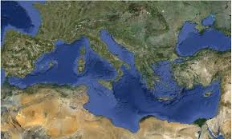
Union for the Mediterranean (UfM) – Horizon 2020 Initiative for a cleaner Mediterranean (Geopolitic context)
Main commitments related to the second phase of Horizon 2020 Initiative (2015-2020)
Broadening the scope: more focus on pollution prevention and attention to emerging issues including hazardous waste and marine litter
Increased synergies with the UNEP/MAP-Barcelona Convention (IMAP, Regional Plans, SCP Action Plan, MSSD, NAP update including hotspots and project prioritisation, MoU, mainstreaming of focal points as appropriate)
Commitment to apply SEIS principles in line with UNEP/MAP-EcAp Decisions and other regional initiatives
Commitment to initiate reforms at national level to create an attractive investment environment
Commitment regarding implementation and enforcement of legislation

Slide 3
Union for the Mediterranean (UfM) – Horizon 2020 Initiative for a cleaner Mediterranean (Geopolitic context)
Review and Monitoring: Work plan H2020 (2015-2020) validated by the Steering Committee Athens Ministerial 2014
Objective 1. To enhance optimal national information systems allowing for systemic production of indicator-based reporting and sharing of data
Action 2. Maintain and improve efficiency of existing data flows (incl. PRTR), and support creation of relevant new data flows and QA/QC procedures based on expanded H2020 issues (Ecosystem approach)
3. Foster the development and management of IT systems (infrastructure for data, automation, reporting tools reportnet/InfoMAP)
4. Expand indicator management and data services (national and regional)
Objective 2. To expand the existing H2020 priorities with a particular focus on water, solid waste and industrial emissions, identify and address additional priority areas

Slide 4
Strong links with UNEP/MAP Barcelona Convention activities
Horizon 2020 Mediterranean report Toward shared environmental information systems EEA-UNEP/MAP joint report, EEA Technical report No 6/2014
EEA-UNEP/MAP Joint Work Plan for the period 2016-2021
Contribution agreement SEIS-South Support Mechanism (2016-2019)

Slide 5
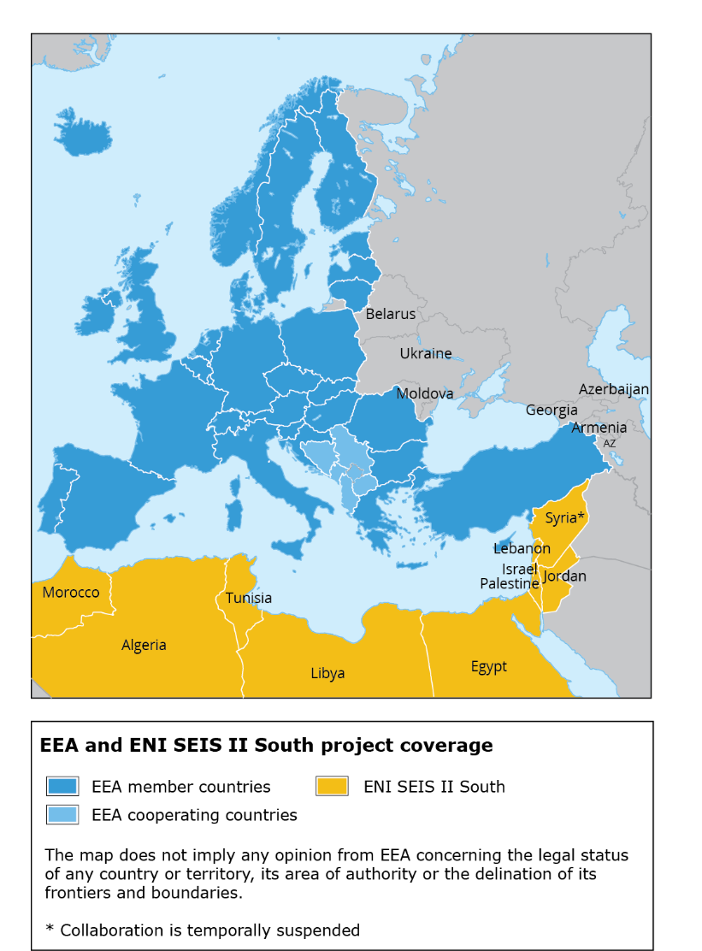
The ENI SEIS South Support Mechanism (2016-2019)
Regional project – supporting a long-term engagement to EU policies and external policy framework aligning to the Union for the Mediterranean and Barcelona Convention efforts on reducing marine pollution
EEA and UNEP/MAP – co-chairs of the Review and Monitoring group of the H2020 Initiative for a cleaner Mediterranean
Building on recent projects: ENPI-SEIS (2010-15) and InSEIS (2014-15) – good basis for further activities in close partnership with UNEP/MAP
Algeria – Egypt – Israel – Jordan – Lebanon – Libya – Morocco – Palestine – Tunisia

Slide 6
Key project elements
Objective: To improve the availability and access to environmental information to the benefit of effective and knowledge-based policy-making.
Expected results:
The H2020 indicator set is refined and complemented to serve multiple purposes.
The in-country processes for organising sharing of data sets underlying the H2020 indicators are stabilised.
Indicator-based H2020 report and assessments are produced in line with EEA/Eionet practices.
The infrastructure for reporting offered by the EEA and UNEP/MAP is more widely used.
Duration:
48 months
(01 February 2016 –
31 January 2020)
Budget:
€4.2 M
EEA-UNEP/MAP project team:
3 fte project-funded
3 fte EEA core
Resources:
EEA-UNEP/MAP experts
Framework contractors
Eionet partners

Slide 7
Conceptual framework for the SEIS Support Mechanism - South
WP1 –
In country support (design)
WP2 –
Indicators and Assessments
WP3 –
Data and Statistics
WP4 – Infrastructure and data management
WP5 - Communication & visibility
Cluster 1 WATER
Cluster 2 WASTE
Cluster 3 INDUSTRIAL EMISSIONS (incl. PRTR)
Cluster 4 CROSS-CUTTING ISSUES
WP1 – In country support (implementation)
WP6 – Management and coordination

Slide 8
Work package 4: data and infrastructure (agreed activities)
Identification of the state of national databases and infrastructure for SDI and data management;
Revision and adjustments to the regional data infrastructure to include new data reporting (e.g. NBB database to include reporting of small and medium size industries);
Development of data policy documents at country level, in support of common regional standards;
SDI initiated and developed at country level (e.g. including data agreements with key national institutions and training on data management and reporting, inclusion of citizen science/community based monitoring etc.);
Extension of the MEDPOL info system to include marine litter H2020 indicators as appropriate in synergy with IMAP info system. Develop marine litter as a pilot, integrating with EcAp/MED II project.
Provision of training of national experts on relevant IT aspects to build a common infrastructure and regional standards.

Slide 9
Work package 4: data and infrastructure (foreseen outputs)
Catalogue with metadata of information sources in the partner countries established and linked with InfoMAP.
Data Dictionaries finalised for the new and agreed indicators.
User requirements further developed with data assessment functions.
Development of Guidelines on using the common IT infrastructure, including SDI and PRTR/NBB info system.
Maximum 50 experts trained on the use of common IT infrastructure, including SDI and PRTR/NBB info system.
Up-to-date PRTR guidelines developed in line with E-PRTR.
Provision of Helpdesk service in the setting up of SEIS IT component.

Slide 10
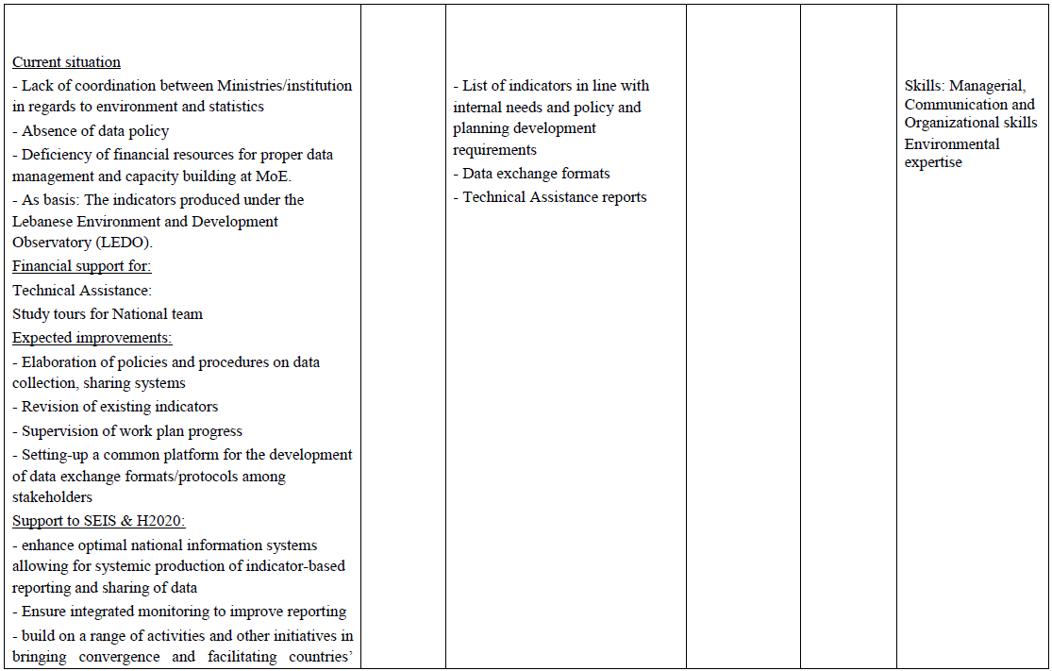
Work package 1: in country support (1)
National Work Plans Infrastructure requests (Ex: Lebanon)

Slide 11
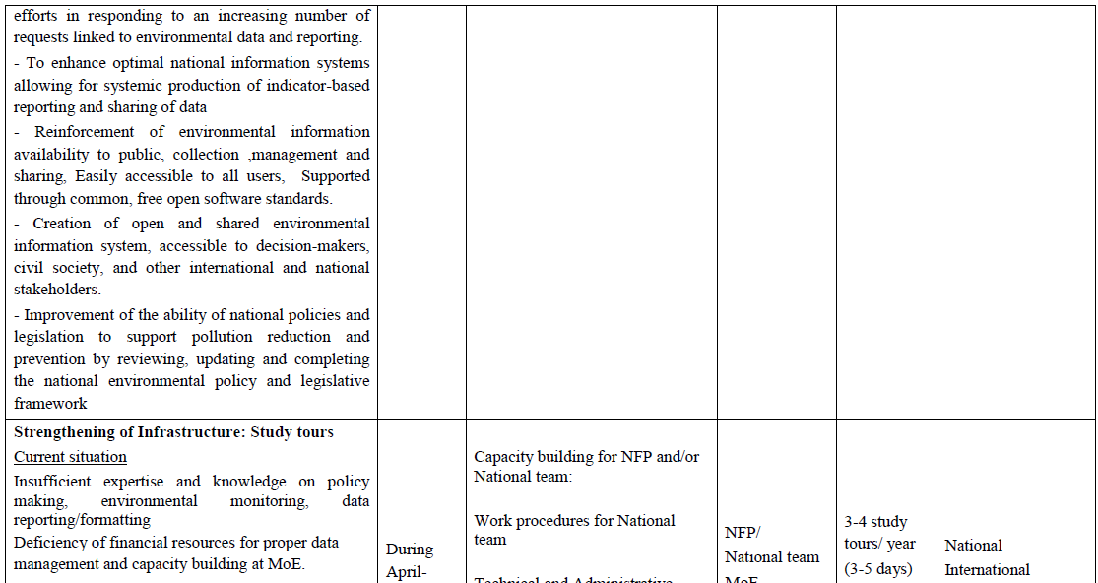
Work package 1: in country support (2)
National Work Plans Infrastructure requests (Ex: Lebanon)

Slide 12
Work package 2: indicators and assessments
Indicator as entry point for designing the data model (system indicator based)
Architecture of the system in line with the ecosystem approach (integration of all RACS’ datasets)
Mapping indicators (6 H2020 indicators, IMAP, MSFD)
Taking as source of inspiration the work under development concerning the Reporting on the 2018 update of articles 8, 9 & 10 for the Marine Strategy Framework Directive
Using schema for indicators (MEDPOL)

Slide 13
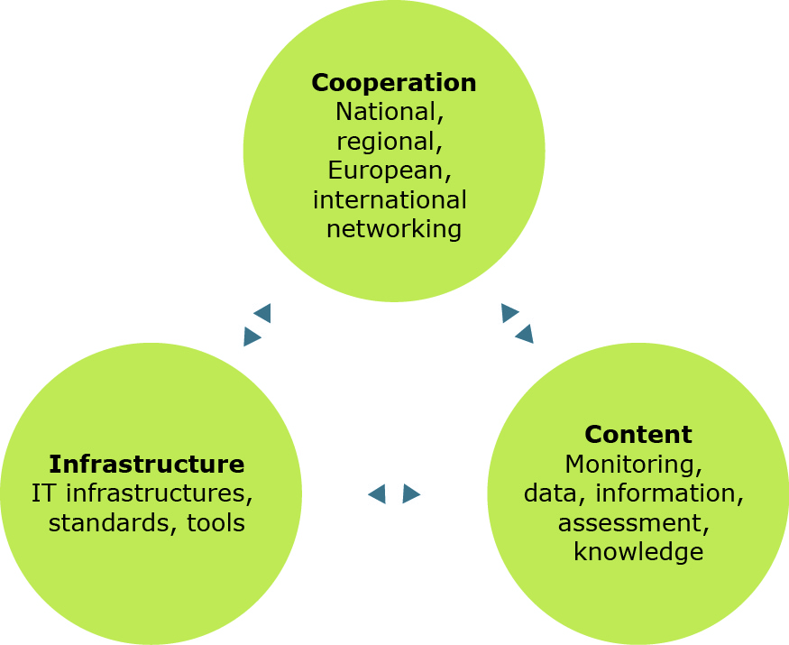
Building the knowledge base on SEIS pillars
EEA/ETC and Eionet network
UNEP/MAP and constituencies

Slide 14
Implementing SEIS through INFO MAP
Decision IG 17/6: Implementation of the ecosystem approach to the management of human activities that may affect the Mediterranean marine and coastal environment
Apply the ecosystem approach to the management of human activities
Roadmap for the implementation of the ecosystem approach (vision and goals, ecological objectives, operational objectives and respective indicators, GES descriptors and targets, monitoring programmes, management measures to achieve GES.
Decision IG.20/4 Implementing MAP ecosystem approach roadmap: Mediterranean Ecological and Operational Objectives, Indicators and Timetable for implementing the ecosystem approach roadmap
Validation of 11 ecological objectives, operational objectives and indicators
IMAP
Decision IG.21/3 on the Ecosystems Approach including adopting definitions of Good Environmental Status (GES) and targets
Definition of good environmental status and targets
Decision IG.22/7 Integrated Monitoring and Assessment Programme of the Mediterranean Sea and Coast and Related Assessment Criteria
List of GES common indicators and targets and principles of IMAP

Slide 15
The project timeframe
H2020 Initiative for a cleaner Mediterranean
UNEP/MAP Barcelona Convention
Athens Declaration (May 2014)
Ecosystem approach, SEIS principles
H2020 programme of work 2015-2020
H2020 Indicators and assessment
NAP implementation
IMAP – set of common indicators
MSSD
SDGs
2nd H2020 indicator-based assessment
UNEP/MAP SoED
2020/2021
Next reporting cycle
EU
Euro-MED
Global
REGIONAL
Quality Status Report
IMAP InfoSystem
Indicator management, data service
2017
2018
2019
NATIONAL
Anchoring the work in
national setting
National Team (mandate, objectives)
National pilot/case
National support
Links to other initiatives
H2020 Indicators
Assessment framework
Results available
Sharing of experiences among countries
National achievements in regional setting
Data quality
H2020 Country Profiles
Endorsement of results
“Evidence-based policy making”
Country-level assessments
Contribution to the 2nd H2020 report
Reporting/availability of indicators
Policy briefs
Inception phase
Establishment of national work plans
Governance structure/ NFPs

Slide 16
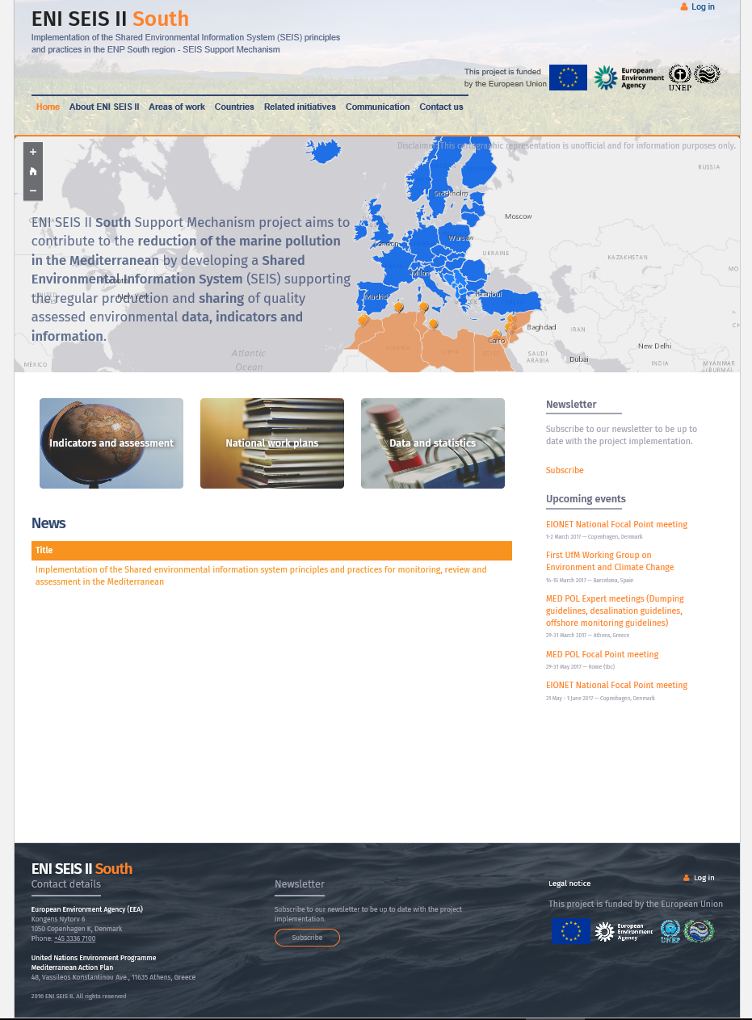
The ENI SEIS South Support Mechanism website
Link: http://eni-seis.eionet.europa.eu/south
Data visualisation capabilities maps and dashboards (Arcgis API, Tableau)
Country’s pages as entry point for data visualization which will require access to the services
Publication of the final assessment (2019) using geo and web technologies in addition to paper based.

Slide 17
Objectives of the 3 days meeting
For each item in the agenda, evaluate the current situation (problems and limits), list a series of points to be addressed, identify working methods (including resources, roles in the team, sharing platform documents) and start working on certain points.
First exercise is to explore INFO MAP infrastructure in view of delineating win-win solution (H2020 data flows) starting from the Medpol database hosted at INFO RAC.
Prepare a Meta data model, business plan, mind map, list of questions to be addressed to UNEP MAP
Audit MedPol Information System to be run against this Meta data model and the corresponding system architecture
Explore other reporting tools related to the Barcelona Convention
Implementation of work plan: supporting INFO RAC activities in order to have INFO MAP working to be developed all along the 3 days visit and more specifically regarding the infrastructure component (WP4) of SEIS II project in line with the other work packages (last day)
Links with the ENI SEIS II website (in a view of implementing data visualization tools)

